Slide 1
Chapter 12 – Income Management
Mr. Singh
BBI2O

Slide 2
Recap of Yesterday
What is budgeting?
What did the “happiness points” signify
How did you decided what to spend on and what to sacrifice?

Slide 3
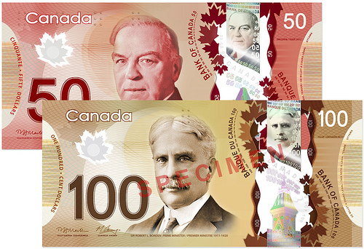
What Is Money?
A means to buy products and services that meet needs and wants.
Legal Tender
Coins and paper money issued by the government of Canada – no true value – has a standard value
Accepted as payment for goods and services.
Canada’s culture, the queen and prime ministers
Notes:
FORMS OF LEGAL TENDER
Cheques and credit cards are not legal tender.
The Royal Canadian Mint manufactures coins such as the $1 and $2 that replaced the less durable paper notes.
Bank notes are issued by the federal government, Canada’s central bank.
English and French versions of notes were first issued in 1935.
The Bank of Canada uses two privately owned, high-security, printing companies.

Slide 4
What is Money Cont’d
Cheques and credit cards are not legal tender.
The Royal Canadian Mint manufactures coins such as the $1 and $2 that replaced the less durable paper notes.
The Bank of Canada issues paper money, aka bank notes
English and French versions of notes were first issued in 1935.
The Bank of Canada uses two privately owned, high-security, printing companies.

Slide 5
$100 Canadian Bank Note

Slide 6
Special Features of Bank Notes
Canada’s new bank notes have a state-of-the-art security features to discourage high-tech counterfeiting
unique textures help visually impaired
Credit cards, traveler's cheques, passports, etc. are subject to counterfeiting
Notes:
FORMS OF LEGAL TENDER
Special Features of Bank Notes
See Figure 12.1, “Security Features on This $5 Bill”, on page 366.
Counterfeiting is the production of fake money.
MONEY’S CHANGING PURCHASING POWER
Inflation causes our money to be worth less as prices for goods and services goes up.
Calculated monthly, the Consumer Price Index (CPI) is a figure that represents purchasing power.
CPI calculates the cost of 600 products, including food, shelter, transportation, clothing, and recreation.

Slide 7
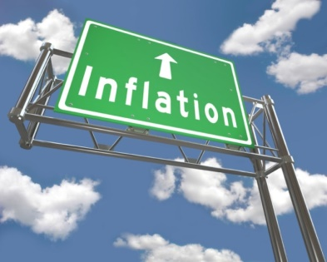
Money’s Changing Purchasing Power
Money’s true value is its purchasing power. It’s worth something because we accept it has a specific value
Inflation
In general, prices tend to rise, so the dollar buys less from one year to another.
causes our money to be worth less as prices for goods and services goes up.
Consumers’ money buys them less every year
http://www.bankofcanada.ca/rates/related/inflation-calculator/
Notes:
FORMS OF LEGAL TENDER
Special Features of Bank Notes
See Figure 12.1, “Security Features on This $5 Bill”, on page 366.
Counterfeiting is the production of fake money.
MONEY’S CHANGING PURCHASING POWER
Inflation causes our money to be worth less as prices for goods and services goes up.
Calculated monthly, the Consumer Price Index (CPI) is a figure that represents purchasing power.
CPI calculates the cost of 600 products, including food, shelter, transportation, clothing, and recreation.

Slide 8
Income
Money that an individual or business receives from:
Salary
Wages
Commission
Piecework
Profit sharing
Notes:
Some people earn just enough to pay for needs or necessities such as food, rent, and clothing.
Individuals with higher incomes usually spend more on wants and non-essential items such as vacations and electronics.

Slide 9
Consumer Price Index (CPI)
Purchasing power is measured by the CPI
It measures 600 products typically bought by Canadian households
This includes food, shelter, transportation, clothing, and recreation

Slide 10
Types of Income
Gross Income
the total amount of money received by a person before any deductions.
Disposable Income (Take-Home-Pay)
the amount of income that is left after deductions of income tax, Canada Pension Plan (CPP), and Employment Insurance (EI).
Notes:
TYPES OF PERSONAL INCOME
Gross Income
See Figure 12.2, “Nadira’s Annual Gross Income”, on page 368.
Disposable Income
The amount an individual pays in income tax varies depending on things such as union dues, charitable contributions, pension deductions, dependents, etc.
Taxes are paid to Canada Revenue Agency (federal) and to the province the person lives in.
See Figure 12.3, “Nadira’s Disposable Income” on page 369.
Discretionary Income
See Figure 12.4, “Nadira’s Monthly Necessity Expenses and Discretionary Income”, on page 370.

Slide 11
Types of Income
Discretionary Income
the amount of money that is left over after all necessities (rent, food etc.) have been paid.
Notes:
TYPES OF PERSONAL INCOME
Gross Income
See Figure 12.2, “Nadira’s Annual Gross Income”, on page 368.
Disposable Income
The amount an individual pays in income tax varies depending on things such as union dues, charitable contributions, pension deductions, dependents, etc.
Taxes are paid to Canada Revenue Agency (federal) and to the province the person lives in.
See Figure 12.3, “Nadira’s Disposable Income” on page 369.
Discretionary Income
See Figure 12.4, “Nadira’s Monthly Necessity Expenses and Discretionary Income”, on page 370.

Slide 12
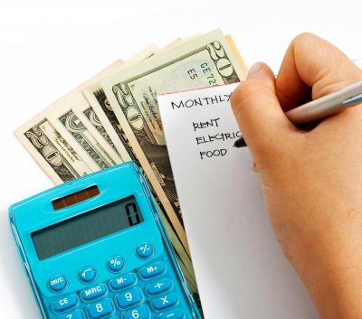
Money Management – Personal Use
Daily financial activities aimed at satisfying a person’s needs and wants within a limited income.
Individuals need to carefully plan, save, and spend their money.
Notes:
WHY WE BUY
Money management education is very important and people often learn it by observing how adults close to them earn and spend.
It is important to know how much you have to spend, where you spend it, and financial goals.
Income and Price
Family obligations, such as children, and disposable income greatly influence what we buy.
Low-income families spend a greater percentage of income on necessities.
High-income families have more to spend on wants.
Price is the most important consideration for consumers.
Some consumers believe that a higher price always means better quality or design.
Status
Some people feel that having a certain product makes them better or more noticed than others.
Conspicuous consumption is the purchase of products or services with the primary purpose of impressing others.
Current Trends
Clothing trends, for some people, are the foundation of their image.
Clothing is often seen as an indication of status, popularity, or group identity.
Peer pressure, a strong influence on people in their social group, can cause individuals to buy products they do not want or need.
Customs and Habits
Customs related to family, religion, and community influence consumer choices.
Habits are behaviours formed over time and done repetitively such as buying a magazine monthly.
Promotion
Advertising and promotion influence consumer spending creating desire for products and services.
Lifestyle advertising incorporated attractive, successful, and appealing people thereby implying that using the product or service will improve ones life.

Slide 13
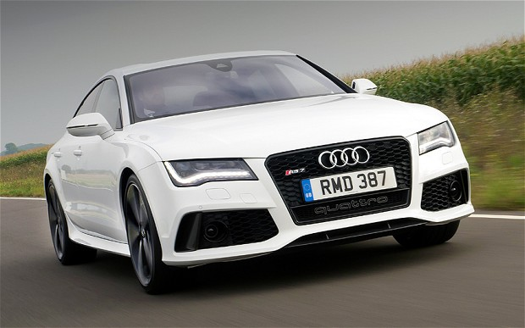
Why We Buy
Money management education is very important and people often learn it by observing how adults close to them earn and spend.
It is important to know how much you have to spend, where you spend it, and financial goals.
Five key factors that influence consumer buying decisions include
income and price
status
current trends
custom and habits
promotion
Notes:
WHY WE BUY
Money management education is very important and people often learn it by observing how adults close to them earn and spend.
It is important to know how much you have to spend, where you spend it, and financial goals.
Income and Price
Family obligations, such as children, and disposable income greatly influence what we buy.
Low-income families spend a greater percentage of income on necessities.
High-income families have more to spend on wants.
Price is the most important consideration for consumers.
Some consumers believe that a higher price always means better quality or design.
Status
Some people feel that having a certain product makes them better or more noticed than others.
Conspicuous consumption is the purchase of products or services with the primary purpose of impressing others.
Current Trends
Clothing trends, for some people, are the foundation of their image.
Clothing is often seen as an indication of status, popularity, or group identity.
Peer pressure, a strong influence on people in their social group, can cause individuals to buy products they do not want or need.
Customs and Habits
Customs related to family, religion, and community influence consumer choices.
Habits are behaviours formed over time and done repetitively such as buying a magazine monthly.
Promotion
Advertising and promotion influence consumer spending creating desire for products and services.
Lifestyle advertising incorporated attractive, successful, and appealing people thereby implying that using the product or service will improve ones life.

Slide 14
1. Income and Price
Family obligations, such as children, and disposable income greatly influence what we buy.
Low-income families spend a greater percentage of income on necessities (food, clothing & shelter).
High-income families have more to spend on wants (invest, travel, spend more on entertainment and recreation).
Price is the most important consideration for consumers.
Some consumers believe that a higher price always means better quality or design.

Slide 15
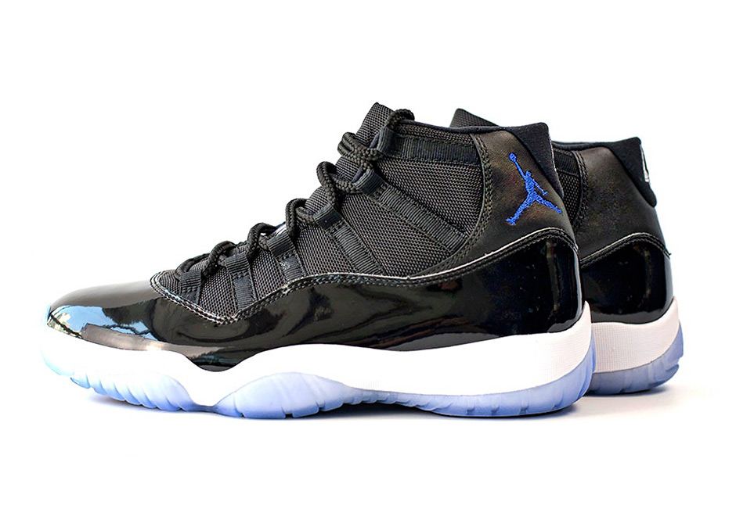
2. Status
Some people feel that having a certain product makes them better or more noticed than others.
Conspicuous consumption is the purchase of products or services with the primary purpose of impressing others.

Slide 16
3. Current Trends
Clothing trends, for some people, are the foundation of their image.
Clothing is often seen as an indication of status, popularity, or group identity.
Peer pressure, a strong influence on people in their social group, can cause individuals to buy products they do not want or need

Slide 17
4. Custom and Habits
Customs related to family, religion, and community influence consumer choices.
Habits are behaviours formed over time and done repetitively such as buying a magazine monthly.

Slide 18
5. Promotion
Advertising and promotion influence consumer spending creating desire for products and services.
Lifestyle advertising incorporated attractive, successful, and appealing people thereby implying that using the product or service will improve ones life.

Slide 19
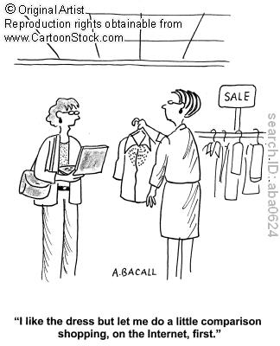
Consumer-Driven Economy
Economy offers consumers a never ending supply of exciting and innovative goods and services.
Before you buy anything you must compare the price, quality and features of a product
Notes:
COMPARISON SHOPPING
See Figure 12.5, “The Wise Shopper” On page 375.
Comparing Price and Quality
Selecting a product that has higher quality, usually at a higher price, may result in a savings since it may be more durable and last longer.
Features
Weather it is the gears on a bike, the safety aspects of a new car, or cell phone features all of these characteristics influence purchases.

Slide 20
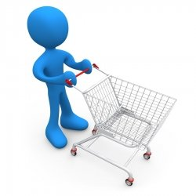
Comparison Shopping
Comparing price, quality, features, and services helps make smart purchases
Use catalogues, newspapers, calling stores, internet
Notes:
COMPARISON SHOPPING
See Figure 12.5, “The Wise Shopper” On page 375.
Comparing Price and Quality
Selecting a product that has higher quality, usually at a higher price, may result in a savings since it may be more durable and last longer.
Features
Weather it is the gears on a bike, the safety aspects of a new car, or cell phone features all of these characteristics influence purchases.

Slide 21
Comparing price and quality
This does not always mean paying the lower price
Sometimes we pay for the quality so the products lasts longer
If you pay for something that is really cheap, you may have to spend more money to fix it or replace it due to quality

Slide 22
Comparing features
Make sure you buy the product where the features suits your needs and wants
If you buy a bike and live in a hilly area, you will need one with many gears and good traction

Slide 23
Services
Does the product offer a good warranty?
Does the store deliver to your house?

Slide 24
When to buy?
Clearance Sales – At the end of the season the store usually reduces prices to clear inventory
Promotional Sales – Opening a new store, lower prices of existing products for newer ones
Second-hand shopping – Buying products that have been used before. Much cheaper and can find great deals

Slide 25
Avoid Impulse Buying
Don’t buy something right away.
Look for the best value and compare products
Impulse buying normally occurs at the front of the store and when you’re checking out.
Stores hope you will see it and want to buy on impulse

Slide 26
When to Buy
Clearance Sales
Promotional Sales
Second-Hand
Avoid Impulse Buying
Notes:
CLEARANCE SALES
Clothing stores usually have sales in January and June (July).
Traditionally Christmas items go on sale on Boxing Day.
Car dealerships lower prices in August and September to make room for new models.
Clearance sale selection is often limited making consumers decide it the lower price out-weights not getting exactly what they want.
PROMOTIONAL SALES
The hope is the consumer will like the product that they purchased on sale and buy it again.

Slide 27
Till Debt Do Us Part
Episode on Slice

