Slide 1
Ch. 13 – Banking Continued

Slide 2
Banks Explained Video
https://www.youtube.com/watch?v=fTTGALaRZoc

Slide 3
About Accounts
People open accounts at financial institutions to save money and, potentially, to make money or interest.
Interest rates vary and are dependent on the balance and they type of account.
Usually only a small amount of money is necessary to open a savings account.
An account in one person’s name gives them full control.
A joint account can be opened by two or more individuals.

Slide 4
Account Statements & Passbooks
Shows all deposits, withdrawals, transfers of money, service charges, and any interest earned on the account.
Account statements are mailed to clients on a monthly basis
Passbooks can be updated in the financial institution and at many automated banking machines.
Customers can access account information online by using their bank card number and their PIN code.

Slide 5
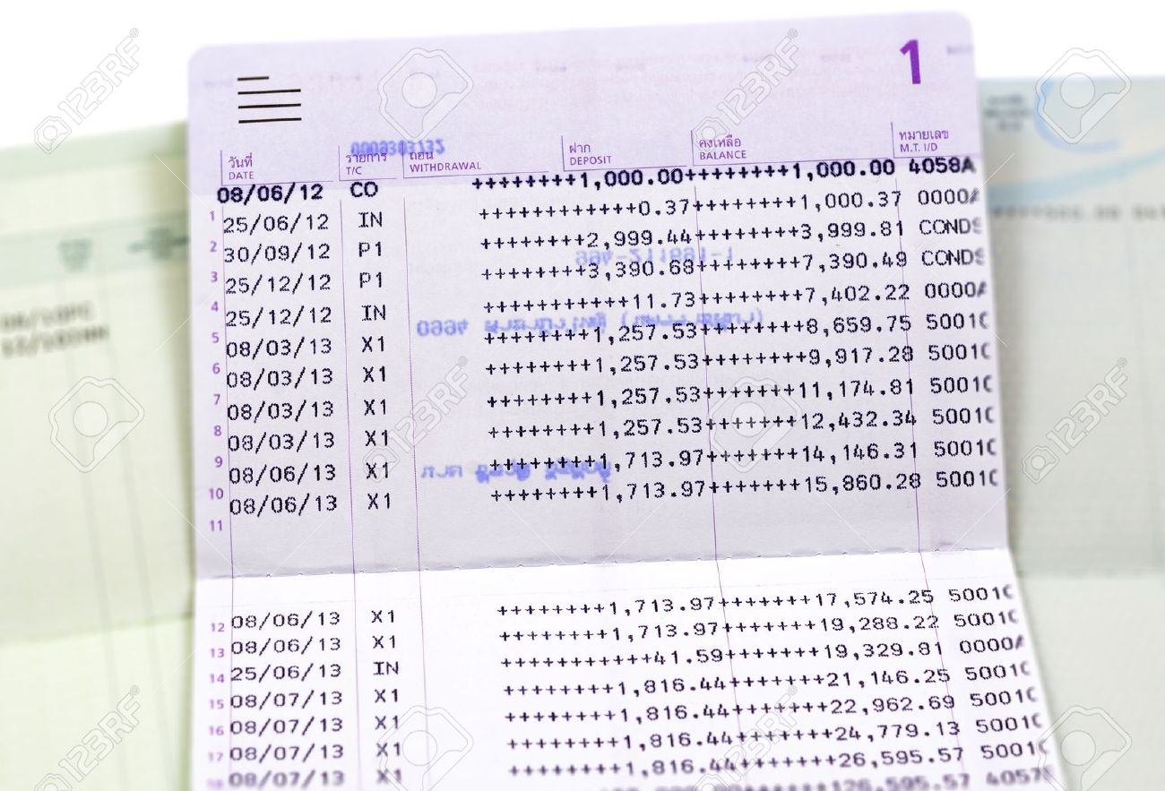
Passbook

Slide 6
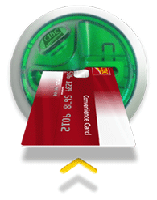
Opening and Accessing an Account
Personal information- full name and home address, date of birth, telephone number, and occupation.
Provide two current pieces of identification containing a signature and if possible a photograph. (driver’s licence, credit card, employer identity card, passport, and student card.
Fill out a signature card
Will receive a debit card
Notes:
People open accounts at financial institutions to save money and, potentially, to make money or interest.
Interest rates vary and are dependent on the balance and they type of account.
Usually only a small amount of money is necessary to open a savings account.
An account in one person’s name gives them full control.
A joint account can be opened by two or more individuals.
Withdrawals from joint account may require more that one person’s signature and is dependant on the way the account was set up.
OPEINING AND ACCESSING AN ACCOUNT
Personal information includes full name and home address, date of birth, telephone number, and occupation.
You will also have to provide two current pieces of identification containing a signature and if possible a photograph.
Acceptable identification includes a driver’s licence, credit card, employer identity card, passport, and student card.

Slide 7
Deposits & Withdrawal
In the financial institution the teller facilitates the deposit either electronically or by filling in a deposit slip and then gives the customer a receipt.
Automated banking machines (ABMs) are computer terminals that allow customers to withdraw, deposit, pay bills, check balances, and transfer money with a bank card (with a magnetic strip) and personal identification number (PIN) code.

Slide 8
Deposits & Withdrawal
ABMs work with an electronic network that validate the bank card and PIN.
The ABM, upon request, provides the user with a paper transaction record.
Transactions made before 3:00 p.m., on business days, are usually processed the same day and after or on weekends and holidays on the next business day.
See “Security Tips for Using ABMs” on page 408.

Slide 9
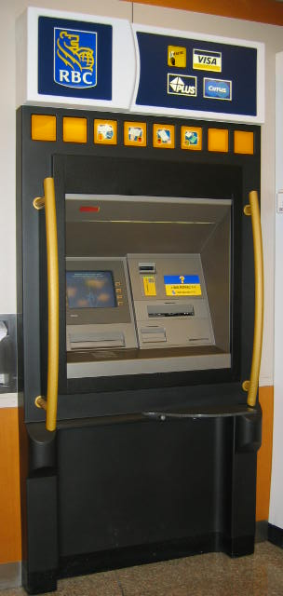
About Accounts
Deposit or Withdrawl
Can be made at the financial institution or at an automated banking machine (ABM).
Need Personal identification numbers (PIN)
Notes:
Account Statements and Passbooks
The statement and passbook shows all deposits, withdrawals, transfers of money, service charges, and any interest earned on the account.
Account statements are mailed to clients on a monthly basis.
Passbooks can be updated in the financial institution and at many automated banking machines.
Customers can access account information online by using their bank card number and their PIN code.
Making a Deposit
In the financial institution the teller facilitates the deposit either electronically or by filling in a deposit slip and then gives the customer a receipt.
Automated banking machines (ABMs) are computer terminals that allow customers to withdraw, deposit, pay bills, check balances, and transfer money with a bank card (with a magnetic strip) and personal identification number (PIN) code.
ABMs work with an electronic network that validate the bank card and PIN.
The ABM, upon request, provides the user with a paper transaction record.
Transactions made before 3:00 p.m., on business days, are usually processed the same day and after or on weekends and holidays on the next business day.
See “Security Tips for Using ABMs” on page 408.

Slide 10
Types of Accounts
Transaction Accounts (chequing account) – for everyday needs -
Transaction Register – your record of all transactions
Savings account – collect some interest
Combination – Transaction + Savings
Depending on plan may have service fee
Cancelled Cheque – is a cheque that has been cashed and paid by the financial institution

Slide 11
Types of Accounts Cont’d
Current Account – For businesses only
Must be registered with the provincial or federal government and the account must be in the business’s name
Normally there is no interest earned on these accounts and the business usually pays a service fee for each deposit, withdrawal and cheque

Slide 12
Reconciliation
Transaction register (your record) and the monthly bank statement (printed by bank) are compared to ensure they agree.
Important to do each month so you know current balance
Notes:
Steps in a ReconciliationStep 3: List any deposits in the transaction register and not on the account statement.
Step 1: Check off transactions that appear on the account statement and the transaction register.
Step 2: List any cheques and withdrawals that are in you register but are not on the bank statement.
This list represents withdrawals that occurred after the bank statement cut-off date and cheques that have not cleared through the account.
Cheques that have not been cashed or deducted from the account balance are called outstanding cheques.
Step 3: Deposits listed should be those made since the statement was prepared.
Add this total to the closing balance of your account statement.
Step 4: Subtract the total in Step 2 from the total in Step 3.
Step 5: Example of entries not yet in the transaction register are interest, service charges, debit card purchases, and ABM transactions.
Calculate a new register balance.
The balance at the end of Step 4 should match the balance at the end of Step 5.
If they do not agree recheck your work for errors and if none made contact your financial institution.

Slide 13
Reconciliation
What if your balance on your transaction register (your record) does not match up with your account balance (monthly bank statement)?
We need to make the 2 balance which is called reconciliation
Important to do each month so you know current balance

Slide 14
Steps to Reconcile
Step 1: Check off transactions that appear on the account statement and the transaction register.
Step 2: List any cheques and withdrawals that are in you register but are not on the bank statement.
This list represents withdrawals that occurred after the bank statement cut-off date and cheques that have not cleared through the account.

Slide 15
Steps to Reconcile
Cheques that have not been cashed or deducted from the account balance are called outstanding cheques.
Step 3: Deposits listed should be those made since the statement was prepared.
Add this total to the closing balance of your account statement.

Slide 16
Steps to Reconcile
Step 4: Subtract the total in Step 2 from the total in Step 3.
Step 5: Example of entries not yet in the transaction register are interest, service charges, debit card purchases, and ABM transactions.
Calculate a new register balance.
The balance at the end of Step 4 should match the balance at the end of Step 5.
If they do not agree recheck your work for errors and if none made contact your financial institution.

Slide 17
Writing Cheques
Most written from a chequebook, but can be writing on anything (special fee to process)
Financial institutions have
Cheque Essentials
date, payee, drawee (bank), drawer, amount, and account number.
Notes:
CHEQUE ESSENTIALS
See “Essential of a Cheque” on page 413.
Date: All cheques need a day of month, month, and year.
Staledated cheques, are dated more than six months prior to the day they are presented at the financial institution are not usually accepted.
Postdated cheques, a cheques with a date on it that is later that the actual date, will not be accepted at a financial institution until cheque’s date.
Payee: The payee is the name of the person or business to whom the cheque is written.
Drawee: The drawee is the financial institution that will honour the cheque.
Drawer: The drawer is the person or business from whose chequing account the money will be taken.
The drawer must sign the cheque on the line in the bottom right corner and the signature should be the dame as the drawer’s signature card.
Amount: The amount of the cheque must appear in both numbers and in words and they must agree.
Numbers should be written close to the dollar sign and the words as far left as possible (followed by a line to fill in the blank space).
The number of cents should be written above the /100 and no cents should be indicated with xx or 00.
Account Number: The account number, that indicated from which account the money is to be drawn, is printed (or can be written) at the bottom of the cheque.
STOPPING PAYMENT
A stop payment is an order requesting a financial institution not to pay a particular cheque.
See “Tips for Writing Cheques”, on page 415.

Slide 18
Writing Cheques
Security Features
inks that change colour when rubbed, watermarks, and special fibres.
Stop Payment Request
can be made if you do not want a cheque to be cashed, or if it is lost or stolen.
Notes:
CHEQUE ESSENTIALS
See “Essential of a Cheque” on page 413.
Date: All cheques need a day of month, month, and year.
Staledated cheques, are dated more than six months prior to the day they are presented at the financial institution are not usually accepted.
Postdated cheques, a cheques with a date on it that is later that the actual date, will not be accepted at a financial institution until cheque’s date.
Payee: The payee is the name of the person or business to whom the cheque is written.
Drawee: The drawee is the financial institution that will honour the cheque.
Drawer: The drawer is the person or business from whose chequing account the money will be taken.
The drawer must sign the cheque on the line in the bottom right corner and the signature should be the dame as the drawer’s signature card.
Amount: The amount of the cheque must appear in both numbers and in words and they must agree.
Numbers should be written close to the dollar sign and the words as far left as possible (followed by a line to fill in the blank space).
The number of cents should be written above the /100 and no cents should be indicated with xx or 00.
Account Number: The account number, that indicated from which account the money is to be drawn, is printed (or can be written) at the bottom of the cheque.
STOPPING PAYMENT
A stop payment is an order requesting a financial institution not to pay a particular cheque.
See “Tips for Writing Cheques”, on page 415.

Slide 19
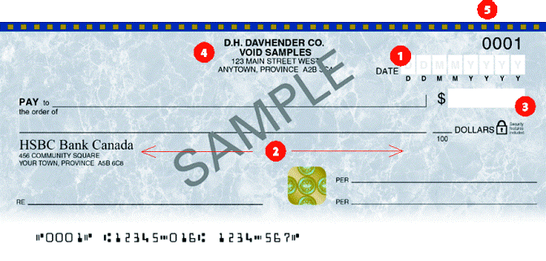
Chapter 13: Banking Writing Cheques
Notes:
CHEQUE ESSENTIALS
See “Essential of a Cheque” on page 413.
Date: All cheques need a day of month, month, and year.
Staledated cheques, are dated more than six months prior to the day they are presented at the financial institution are not usually accepted.
Postdated cheques, a cheques with a date on it that is later that the actual date, will not be accepted at a financial institution until cheque’s date.
Payee: The payee is the name of the person or business to whom the cheque is written.
Drawee: The drawee is the financial institution that will honour the cheque.
Drawer: The drawer is the person or business from whose chequing account the money will be taken.
The drawer must sign the cheque on the line in the bottom right corner and the signature should be the dame as the drawer’s signature card.
Amount: The amount of the cheque must appear in both numbers and in words and they must agree.
Numbers should be written close to the dollar sign and the words as far left as possible (followed by a line to fill in the blank space).
The number of cents should be written above the /100 and no cents should be indicated with xx or 00.
Account Number: The account number, that indicated from which account the money is to be drawn, is printed (or can be written) at the bottom of the cheque.
STOPPING PAYMENT
A stop payment is an order requesting a financial institution not to pay a particular cheque.
See “Tips for Writing Cheques”, on page 415.

Slide 20
Writing Cheques
Cheque Clearing
processing of cheques and the settling of account balances
Magnetic Ink Character Recognition (MICR)
coded characters across bottom that are read by electronic cheque sorting machines.
Notes:
CHEQUE CLEARING
Daily, representative of financial institutions exchange cheques and computer or electronic records through regional data centres.
Branches usually receive cheques no later than two days after they are deposited.
Magnetic ink character coding, electronic and digital equipment, and fast, linked computer terminals support the speed and efficiency of the process.
With over a billion cheques handled annually and the huge cost associated with the processing, financial institutions encourage customers to make electronic transactions that reduce costs.
See Figure 13.1, “A Cheque’s Journey Through the Canadian Clearing System”, on page 416.
Magnetic Ink Character Recognition (MICR)
When a cheque is processed through an electronic sorting machine, the encoding line is magnetized and the cheque number, institution and branch numbers, and the account numbers are read.
During clearing two codes for the amount and type of transaction are added.
Holds on Cheques
Holds are a way for financial institutions to ensure that the person or business writing the cheque is willing and able to cover its value.
Holds also protect individuals, businesses, and institutions from loses due to NSF cheques and cheques written for illegal purposes.

Slide 21
Holds on Cheques
Deposited cheques can have a hold or delay to give institution time to clear the cheque (check funds are available)
Notes:
CHEQUE CLEARING
Daily, representative of financial institutions exchange cheques and computer or electronic records through regional data centres.
Branches usually receive cheques no later than two days after they are deposited.
Magnetic ink character coding, electronic and digital equipment, and fast, linked computer terminals support the speed and efficiency of the process.
With over a billion cheques handled annually and the huge cost associated with the processing, financial institutions encourage customers to make electronic transactions that reduce costs.
See Figure 13.1, “A Cheque’s Journey Through the Canadian Clearing System”, on page 416.
Magnetic Ink Character Recognition (MICR)
When a cheque is processed through an electronic sorting machine, the encoding line is magnetized and the cheque number, institution and branch numbers, and the account numbers are read.
During clearing two codes for the amount and type of transaction are added.
Holds on Cheques
Holds are a way for financial institutions to ensure that the person or business writing the cheque is willing and able to cover its value.
Holds also protect individuals, businesses, and institutions from loses due to NSF cheques and cheques written for illegal purposes.

Slide 22
Shared ABM Networks
ABMs (Canada 1970) allow customers to access their accounts quickly, conveniently, and accurately.
Notes:
ABMs are found in supermarkets, airports, malls, gas stations, stores, schools, etc.
The three main shared ABM networks in Canada are Interac, Cirrus, and Plus.
Interac is the largest and is a Canadian network that links with Cirrus and Plus, both international ABM networks allowing cardholders access to accounts abroad.
Customers usually pay a fee for each ABM transaction; these charges can add up fast.
DEBIT CARDS AND DIRECT PAYMENT
Interac Direct Payment (IDP) is a method of paying for goods and services electronically that uses customers’ banking cards to immediately and directly transfer funds from their bank accounts to those of merchants or other service providers.
Another name for a bank card, a debit card allows customers to access their accounts electronically at ABMs or at retailers using the Interac direct payment service.
Password or PIN protection is important with merchant transactions as well and ABM transactions.
IDP customers can use remote or mobile card readers to pay for taxis and delivered pizza.
When there is sufficient funds in the customer’s account it is debited and then credited to the retailer’s account.
A direct payment transaction fee may be applied by the financial institution and sometimes even the retailer.

Slide 23
Other Financial Services
Loans
Lines of Credit
Online banking – convenient 24/7 access
Credit cards
Direct Deposit – ex: salary
Money Order and Drafts - like cheque with guarantee
Overdraft protection
Pre-authorized bill payments
Notes:
LOANS
Loans are made to consumers, businesses, and all three levels of government.
The range from small to multibillion—dollar financing.
Money is only lent if it seems likely that it can be repaid on time.
Term loans, student loans, credit cards, lines of credit, and mortgages are common types of loans.
A term loan involves borrowing money and paying it back at a specific time.
Interest on a loan can be fixed (a set rate of interest for a specified term) or variable (interest rates fluctuate with general rates).
LINES OF CREDIT
This ability to access credit instantly requires payment of interest only on the exact amount borrowed for the number of days that it is used.
Interest rates are usually lower that basic credit cards.
Lines of credit can be critical for new business in the start-up period and for seasonal businesses.
CREDIT CARDS
Many financial institutions offer one of two major credit cards: Visa or MasterCard.
Features, fees, and interest rates on credit cards vary.

Slide 24
Loans
Loans are made to consumers, businesses, and all three levels of government.
Term loans, student loans, credit cards, lines of credit, and mortgages are common types of loans.
A term loan involves borrowing money and paying it back at a specific time.
Interest on a loan can be fixed (a set rate of interest for a specified term) or variable (interest rates fluctuate with general rates).

Slide 25
Lines of Credit
This ability to access credit instantly requires payment of interest only on the exact amount borrowed for the number of days that it is used.
Interest rates are usually lower that basic credit cards.
Lines of credit can be critical for new business in the start-up period and for seasonal businesses.

Slide 26
Credit Card
Many financial institutions offer one of two major credit cards: Visa or MasterCard.
Features, fees, and interest rates on credit cards vary.

Slide 27
Direct Deposit
Service transfers from an outside source directly into your account
Ex: Work salary, or perhaps a tax refund

Slide 28
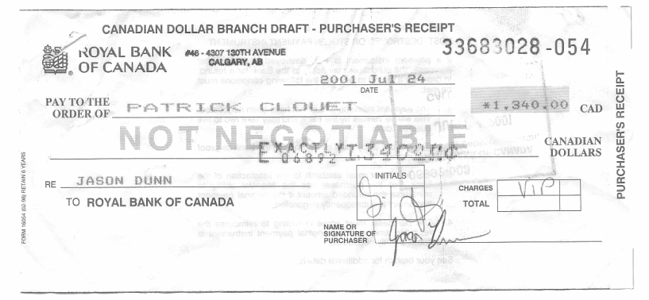
Money Order or Draft
Form of payment similar to a cheque
Difference is the institution prints it for you and guarantees to pay the amount shown
Both money order and drafts are relatively the same thing – only difference is a draft is issued only by financial institutions

Slide 29
Overdraft Protection
If you write a cheque for $100 but only have $50 in your account, your account overdraft is $50
This protection allows the institution to lend the money to the depositor on your behalf
You normally need to pay for this service.

Slide 30
Preauthorized Bill Payments
You have normal bills to pay such as TV, mortgage, phone etc
You can give a company permission to make a preauthorized debit which allows them to take the money right out of your account.

Slide 31
Task
Do some online research to answer the following:
What is the difference between virtual banking and online banking and the advantages and disadvantages of each
Make sure to include the results in your notes!
When you’re done work on your summative!

