Slide 1
Marketing Concepts
Mr. Singh

Slide 2
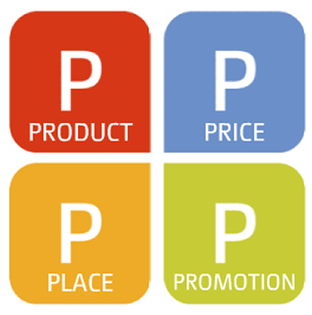
The Four Ps of Marketing
Product
Price
Place
Promotion
Marketing Mix - A good combination of all four elements translates into an effective campaign.
Notes:
The Four Ps of Marketing are the four elements of a good marketing campaign: product, price, place, and promotion. - product concept
The Two Cs of Marketing are the two major external factors in marketing: the competition and the consumer. – market concept
THE FOUR Ps OF MARKETING
The four Ps of marketing are product, price, place and promotion.
See Figure 8.3, “The Marketing Mix”, on page 240.

Slide 3
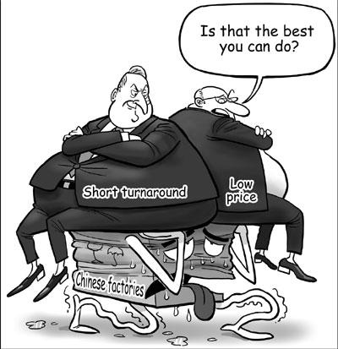
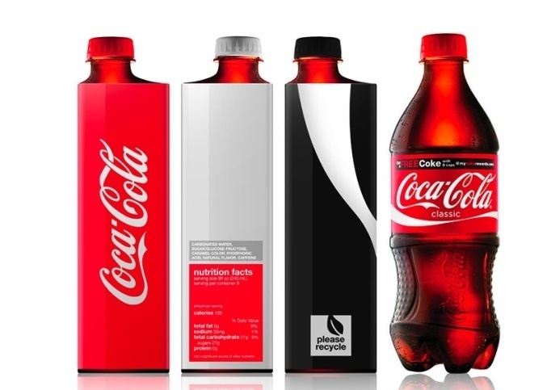
Products and Services
Take into account:
1. Quality
Improvements in quality attracts customers
If you improve the quality of your product, you will attract more customers
Design
Buy one product over another because of the way it looks
Ex: Coke, Skinny Jeans, Porsche
Notes:
The Four Ps of Marketing are the four elements of a good marketing campaign: product, price, place, and promotion.
The Two Cs of Marketing are the two major external factors in marketing: the competition and the consumer.
THE FOUR Ps OF MARKETING
The four Ps of marketing are product, price, place and promotion.
See Figure 8.3, “The Marketing Mix”, on page 240.

Slide 4
Quality
Consumers depend on the quality of many established brand names.
Consumers know that higher quality usually means that the product or service is more expensive.

Slide 5
Design
Since products like liquid detergent, where design doesn’t really apply, how can they make their product stand out?
Packaging!
Consumers can identify with a products shape or packaging
Ex. Coca-Cola bottle is one of the most identifiable packages in the world
Arizona Iced Tea shrink wraps colourful plastic labels around the entire bottle

Slide 6
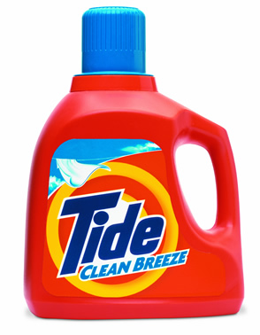
Products and Services
Features
Materials, scent, size, taste etc.
Product developers consider the features used
Some examples of product features are the smell of different perfumes, foam or feather pillows, and laundry detergent can be spring sent or sent-free.
Notes:
THE FOUR Ps OF MARKETING
Products and Services
Quality
Consumers depend on the quality of many established brand names.
Consumers know that higher quality usually means that the product or service is more expensive.
Some products are successful because they can meet consumer needs, at a lower quality, and therefore a lower price.
Design
We often think of design in relation to clothing, such as jeans that come in many different styles.
When a package is designed the function has to be considered.
Packaging protects the product from light, dirt, germs, air, water, tampering, and damage.
Packaging can aid ease of use, such as a spout or a resealable bag.
Product identification or recognition benefits from package shape and colour, such as the Coca-Cola bottle.
Label design is also an aspect of design and it can help a product stand out. Labels also give information such as size, weight, ingredients, and nutritional facts.
Services consider design features in their web pages and the physical design of their store.
Features
Product developers consider the features used
Some examples of product features are the smell of different perfumes, foam or feather pillows, and laundry detergent can be spring sent or sent-free.

Slide 7
Products and Services
Benefits
Need to make consumers aware of the advantages so they are motivated to buy it.
If you’re selling towels – show that yours is better quality – perhaps absorbs water better
The Product/Service Mix
Providing both can increase sales to existing customers and attract new ones.

Slide 8
The Product/Service Mix
Retail stores that provide services as well add huge value to the products they sell
Example of a store that his this?
Retail stores can offer services such as delivery, installation, extended warranties, gift-wrapping etc.
Stores offer coffee or relaxation areas and even restaurants
On the other hand services businesses such as a theater sell product as well (Ex. Popcorn)

Slide 9
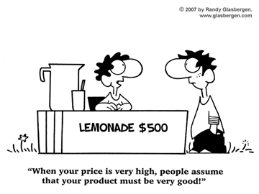

Slide 10
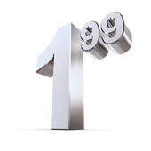
Price
Prices for products must be set with care
Consumers price shop
Businesses need to be price sensitive (aware of competitors prices)
If consumers think the price of a product is too high, it will not sell.
Consumers can easily find out product prices by searching on the Internet.
Marketers need to be aware of how price sensitive their product is: how much sales will go up or down when the price goes up or down.
Notes:
Price
If consumers think the price of a product is too high, it will not sell.
Consumers can easily find out product prices by searching on the Internet.
Marketers need to be aware of how price sensitive their product is: how much sales will go up or down when the price goes up or down.

Slide 11
Price Example
You want to sell ipods and it costs you $25 to make one ipod
If you sell 100 ipods at $100 each. Profit = $75 per ipod. Total profit = $7500 (75x100)
If you lower your price to $50 and sell 1000 ipods, profit is $25 per ipod. Total profit $25000
At $50 per ipod, if you sold 200 total profit will only be $5000.
You need to know how price sensitive your product is

Slide 12
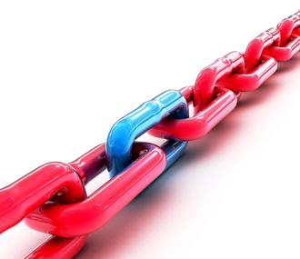
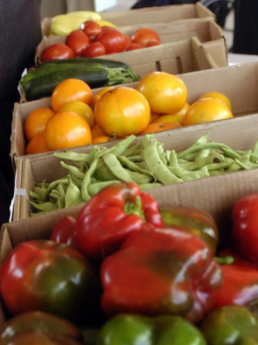
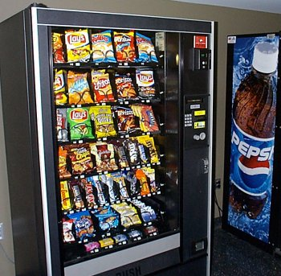
Place
Where/how it’s sold
Direct Channels
Producer → Consumer
Ex: Farmers market
Indirect Channels
intermediaries – wholesalers, importers, retailers
Specialty Channels
vending machines, telemarketing, catalogue, e-commerce etc.
Notes:
THE FOUR Ps OF MARKETING
Place (Channels of Distribution)
A product does not change as it moves through the distribution chain.
If the product is changed or altered that is the end of that channel and a new one begins.
See Figure 8.4, “Channels of Distribution”, on page 243.
Direct Channels
Simplest form of distribution.
This is also referred to as the maker-user relationship.
Direct channel distribution does not use intermediaries or businesses that take possession of the goods before the consumers do, they add costs to the product so that they realize a profit.
With direct channels consumers can readily inform the producers of their needs and they may feel more confident about the product because they deal directly with the company that produces it.
Indirect Channels of Distribution
Importers: Importers are businesses that seek out foreign products to bring into their own country. Importers may negotiate distribution deals with foreign manufacturers, buy the goods, store the goods, and may sell the goods. To eliminate risk importers can arrange only delivery of foreign goods to Canadian businesses.
Wholesalers: Wholesalers buy goods from producers or importers and resell the goods to retailers. The manufacturer may require that the retailer buy a minimum quantity of goods. Using a wholesalers may mean that the retailer pays a higher price but they get the quantity they need and the wholesaler may store the products close by.
Retailers: Linked directly to consumers, retailers buy merchandise customers want, keep it in stock, and display it so that customers can examine it in an easy-to-reach location.

Slide 13
Direct Channels
Simplest form of distribution - Selling directly to the customer
This is also referred to as the maker-user relationship.
Direct channel distribution does not use intermediaries or businesses that take possession of the goods before the consumers do, they add costs to the product so that they realize a profit.
With direct channels consumers can readily inform the producers of their needs and they may feel more confident about the product because they deal directly with the company that produces it.

Slide 14
Indirect Channels
Importers: Importers are businesses that seek out foreign products to bring into their own country. Importers may negotiate distribution deals with foreign manufacturers, buy the goods, store the goods, and may sell the goods. To eliminate risk importers can arrange only delivery of foreign goods to Canadian businesses.

Slide 15
Indirect Channels Cont’d
Wholesalers: Wholesalers buy goods from producers or importers and resell the goods to retailers. The manufacturer may require that the retailer buy a minimum quantity of goods. Using a wholesalers may mean that the retailer pays a higher price but they get the quantity they need and the wholesaler may store the products close by.
Retailers: Linked directly to consumers, retailers buy merchandise customers want, keep it in stock, and display it so that customers can examine it in an easy-to-reach location.

Slide 16
Channels of Distribution
Producer
Consumer
Producer
Retailer
Consumer
Producer
Wholesaler
Retailer
Consumer
Producer
Specialty Channel
Consumer

Slide 17
Promotion
Sales promotion encourages consumers to buy products
Coupons: offer consumers money off the price of a product.
Advertisers measure the effectiveness of a coupon promotion by the redemption rates - % of coupons actually used
Contests: increase brand recognition and sales and anyone can enter and win
By law, businesses cannot require consumers to buy a product in order to enter (Not allowed to gamble in contests)
Notes:
PROMOTION
Coupons: offer consumers money off the price of a product but redemption rates, a method of determining effectiveness, are only about 5%.
Contests: increase brand recognition through an anyone can enter and win concept that is not gambling and cannot require a purchase to enter.
Premiums: are when the consumer makes a purchase and they get something for free.
Customer loyalty cards are stamped with each purchase and, when full, entitles the customer to a discount or a free product.
Samples: samples are small “trail” sizes of a product that are given to consumers, it is expensive but often results in increased sales.
Special Events: are used to attract customers and increase sales.

Slide 18
Promotion Cont’d
Premiums: when the consumer makes a purchase and they get something for free.
Customer loyalty cards are stamped with each purchase and, when full, entitles the customer to a discount or a free product.
Samples: samples are small “trail” sizes of a product that are given to consumers, it is expensive but often results in increased sales.
Special Events: are used to attract customers and increase sales.

Slide 19
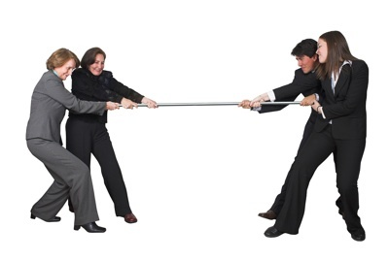
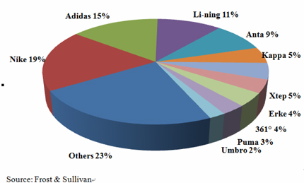
The Two Cs of Marketing
The Competitive Market
All the sellers of a specific product
Market Share - % of the market that a company or brand has.
Market Segment - part of the overall market with similar characteristics.
Ex: American soft drink is a $68 Billion dollar industry
If you’re a soft drink company that sells $10 Billon a year, you own 14% of the market
(.14 x 68) = 14% market share
Notes:
THE TWO Cs OF MARKETING
See Figure 8.6, “The Two Cs of Marketing”, on page 249.
The Competitive Market
See Table 8.1, “Estimated U.S. Market Share for Major Soft Drink Brands*”, on page 250.
The soft drink market has a flavoured market segment (root beer for example) and an energy drink segment (Red Bull for example).
The two ways to increase market share are to increase the size of the overall market (the introduction of energy drinks created a new segment) and to take sales away for the competition.
Competition among Products
All products and services compete for the consumer’s money in some way.
Indirect Competition: Is competition between products or services that are not directly related to each other such as a teen with $25 who decides on spending it on movie tickets or on a CD.
Discretionary Income: The portion of one’s disposable income that is not already committed to paying for necessities and can be used to buy things for pleasure, satisfaction, and comfort.
Disposable Income: Is the amount of income that is left after taxes have been paid. This income can be used to pay for the basic necessities such as food, clothing, and shelter.
Direct Competition: Competition between products that are very similar and have only minor differences. These products that compete directly with each other do so through image, quality, price, design, features, and benefits.

Slide 20
Segments
There are many different types of segments in soft drink
Flavoured soft drinks like root beer, sprite etc.
Diet Segment like Diet Coke and Diet Pepsi
Energy Drink Segment like Red Bull

Slide 21
How to increase market share?
2 ways to increase market share
Increase the overall size of the market
Ex: When energy drinks became popular, a whole new segment of the overall beverage market was created
With an increased market size, competitors could see profit
2nd way to increase market share is by taking sales away from competitors
Ex. Sprite took many sales away from Mountain Dew

Slide 22
Competition Among Products
Indirect competition - not directly related to each other (Ex: movies vs pizza)
Direct competition - products that are similar to one another (Ex: pizza pizza vs pizza hut)
Notes:
THE TWO Cs OF MARKETING
See Figure 8.6, “The Two Cs of Marketing”, on page 249.
The Competitive Market
See Table 8.1, “Estimated U.S. Market Share for Major Soft Drink Brands*”, on page 250.
The soft drink market has a flavoured market segment (root beer for example) and an energy drink segment (Red Bull for example).
The two ways to increase market share are to increase the size of the overall market (the introduction of energy drinks created a new segment) and to take sales away for the competition.
Competition among Products
All products and services compete for the consumer’s money in some way.
Indirect Competition: Is competition between products or services that are not directly related to each other such as a teen with $25 who decides on spending it on movie tickets or on a CD.
Discretionary Income: The portion of one’s disposable income that is not already committed to paying for necessities and can be used to buy things for pleasure, satisfaction, and comfort.
Disposable Income: Is the amount of income that is left after taxes have been paid. This income can be used to pay for the basic necessities such as food, clothing, and shelter.
Direct Competition: Competition between products that are very similar and have only minor differences. These products that compete directly with each other do so through image, quality, price, design, features, and benefits.

Slide 23
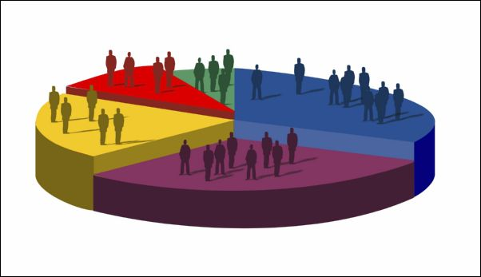
The Consumer Market
Businesses study and target potential users of a product or service to be competitive
These consumers can be identified by:
Demographics: age, gender, culture, income etc.
Lifestyle: The way people live, values, beliefs, motivations
Notes:
THE TWO Cs OF MARKETING
The Consumer Market
Demographics are used by businesses to target specific consumers.
Age: Age defines our tastes as well as our needs and wants. Some age groups are consumers, but not always customers. Adults or parents are gatekeepers, or the person who makes buying decisions for others, often children who can influence their decisions.
Gender: Some products lines are distinctly marketed to men or women, but more and more traditionally gender marketed products are being targeted to both groups (detergent and power tools are examples).
Family life cycle: People’s stage in the family life cycle often determines needs and wants. New parents need baby items and seniors may buy a retirement escape.
Income level: Is the grouping of consumers by how much money they make or have. Some products are marketed to consumers in every income bracket (Kellogg’s Corn Flakes), some are not (Mercedes).
Ethnicity and culture: Businesses target people based on their background and customs.
Lifestyle study is called psychographics.
When marketing to demographic groups, marketers need to consider their lifestyles because a person’s beliefs (such as being environmentally conscious or concerned about diet) influence what they purchase.

Slide 24
Demographics & Lifestyle
Demographics are used by businesses to target specific consumers.
Age: Age defines our tastes as well as our needs and wants. Some age groups are consumers, but not always customers. Adults or parents are gatekeepers, or the person who makes buying decisions for others, often children who can influence their decisions.
Gender: Some products lines are distinctly marketed to men or women, but more and more traditionally gender marketed products are being targeted to both groups (detergent and power tools are examples).

Slide 25
Demographics & Lifestyle
Family life cycle: People’s stage in the family life cycle often determines needs and wants. New parents need baby items and seniors may buy a retirement escape.
Income level: Is the grouping of consumers by how much money they make or have. Some products are marketed to consumers in every income bracket (Kellogg’s Corn Flakes), some are not (Mercedes).
Ethnicity and culture: Businesses target people based on their background and customs.

Slide 26
Demographics & Lifestyle
Lifestyle study is called psychographics.
When marketing to demographic groups, marketers need to consider their lifestyles because a person’s beliefs (such as being environmentally conscious or concerned about diet) influence what they purchase.

