Slide 1
The 5-Step Planning Process
Mr. Singh

Slide 2
5 Phases to planning your launch
#1: Set your goals
#2: Map out your launch
#3: Overlay the Calendar
#4: Chunk it out
#5: Break it down

Slide 3
What is a webinar?
A live presentation that delivers immense value
Establishes you as an authority
Creates incredible demand for your product which you then sell at the end of the webinar.

Slide 4
Setting your goals
The Numbers That Matter
Total Sales
Total Attendees
Total Registrants
TRAFFIC
REGISTRANTS
ATTENDEES
SALES

Slide 5
YOUR GOAL
EG: $100 000 IN SALES
How many units do we need to sell?
If our product is $497
$100 000 / $497 = 202 sales

Slide 6
Setting your goals
30%
10%
TRAFFIC
REGISTRANTS
3,337
ATTENDEES
1,010
SALES
101 Sales
1st : 202/2 = 101 -> You generally need half on webinar
2nd: 101/.10 = 1,010
3rd: 1010/ .30 = 3,337

Slide 7
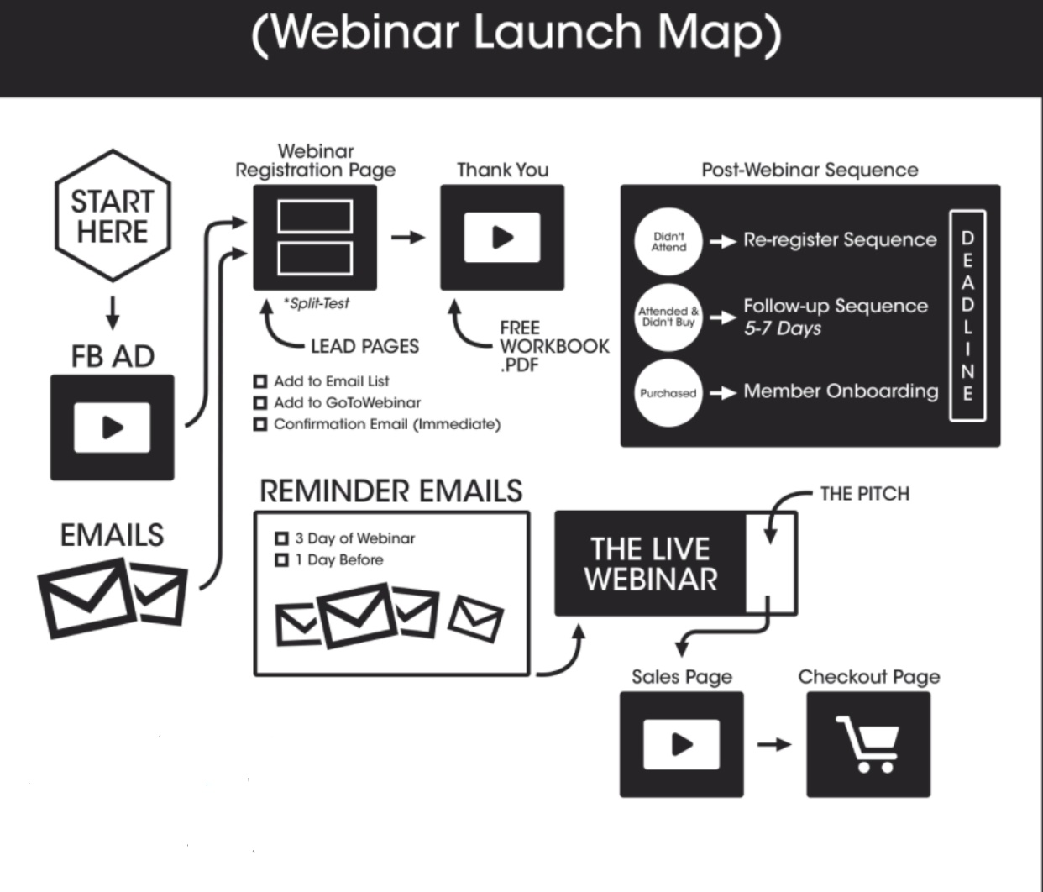
Mapping out your launch

Slide 8
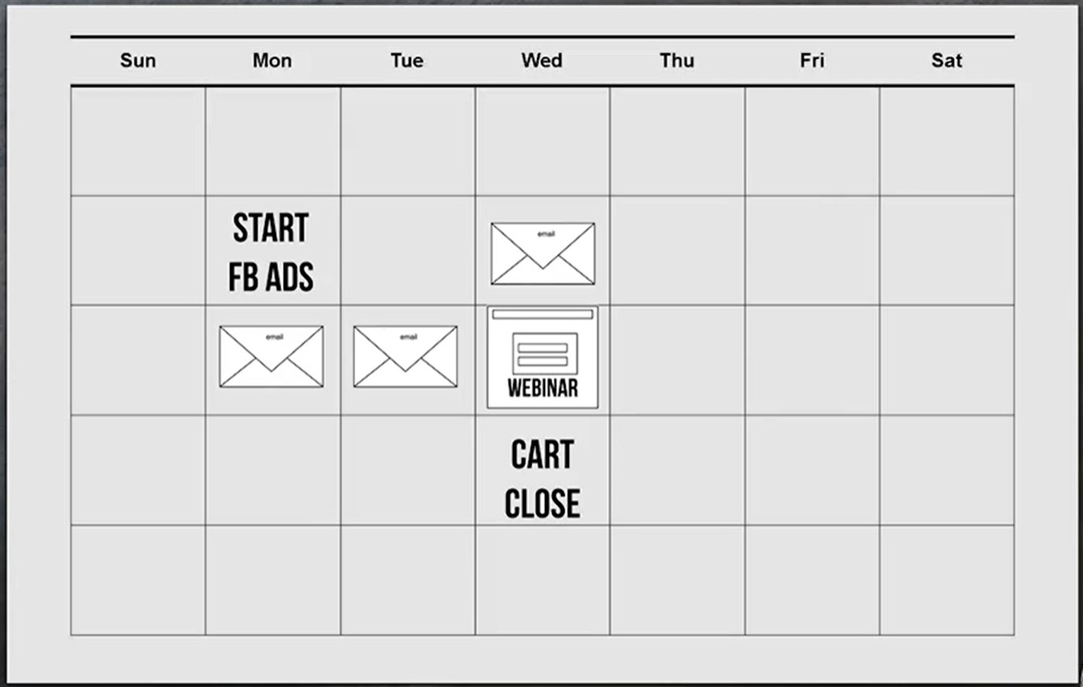
Book it: launch calendar

Slide 9
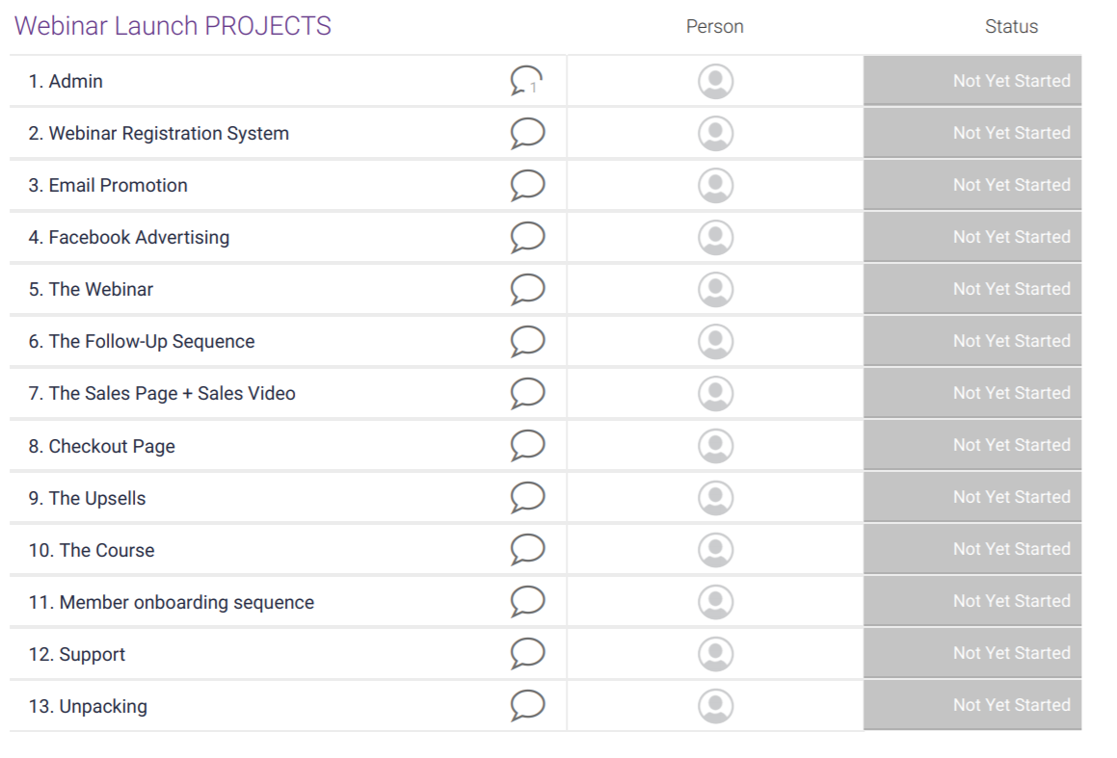
Chunk it out: Plan out each project for the launch

Slide 10
Break it down:
This phase you brake down each project and complete the tasks for each
Explain your 7 steps for your irresistible offer
Include fast action bonuses and stay-to-the end bonus

Slide 11
