Slide 1
Chapter 9 - Accounting
Accounting

Slide 2
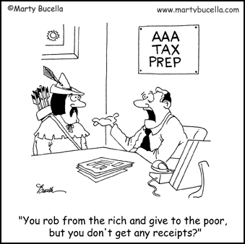
What Accountants Do
Record, analyze, and interpret financial or economic activities of a business. Businesses can conduct hundreds—even thousands of transactions daily.
Transactions include paying staff; paying bills, such as heat and electricity; and buying and storing inventory.
Notes:
WHAT ACCOUNTANTS DO
Provide useful information for decision makers
Businesses can conduct hundreds—even thousands of transactions daily.
Transactions include paying staff; paying bills, such as heat and electricity; and buying and storing inventory.
Most businesses use accounting software packages, such as QuickBooks and Simply Accounting, to record and track financial information.

Slide 3
Questions A Business May Ask About Financial Worth
How much money did we make last year?
How much can we afford to spend on a new store addition?
How can we reduce our expenses?
Is it wise for us to merge with another business?
How much will any or all of this cost?
Notes:
WHAT ACCOUNTANTS DO
Provide useful information for decision makers
Businesses can conduct hundreds—even thousands of transactions daily.
Transactions include paying staff; paying bills, such as heat and electricity; and buying and storing inventory.
Most businesses use accounting software packages, such as QuickBooks and Simply Accounting, to record and track financial information.

Slide 4
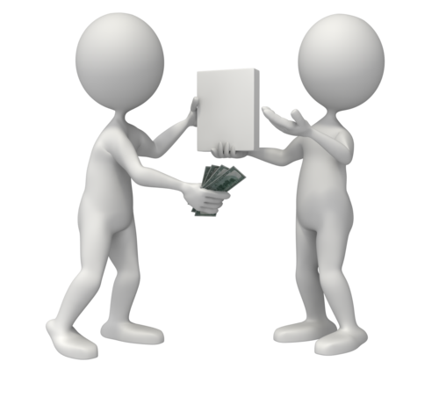
Transactions
Recorded activities of a business that involve money
When something of value is exchanged
Businesses can conduct THOUSDANDS a day
Notes:
Double-entry Bookkeeping
A transaction could result in one increase offset by one decrease, two increases, or two decreases.
An example would be if a business pays $80 for labour, it decreases cash while increasing expenses.
Bookkeeping
recording of all transactions for a business in a specific format.

Slide 5
Transactions
A transaction could result in one increase offset by one decrease, two increases, or two decreases.
An example would be if a business pays $80 for labour, it decreases cash while increasing expenses.

Slide 6
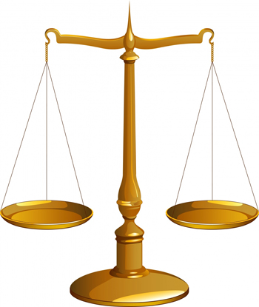
Double-Entry Bookkeeping
Bookkeeping – recording of all transactions
Each transaction involves two changes
one increase and one decrease, 2 decreases or 2 increases
For example, a business pays $100 for labour:
decreases ⬇ cash balance, and…
increases ⬆ expenses (labour cost)
Notes:
Double-entry Bookkeeping
A transaction could result in one increase offset by one decrease, two increases, or two decreases.
An example would be if a business pays $80 for labour, it decreases cash while increasing expenses.

Slide 7
Net Worth
Value of everything you own after ALL debts are paid
Notes:
ACCOUNTING AND INDIVIDUALS
Personal records or transactions can be recorded in a cheque register or on a computer program.
Preauthorized payments - money taken automatically and on a regular basis from their bank accounts.
An example of a preauthorized payment would be a utility bill deducted on a monthly basis from a chequing account.
Always keeping accurate records ensures that individuals do not find themselves with insufficient funds.
Assets
When you take ownership of something, even if you owe money on it, it becomes yours and it is an asset.
Liabilities
Individuals and businesses may borrow money from financial or credit companies.
Personal Equity or Net Worth
See equation below Owner’s Equity on the next slide.

Slide 8
Assets and Liabilities
Assets
something that has value and is owned by a person
Ex. If you own a bicycle, this is one of your assets!
Liabilities
debt or amount owed to others
Ex. You owe your parents $100 toward your iPhone

Slide 9
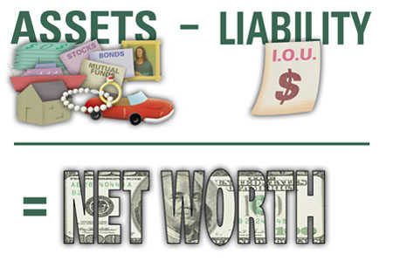
Basic Accounting Concepts
Net Worth = Assets - Liabilities
Ex. Ashley has calculated total assets to be $1400. If she has debts of $300, then her personal equity, or net worth, would be
$1400 - $300 = $1100

Slide 10
Owner’s Equity
Owner’s investment in the business
Financial portion of the business that belongs to the owners or shareholders.
Owner’s Equity – Net worth for a business
Assets – Liabilities = Owner’s Equity
Notes:
ACCOUNTING AND BUSINESSES
A balance sheet is a financial statement that shows the financial position of a business on a specific date.
If the information on the balance sheet is correct, the left and right side will be equal.
1. To determine owner’s equity:
Assets – Liabilities = Owner’s Equity
2. To determine total assets:
Assets = Liabilities + Owner’s Equity

Slide 11
Business and Financial Statements
Present financial information in a way that helps business people keep track of the financial health of the business
BALANCE SHEET
INCOME STATEMENT
STATEMENT OF CASH FLOWS
Notes:
helps owners and managers keep track of the financial health of the business.
provide outsiders with accurate information about the business.

Slide 12
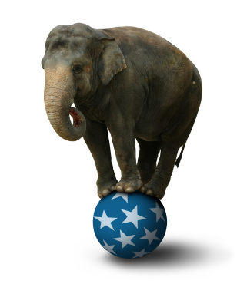
Balance Sheet
Snapshot that shows how a business is doing on a specific day
Does not indicate whether a business has made a profit
Notes:
See Figure 9.1, “Types of Financial Statements”, on page 281.
Preparing a Balance Sheet
On any given day the balance sheet should be different, that is why it is like a snapshot.
Balance Sheet Equation Method
If the business did not have any debts the balance sheet equation would be: Assets = Owner’s Equity.

Slide 13
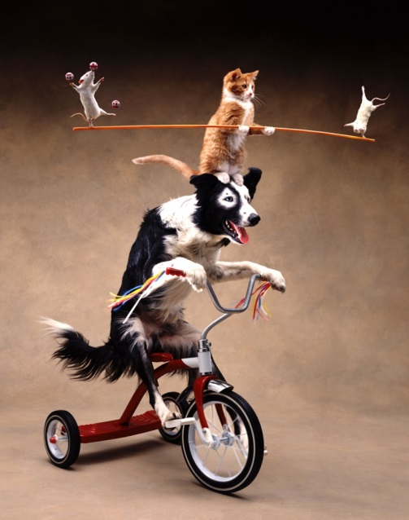
Balance Sheet Equation
“Balanced” because the left side (LS) must equal the right side (RS):
ASSETS = LIABILITIES + OWNER’S EQUITY
Notes:
Balance Sheet Equation Method
left side of the equation (assets) ALWAYS equals the right side (liabilities plus owner’s equity).
Assets are owned by one of two groups
owner(s) of the business (owner’s equity)
individuals or businesses owed money (liabilities)

Slide 14
Cost Principle & Depreciation
If you buy a building or home on July 1st 2016, will it be worth the same on July 1st 2017?
No
On the Balance sheet we have to follow the cost principle – Assets are recorded at the actual amount they cost the business
We know that assets lose value overtime, this is called Depreciation
A car depreciates every year from the day its bought

Slide 15
What is an Asset? Or Liability?
Cash?
Cash is an asset.
Money that is owed to the business from customers?
Asset – known as Accounts Receivable
Bank loan for a car?
Any type of loan is a liability
You owe money for the supplies you bought
Supplies = Asset, Owed money = Liability
Anytime a business owes money, this account is called Accounts Payable

Slide 16
Help Mr. Singh and his Business
Nemesis Sports has a computer ($500), money in the business bank account ($1000), a few customers who owe him money ($500), owns the land ($100 000) and building ($150 000).
Nemesis Sports also has a mortgage of $110 000 and a loan on a car of $20 000. They also owe $1000 to Victoria Park C.I.
What is their owner’s equity?
252 000 – 131 000 = $121 000

Slide 17
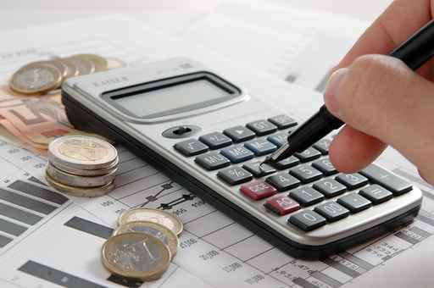
→ Your Turn ☺
Calculate your own net worth using as much information as you can (or are willing to)
Hint: start by listing
your assets and
liabilities

