Slide 1
Challenges and Changes in the Labour Market
Mr. Singh

Slide 2
Terms
Agricultural Age
Merchant
Industrial Age
Labourer
Intangible Asset
Goodwill
Command and Control
Trade Union
Strike
New Economy

Slide 3
Where did it all come from?
Started with the Agricultural Age
People moved from place to place searching for food and water
Common type of jobs were merchants, crafts people, farmers, or farm workers
This is where entrepreneurship began
Some people brought their food or product directly to the customer
People traded goods and made a living that way

Slide 4
Industrial Age
The agricultural age gradually evolved into the Industrial Age
This is where people started to build equipment so they could produce goods in larger quantities
Because equipment was so expensive only a few people could afford to have it
The owners of equipment would hire labourers, to use the equipment
This changed the way goods were produced

Slide 5
Industrial Age
Organizations started forming to produce goods and services
Their assets included their equipment, their capital investment, and intangible asset of goodwill – established reputation of a business
Most organizations operated under a command and control model – labourers were expected to follow exactly what managers say

Slide 6
Industrial Age
Owners wanted to make sure they stay on top
If labourers demonstrated enterprising characteristics or creativity, they were discouraged and sometimes fired
Many more employees became creative and wanted better so workers began to form trade unions
With these unions, unionized workers were able to negotiate better wages and working conditions
If it failed, workers opted to strike

Slide 7
The information age
The new economy has ushered in the Information Age
This age is very different than agricultural and Industrial because, for the first time, information and knowledge are valued
This age is prime for entrepreneurs and enterprising people
Information is not dependent on expensive equipment and large factories, but available easily to anyone who wants it

Slide 8
The Information Age
The people who succeed in the information age are those who seek out new information or new ways of handling information
Ex: Uber, Airbnb etc.

Slide 9
Current Trends in the Labour Market
Make sure you read the article and pick your top 4 labour trends that you feel are important
You will be tested on this.
Article can be found on the course website

Slide 10
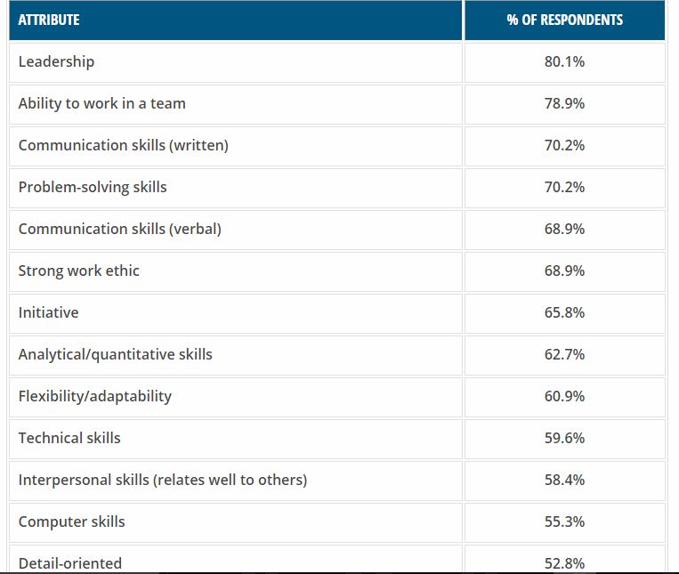
What employers are looking for on your resume?

Slide 11
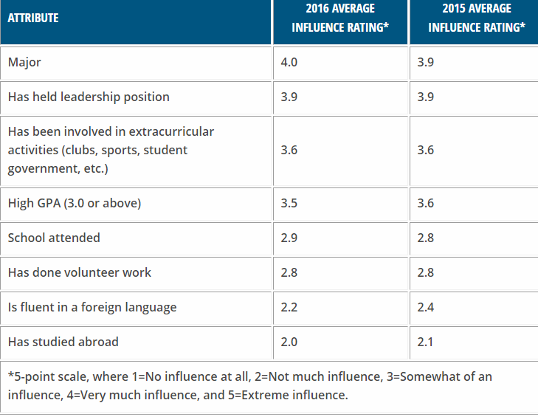
What influences employers in hiring you?

Slide 12
Work-Life Balance
Studies show a person who can successfully balance work with family needs is less likely to be stressed and more productive
Employers understand this want to make employees feel connected to the organization and meet their expectations
If employers want to retain their good employees, workplaces must be flexible in ways that help their employees balance their work with other aspects of their lives

Slide 13
Home-Based Employment
Telecommuters
can work from home with computer access to files, collaborating with others via e-mail and software programs
Teleconferencing
Eg. Skype – video conversations
Work-at-home employees are generally more productive, having eliminated travel time and office distractions
They tend to be happier and businesses can reduce their office costs

Slide 14
Enterprising Employees
People who can generate innovative ideas and communicate them to others
In the Information Age, intellectual capital has become an important asset to any organization
Employees who build their knowledge and skills on the job are critically important to any organization success
Skills become outdated over time but enterprising employees are able to learn new skills and adapt to new ways of doing things

