Slide 1
Chapter 10: Individual Behaviour
Mr. Singh

Slide 2
Perception
The process through which people receive, organize and interpret information from the environment
People can perceive the same things or situations differently
People behave on the basis of their perceptions
It acts as a screen or filter before someone makes a decision and/or can change behavior
* Reflect on perception from Lie to Me season 1 episode 1 – Identify 5 different elements

Slide 3
Psychological Contracts
A persons job-fit begins here
A set of expectations held by an individual about what will be given and received in the employment relationship
An ideal work situation is one with a fair psychological contract
Balance of contributions and inducements

Slide 4
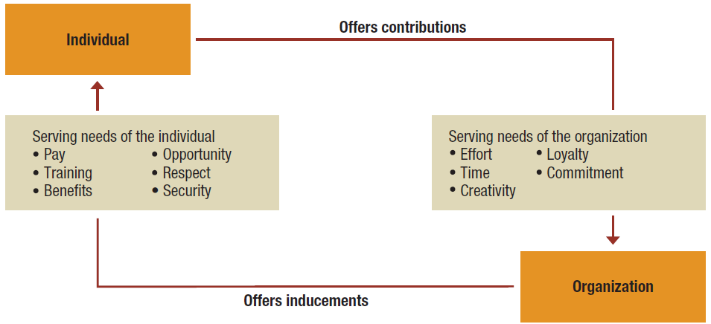
Figure 10.1 Components in the psychological contract

Slide 5
Perceptual Tendencies
Stereotypes: occur when someone is identified with a group or category, and then oversimplified attributes associated with the group or category are used to describe the individual
Example: “He’s talking with co-workers”
Interpretation: he’s discussing a new deal
“She’s talking with co-workers”
Interpretation: She’s gossiping
This is an example of a gender stereotype

Slide 6
Perceptual Tendencies
Halo Effect: Occurs when one attribute is used to develop an overall impression of a person or situation
Example: If you meet someone new that has a nice smile, generally that’s a positive first impression

Slide 7
Perceptual Tendencies
Projection - Perceptual error that involves the assignment of personal attributes to other individuals
Example: Assume that other persons share our needs, desires, and values
If you like responsibility and challenge at work, that doesn’t mean everyone does

Slide 8
Perceptual Tendencies
Selective Perception – the tendency to single out for attention those aspects of a situation or attributes of a person that reinforce or appear consistent with one’s existing beliefs, values, or needs
If you work in a marketing department, you may see things differently than someone in manufacturing

Slide 9
Perceptual Tendencies
Impression Management - A systematic attempt to influence how others perceive us
How to make a good impression at work and elsewhere?
Dress to convey favourable appeal
Flatter others to generate positive feelings
When conversing, make eye contact and smile
Display a high level of energy

Slide 10
Personality
The combination or overall profile of characteristics that makes one person unique from others
Researchers have identified 5 personalities that are significant in the work context
These are known as the Big 5

Slide 11
“Big Five” personality traits
Extroversion:
The degree to which someone is outgoing, sociable, and assertive
Agreeableness:
The degree to which someone is good-natured, cooperative, and trusting
Conscientiousness:
The degree to which someone is responsible, dependable, and careful
Emotional stability:
The degree to which someone is relaxed, secure, and unworried
Openness:
The degree to which someone is curious, receptive to new things, and open to change

Slide 12
What should we know about personalities in the workplace?
Myers-Briggs Type Indicator:
Extraverted vs. Introverted: whether a person is drawn towards external stimulation and is energised by socialising or prefers independent contemplation and is energised by solitude
Sensing vs. Intuitive: whether a person tends to focus on details or on the big picture in dealing with problems
Thinking vs. Feeling: whether a person tends to rely on logic or emotions in dealing with decision making
Judging vs. Perceiving: whether a person prefers order and control, or acts with flexibility and spontaneity

Slide 13
Additional Personality Traits
Locus of Control:
The extent to which people believe they are in control of their destinies versus believing that that what happens to them is beyond their control
Authoritarianism:
The degree to which a person defers to authority and accepts status differences
Machiavellianism:
The extent to which someone is emotionally detached and manipulative in using power

Slide 14
Additional Personality Traits (cont’d)
Self-monitoring:
The degree to which someone is able to adjust and modify behaviour in response to the situation and external factors
Type A Personality:
A person oriented toward extreme achievement, impatience, and perfectionism

Slide 15
Attitudes and Behaviour
Attitude:
A predisposition to act in a certain way toward people and things in one’s environment
3 Components of Attitudes:
Cognitive component – a belief or opinion
Affective or emotional component – specific feeling
Behavioural component – behave in a manner consistent with your belief or feeling
Cognitive Dissonance - The discomfort a person feels when attitudes and behaviour are inconsistent
Ex: Dropping out of sports to get extra study time

Slide 16
Job Satisfaction
Job Satisfaction:
The degree to which an individual feels positively or negatively about various aspects of work
Common aspects of job satisfaction:
Work itself – job interesting, challenging
Supervision – support available
Co-workers
Advancement opportunities
Pay
Work conditions
Security – is the job and employment secure?
Strong and positive relationship between satisfaction and absenteeism and turnover

Slide 17
Organizational Citizenship
Research identifies a positive relationship between job satisfaction and organizational citizenship
Organizational Citizenship:
Willingness to “go beyond the call of duty” or “go the extra mile” in one’s work
Employees accomplish tasks not necessarily required of them
Someone working extra hours at no pay just to make sure things are done right for his/her boss

Slide 18
Emotions, Moods & Stress
3 aspects of Individual Psychology
Emotion - A strong feeling directed toward someone or something
You might have a negative emotion when a teacher criticizes you in front of the class
You might feel a positive emotion when a teacher congratulates you
We perform better in situations when are good at recognizing and dealing with emotions in ourselves and others

Slide 19
Emotional Intelligence Competencies
Self–Management :
ability to think before acting and to be in control of otherwise disruptive impulses
Relationship Management:
Social insight, the ability to establish rapport with others in ways that build good relationships and influences their emotions in positive ways

Slide 20
Emotional Intelligence Competencies
There are 4 emotional intelligence competencies
Self-Awareness:
ability to understand our own emotions and moods, and to understand their impact on our work and on others
Social Awareness:
ability to empathize, to understand the emotions of others, and to use this understanding to better relate to them

Slide 21
Moods
Emotions are normally short term but moods are generalized positive and negative feelings or states of mind that may persist for some time
Have you woke up in the morning feeling refreshed and just happy or depressed and generally unhappy?
What are the consequences of these different moods for your behaviour with friends, family, at work or school?
What does the research say about how moods effect your behaviour? AKA mood contagion

Slide 22
Stress
Stress: a state of tension experienced by individuals facing extraordinary demands, constraints, or opportunities
Stressors:
Are things that cause stress
Originate in work, personal, and non-work situations
Have the potential to influence work attitudes, behaviour, job performance, and health

Slide 23
Work factors as potential stressors
Includes:
Excessively high or low task demands
Role conflicts or ambiguities
Poor interpersonal relationships
Too slow or too fast career progress
Work-related stress syndromes:
Set up to fail
Mistaken identity

Slide 24
Consequences of Stress
Constructive Stress:
Acts as a positive influence
Can be energizing and performance enhancing
Destructive Stress:
Acts as a negative influence
Breaks down a person’s physical and mental systems
Can lead to job burnout and/or workplace rage

Slide 25
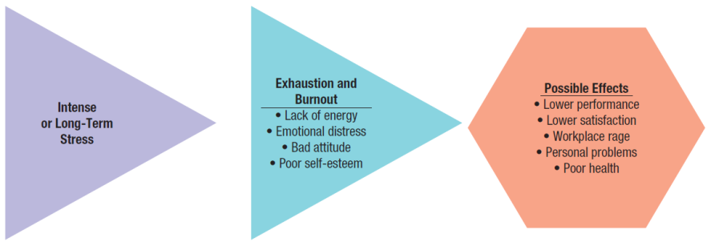
Figure 10.9 Potential negative consequences of a destructive job stress-burnout cycle

Slide 26
Stress Management
Personal wellness:
The pursuit of positive personal and mental potential though a health-promotion program
A form of preventative stress management
Enables people to be better prepare and deal with stress

