Slide 1
Chapter 11: Motivation Theory and Practice
Mr. Singh

Slide 2
What is motivation?
Motivation: the forces within the individual that account for the level, direction, and persistence of effort expended at work
Basically a highly motivated person works hard at work vs someone who is not motivated
With motivation comes rewards which is simply a work outcome of positive value to the individual
There are 2 types of rewards

Slide 3
Extrinsic & Intrinsic Rewards
Extrinsic Reward – is something given to you by another person normally a supervisor or higher level manager
Examples: Promotion, time off, bonuses etc.
Intrinsic Reward – these are self administered
This is when you feel good about yourself, you have personal development, and have feelings of competency

Slide 4
Let’s talk about Starbucks
They have a great rewards and performance system
They offer stock option plans to all its employees based on their base pay
They can buy at a fixed price which means if the market value is higher than the price of their stock option, they gain
This should motivate them to do well so the business performs at its best
This is an example of performance – contingent rewards

Slide 5
Motivation Cont’d
Motivation begins with the concept of needs – basically the desires of an individual
Explain workplace behaviour and attitudes
Create tensions that influence attitudes and behaviour
Good managers and leaders facilitate employee need satisfaction

Slide 6
Extrinsic Reward Theories
Needs:
Are unfulfilled physiological and psychological desires of an individual
Explain workplace behaviour and attitudes
Create tensions that influence attitudes and behaviour
Good managers and leaders facilitate employee need satisfaction

Slide 7
Extrinsic Reward Theories (CONT’D)
Hierarchy of needs theory:
Developed by Abraham Maslow
Lower-order and higher-order needs affect workplace behaviour and attitudes
Lower-order needs:
Physiological, safety, and social needs
Desires for physical and social well being
Higher-order needs:
Esteem and self-actualization needs
Desire for psychological growth and development

Slide 8
Extrinsic Reward Theories (CONT’D)
Maslow uses 2 principles to describe how these needs affect human behaviour
Hierarchy of needs theory:
Deficit Principle:
A satisfied need is not a motivator of behaviour
Progression Principle:
A need at one level does not become activated until the next lower-level need is satisfied

Slide 9
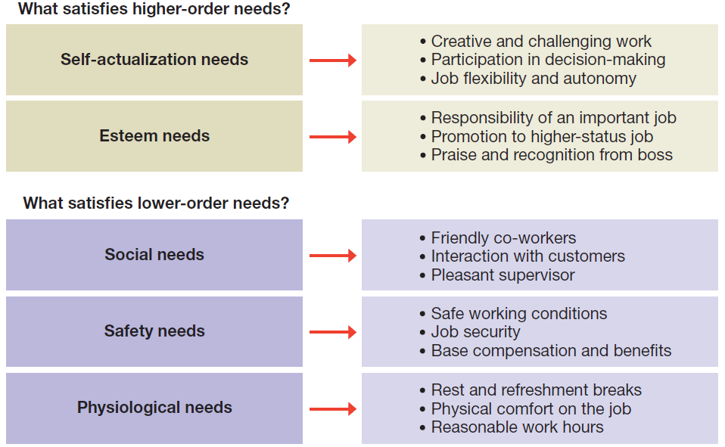
Figure 11.2 Opportunities for satisfaction in Maslow’s hierarchy of human needs

Slide 10
Extrinsic Reward Theories (CONT’D)
ERG Theory:
Developed by Clayton Alderfer
Three need levels
Existence needs: desires for physiological and material well-being
Relatedness needs: desires for satisfying interpersonal relationships
Growth needs: desires for continued psychological growth and development

Slide 11
Extrinsic Reward Theories (CONT’D)
ERG Theory:
Any/all needs can influence behaviour at one time
Frustration-regression principle
An already satisfied lower-level need becomes reactivated when a higher-level need is frustrated

Slide 12
Extrinsic Reward Theories (CONT’D)
Two-Factor Theory
Developed by Frederick Herzberg
Hygiene factors
Elements of the job context
Sources of job dissatisfaction.
Satisfier factors
Elements of the job content
Sources of job satisfaction and motivation

Slide 13
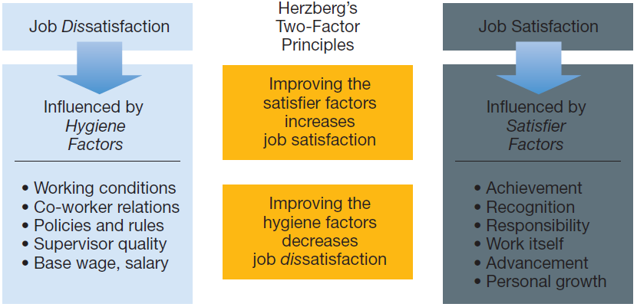
Figure 11.3 Herzberg’s two-factor theory

Slide 14
Extrinsic Reward Theories (CONT’D)
Acquired Needs Theory:
Developed by David McClelland
People acquire needs through their life experiences
Needs that are acquired:
Need for Achievement (nAch)
Need for Power (nPower)
Need for Affiliation (nAff)

Slide 15
Extrinsic Reward Theories (CONT’D)
Acquired Needs Theory (cont’d):
Need for Achievement (nAch)
Desire to do something better or more efficiently, to solve problems, or to master complex tasks
People high in (nAch) prefer work that:
Involves individual responsibility for results
Involves achievable but challenging goals
Provides feedback on performance

Slide 16
Extrinsic Reward Theories (CONT’D)
Acquired Needs Theory (cont’d):
Need for Power (nPower)
Desire to control other persons, to influence their behaviour, or to be responsible for other people
Personal power versus social power
People high in (nPower) prefer work that:
Involves control over other persons
Has an impact on people and events
Brings public recognition and attention

Slide 17
Extrinsic Reward Theories (CONT’D)
Acquired Needs Theory (cont’d):
Need for Affiliation (nAff):
Desire to establish and maintain friendly and warm relations with other persons
People high in (nAff) prefer work that:
Involves interpersonal relationships
Provides for companionship
Brings social approval

Slide 18
Intrinsic Rewards
Goal-Setting Theory:
Developed by Edwin Locke
Properly set and well-managed task goals can be highly motivating
Motivational effects of task goals:
Provide direction to people in their work
Clarify performance expectations
Establish a frame of reference for feedback
Provide a foundation for behavioural self-management

Slide 19
Intrinsic Rewards (cont’d)
Key issues and principles in the goal-setting process:
Set specific goals
Set challenging goals
Build goal acceptance and commitment
Clarify goal priorities
Provide feedback on goal accomplishment
Reward goal accomplishment

Slide 20
Intrinsic Rewards (cont’d)
Goal-Setting Theory (cont’d):
Participation in goal setting:
unlocks the motivational potential of goal setting
Management by Objectives (MBO) promotes participation
when participation is not possible, workers will respond positively if supervisory trust and support exist

