Slide 1
Chapter 14: Ethics and Social Responsibility
Mr. Singh

Slide 2
What is Ethical Behaviour?
Ethics:
Code of moral principles
Set standards of “good” or “bad” or “right” or “wrong” in one’s conduct
Ethical behaviour:
What is accepted as good and right in the context of the governing moral code

Slide 3
What is Ethical Behaviour? (cont’d)
Laws, Values, and Ethical Behaviour:
Legal behaviour is not necessarily ethical behaviour
Personal values help determine individual ethical behaviour
Is it ethical to make personal calls on company time? Call in sick when you’re not sick?
These are not illegal but many would consider it unethical

Slide 4
What is Ethical Behaviour? (cont’d)
Law, values, and ethical behaviour:
Values:
underlying beliefs and attitudes that help determine individual behaviour
Terminal values: preferences about desired ends (goals you want to achieve in life)
Ex: Self Respect, freedom, happiness
Instrumental values: preferences regarding the means for accomplishing these ends
Ex: Honesty, Ambition, Courage, Imagination

Slide 5
Alternate Views of Ethics
Utilitarian view of ethics:
Greatest good to the greatest number of people.
Assesses actions based on consequences
Business professionals are inclined to use profits, efficiency and other performance measures to judge what is best for most people
Individualism view of ethics:
Primary commitment is to one’s long-term self-interests.
Lying and cheating for short term gain would not be tolerated
This view promotes honesty and integrity

Slide 6
Alternate Views of Ethics (Con’td)
Moral-rights view of ethics:
Respects and protects the fundamental rights of all people.
This was done by Trudeau through the Charter of Rights and Freedoms
Justice view of ethics:
Fair and impartial treatment of people according to legal rules and standards (Everyone is equal)
Procedural justice: policies and rules fairly applied
Distributive justice: equal treatment for all people
Interactional justice: people treated with dignity and respect

Slide 7
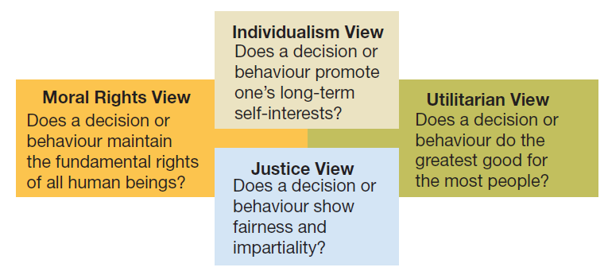
Figure 14.1 Four views of ethical behaviour

Slide 8
Cultural issues in ethical behaviour
Cultural relativism:
Ethical behaviour is always determined by a cultural context
“When in Rome, do as the Romans do”
Cultural universalism:
Behaviour unacceptable in one’s home environment should not be acceptable anywhere else
Considered by some to be ethical imperialism

Slide 9
Figure 14.3 The extremes of cultural relativism and ethical imperialism in international business ethics

Slide 10
Ethics in the workplace
An ethical dilemma occurs when certain choices may be considered unethical, despite possible potential for personal and/or organizational benefit
“I define an unethical situation as one in which I have to do something I don’t feel good about”

Slide 11
Ethical Dilemmas
Discrimination – denying promotion or appointment to a person because of race, religion, gender, age, etc.
Sexual Harassment – making co-worker uncomfortable because of inappropriate comments or actions regarding sexuality
Conflicts of Interest – taking a bribe or gift in return for doing something
Customer Confidence – giving privileged information to another party
Organizational Resource – using work products for personal use

Slide 12
Rationalization for Unethical Behaviour
Unethical behaviour can be rationalized by convincing yourself that:
The behaviour is not actually illegal
The behaviour is truly in everyone’s best interests
Nobody will ever find out
The organization will “protect” you

Slide 13
Maintaining High Ethical Standards
Whistleblowers:
Expose the misdeeds of others in order to:
Preserve ethical standards
Protect against wasteful, harmful, or illegal acts
Laws protecting whistleblowers may vary
In the US 44% of workers fail to report wrongdoings they observe at work
Top reasons for not reporting include: they believe nothing will be done and it won’t be kept confidential

Slide 14
Ethics Training
Structured programs that help participants to understand ethical aspects of decision making
Helps people incorporate high ethical standards into their daily life
Helps people deal with ethical issues while under pressure

Slide 15
Codes of Ethical Conduct
Codes of ethics:
A formal statement of an organization’s values and ethical principles regarding how to behave in situations susceptible to the creation of ethical dilemmas
You’ll find these in professions such as engineering, medicine, law and public accounting

Slide 16
Codes of Ethical Conduct (cont’d)
Areas often covered by an organization’s codes of ethics:
Bribes and kickbacks
Political contributions
Honesty of books or records
Customer/supplier relationships
Co-worker relationships
Confidentiality of corporate information

Slide 17
Ethical Role Models
Top managers serve as ethical role models
All managers can influence the ethical behaviour of people who work for and with them
Excessive pressure can foster unethical behaviour
Managers should be realistic in setting attainable performance goals for others

Slide 18
Social Entrepreneurship
A unique form of entrepreneurship that seeks novel ways to solve pressing social problems at home and abroad
These people pursue innovations that help solve social problems or at least help make lives better for people who are disadvantaged
Examples include:
Housing and job training for homeless
Bringing technology to poor families
Improving literacy among disadvantaged youth
Offering small loans to start minority-owned businesses

Slide 19
Social Responsibility
Corporate social responsibility (CSR):
Obligates organizations to act in ways that serve both its own interests and the interests of society at large
What are ways companies can demonstrate CSR?

Slide 20
Stakeholder Issues and Analysis
Organizational stakeholders:
Those persons, groups, and other organizations directly affected by the behaviour of the organization and holding a stake in its performance
What are different types of stakeholders?

Slide 21
Figure 14.7 Sample Stakeholder Model

Slide 22
Perspectives on social responsibility
Classical view:
Management’s only responsibility is to maximize profits
Socioeconomic view:
Management must be concerned for the broader social welfare, not just profits

Slide 23
Evaluating Corporate Social Performance
We can measure corporate social performance
Criteria for evaluating corporate social performance:
Social Responsibility Audit: assesses organization’s accomplishments in areas of CSR
Asks: is the organization’s…
Economic responsibility met - Is it profitable?
Legal responsibility met - Does it obey the law?
Ethical responsibility met - Is it doing the right thing?
Discretionary responsibility met - Does it contribute to the broader community?

Slide 24
Fig. 14.8 Criteria for evaluating corporate social performance
Economic Responsibility
Ethical Responsibility

Slide 25
Evaluating Corporate Social Performance (cont’d)
Strategies for pursuing social responsibility:
Obstructionist Strategy: meets only economic responsibilities
Defensive Strategy: meets economic and legal responsibilities
Accommodative Strategy: meets economic, legal, and ethical responsibilities
Proactive Strategy: meets economic, legal, ethical, and discretionary responsibilities

Slide 26
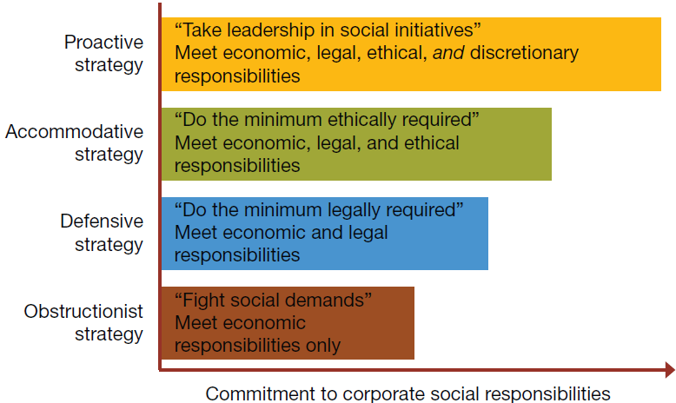
Figure 14.9 Four strategies of corporate social responsibility—from obstructionist to proactive behaviour

