Slide 1
Chapter 2: Business Basics
Mr. Singh

Slide 2
Economic needs and wants
Everyone has needs and wants but some needs and wants cannot be satisfied by buying something
You can’t buy life or friendship
Economic needs and wants – these are needs and wants that you can satisfy by buying something
Need – something necessary for survival
Want – something you desire but could function without

Slide 3
Economic needs and wants
Everyone has needs and wants but some needs and wants cannot be satisfied by buying something
You can’t buy life or friendship
Economic needs and wants – these are needs and wants that you can satisfy by buying something
Need – something necessary for survival
Want – something you desire but could function without

Slide 4
The Exchange
Everyday your exchanging money for something
Exchange is to trade something of value for something you want
Also known as a transaction
What do you call trading items for items?
Answer: Bartering

Slide 5
Money
Money replaces the barter system
Money is a consistent item that people accept in exchange for goods or work
In the past, people used beads, salt, tobacco and gold
Now people use paper money, coins, cheques, cards, e-transfer, etc.

Slide 6
Unit of Value
Money also makes it easier to express the value of goods and services
Value is how much something is worth
With bartering, it becomes a mess to assess the value since everything is valued different
The dollar is the unit of value in Canada
Value can also refer to the worth of an item to an individual
Example shoes

Slide 7
Time Value of Money
Time value of money – money has greater potential worth in the future than it does today
Imagine a pair of Jordans that costs $200. Instead of buying it, you put your money it into a savings account. Next year that $200 becomes $210 but the shoes costs $215.
Did you make the right money management decision?

Slide 8
Store of Wealth
Money is considered are store of wealth because you can literally store it since it’s small unlike the barter system where you can’t store cows and apples

Slide 9
What is Business?
Business – Activity involved in the development and exchange of products
Businesses provide goods and services
Business also means a specific person or group of people who develop and exchange products

Slide 10
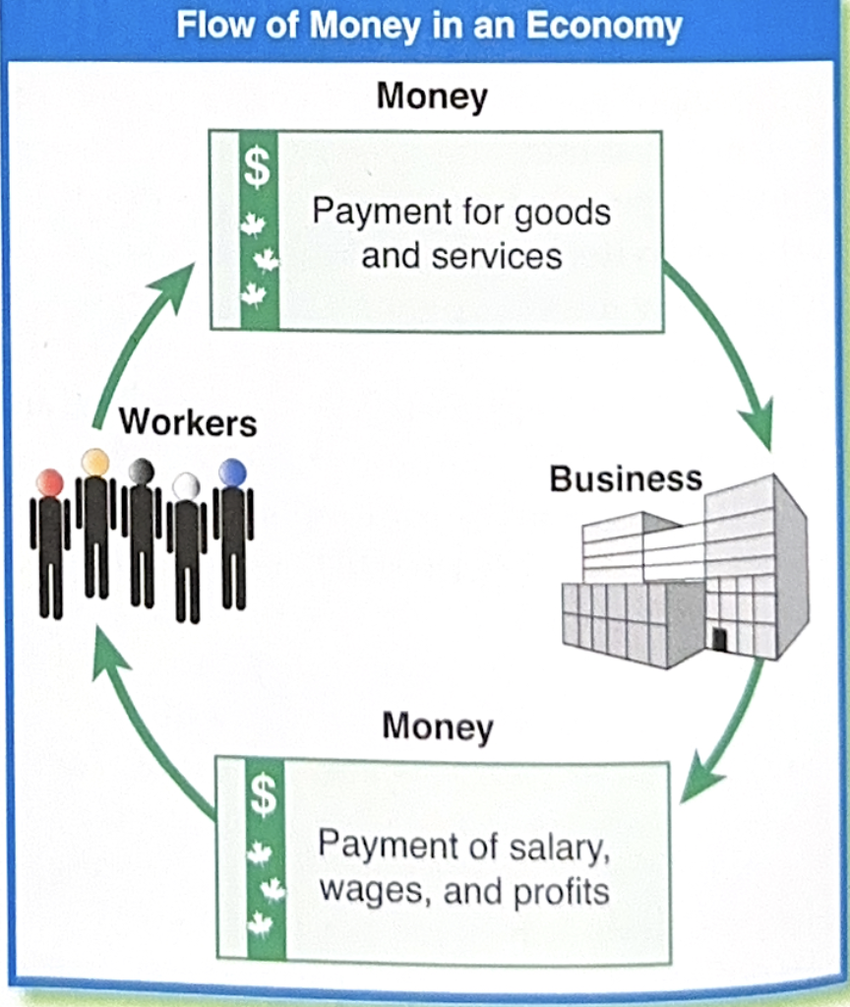

Slide 11
Making A profit
Main goal of business is to make a profit
Profit – money a business has left after all expenses and costs of the business are paid
How does a company make profit?
Satisfying the needs and wants of their customers

Slide 12
Forms of Business Ownership
Sole Proprietorship – business owned by one person
They have all the responsibility
They also have all the liability
Partnership – business owned by 2 or more people
Partners share responsibility and share in the profit
Liability is split between all partners

Slide 13
Forms of Business Ownership
Corporation – A legal entity that can buy property, run a business, manufacture products, earn money, lose money, sue and be sued.
The corporation is separate from the people who own it
The corporation holds all liability and responsibility in the business
Who owns a corporation?

Slide 14
Forms of Business Ownership
Corporations are owned by shareholders or stockholders
A stock or share is a piece of ownership in the corporation
The corporations sell stocks and shares and the people who buy them become shareholders

Slide 15
Not for Profit Organization
These organizations do not make a profit
The goal is to benefit society
Some goals include:
raise for money for medical research
Protect the environment
Social services
Recreation and Sport
Arts
Culture
Food and Health

Slide 16
Aboriginal Businesses in Canada
Approx 37 000 Aboriginal businesses in Canada and most are owned by Metis and First Nations People
Aboriginal businesses earn $1 billion dollars

Slide 17
The Functions Of Business
Businesses carry out 4 main activities
Production
Finance
Marketing
Management

Slide 18
Production
Any activity related to making a product (good, service or idea)
Production includes farming, mining, construction and manufacturing
This can also include work done at a tv station in preparing for a broadcast
For service based business, production is the actual service itself such as haircutting

Slide 19
Finance
MONEY MONEY MONEY
Finance includes all activities involving money
Planning is an important part of finance and people in the business are responsible for setting budgets
A budget is a spending plan
It helps make sure you have enough money to cover expenses
Accounting is a part of finance that handles paying bills, receving money and tracking all money that enters or leaves the business

Slide 20
Marketing
This part of the business focuses on the customer
Marketing includes selling, promotion, and learning about customers so you can develop products
Marketing also follows up with customers to see if what they like or dislike about products

Slide 21
Management
Includes all activates required to plan, organize, lead and control a business
Managers look at the big picture and lead workers to make changes to make the business better
Managers hire, train and supervise employees

