Slide 1
Unit 1: The Nature of Economics and the Economy
Chapter 1: Basic Principles of Economics
Chapter 2: Productive Resources and Economic Systems
Chapter 3: The Evolution of Economic Thought

Slide 2
Chap 2: Productive Resources & Economic Systems
Overview
Types of productive resources
Types of economic systems
How they answer production questions
Types of political systems and how they affect economic systems
The importance of economic goals
Canada’s economic goals

Slide 3
Decisions About Productive Resources
Chapter 1
How productive resources determine the production possibilities frontier
Chapter 2
How productive resources affect the basic production questions every economic system must answer
How different types of economic systems answer these production questions

Slide 4
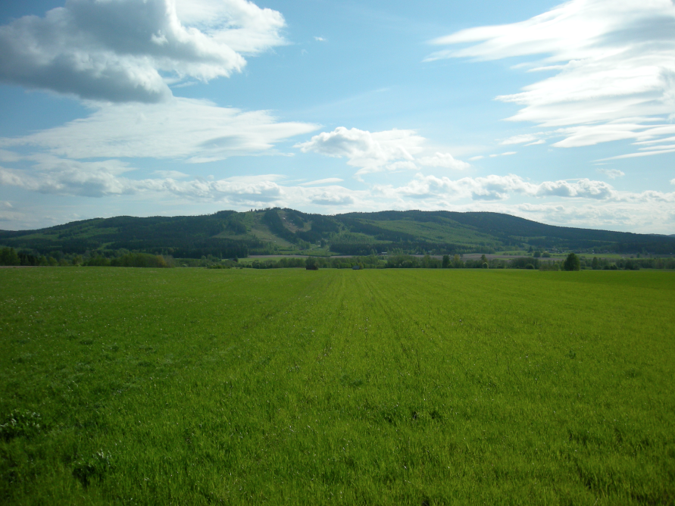
Types of Productive Resources
Land
Includes soil, as well as natural resources
Ex: minerals, groundwater, fossil fuels, forest reserves, etc.
Provides raw materials needed to produce goods and services

Slide 5
Types of Productive Resources
Labour
Includes all elements that human beings contribute to the production process
Physical effort, mental effort, entrepreneurship, knowledge, etc.
Entrepreneurship is the ability to organize economic activity, assume risks, and achieve efficient results.
The contribution that an owner, manager, or innovator makes to the production process

Slide 6
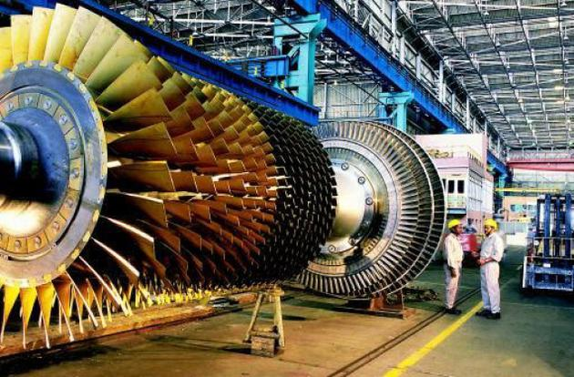
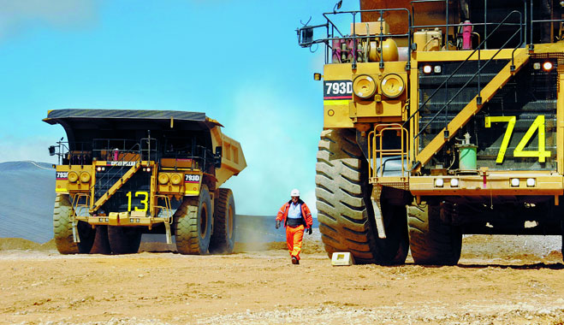
Types of Productive Resources
Capital
The goods that help in the production of other goods and services
Ex: factories, machinery, equipment, etc.
Real capital = goods
Money capital = funds (money)
Investment in real capital expands production and improves productivity

Slide 7
Tangible and Intangible Resources
Tangible resources
Can be seen and touched
Are easily quantified (measured)
Ex: Land, labour, and capital

Slide 8
Tangible and Intangible Resources
Intangible resources
Lack the physical properties that make them easy to quantify. You cannot touch intangible resources
Involve productive human contributions that go beyond the physical form of labour
Ex: Knowledge, entrepreneurship, and environment for enterprise

Slide 9
Intangible Resources
Entrepreneurship
Important because it directly affects national productivity
Knowledge
Important due to shift from manufacturing economy to information economy
The world is changing from a manufacturing economy to more information economy
Environment for enterprise
Involves examining a country’s social, cultural, political, and economic aspects to see if we should do business there

Slide 10
Economic Systems and Production Questions
What to produce?
How to produce?
For whom to produce?
An economic system is a set of laws, institutions, and common practices that help a nation determine how to use its scarce resources to satisfy as many of its people’s needs as possible.

Slide 11
The Traditional Economy
Families are responsible for production of the goods and services that they need.
What to produce?
Determined by needs of family
How to produce?
Parents teach children skills so they can assume parents’ roles and responsibilities
For whom to produce?
Families produce goods for their own use.
Surplus is traded to other families using bartering

Slide 12
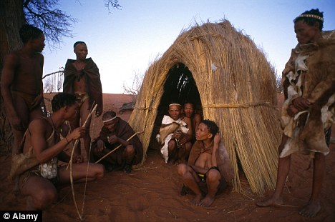
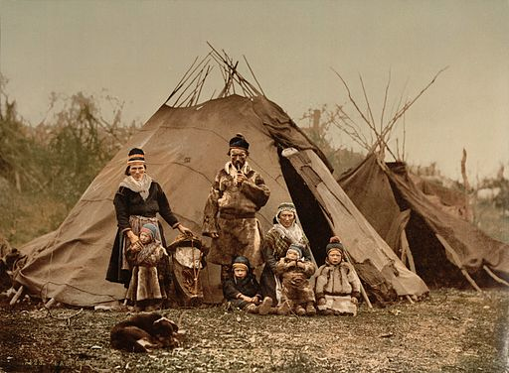
The Traditional Economy
When people lived in small rural communities, this was the most common economic system in the world.
There are still isolated environments where this economy can be found:
The Bushmen of the Kalahari Desert
The Lapps of the Scandinavian tundra
The Mebuti of the Africa rainforest
And several others

Slide 13
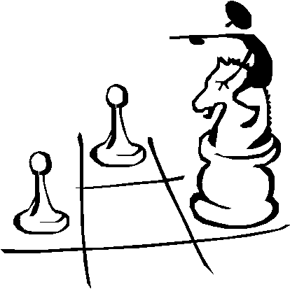
The Command Economy
All production decisions are made by a small group of political leaders who’s decisions are enforced throughout the entire economy
What, how, and for whom to produce is answered by the central authority based on what is in the best interest of the state.
Productive resources are owned and controlled by the state.

Slide 14
The Command Economy
Relies on system of reward and punishment to increase productivity
Emphasizes the production of capital goods over consumer good
Capital goods increase future production
Consumer goods are usually in short supply
Very few pure command economies exist today, with the most well known examples being Cuba and China

Slide 15
The Market Economy
Many individuals make independent production decisions in a free marketplace
What to produce?
Determined by consumer demand
How to produce?
The least costly and most efficient production methods are used to keep costs low
For whom to produce?
Determined by income levels

Slide 16
The Market Economy
Also called free enterprise, since people are acting for themselves, or private enterprise, because the resources are privately owned.
The basic elements are private property, freedom of enterprise, profit maximization, and competition,
Government only provides law and order and assists economic development
Very few pure market economies exist today, with the closest being Hong Kong and the United States

Slide 17
Canada: A Mixed Market Economy
Very few “pure” economic systems exist today for two reasons:
No single economic system is “the best”
Economic decision-makers try to integrate the best elements of each type into their own system
This hybridization of economic systems has resulted in mixed economies.
The Canadian economy is a perfect example of this

Slide 18
Canada: A Mixed Market Economy
The Canadian economy tries to integrate the best features of the 3 types of economic systems
Allows for state-owned or crown land (command), but it also allows land to be privately owned (market).
Offers many social programs (command), but also has free enterprise (market).
Bartering is also becoming a growing practice in Canada (traditional).
This is one example of what has come to be known as underground economy, or hidden economy.

Slide 19
Understanding Political Economics
Economic systems rarely exist today outside a political framework
Political models can be broadly classified as either democracies or dictatorships.
A democracy is a system where the government is elected by the people. It is open to many parties or political views. The people vote for their leaders in power. Government serves the citizens.
A dictatorship is a system in which a single person or party exercises absolute authority over an entire nation. There are no free elections to allow people to change their leadership.

Slide 20
Communism
All production and wealth are owned by the government
Private property and free enterprise are abolished.
It calls for a strong central government with complete authority to plan for maximum economic growth
Opposing political parties and special-interest groups (ex: labour unions) are denied any part in the decision-making process.
Communism has involved the use of force to achieve its goals
It occupies the extreme left wing of the political spectrum.
Communist systems currently exist in China, Cuba, North Korea, and Vietnam.

Slide 21
Socialism
Based on public ownership or control over production.
Uses democratic and peaceful methods to achieve goals.
Opposition parties are not banned.
Often called social democrats and occupy the moderate left position on the political spectrum.
Scandinavian countries (Norway, Sweden, Denmark, and Finland) use a system of “free-enterprise socialism” that has resulted in growing production levels and living standards.
Focuses on private enterprise balanced by socialist government policies that address collective needs (the nationalization of enterprise)

Slide 22
Capitalism
A democratically elected government maintains public order
Industry is privately owned and operated under free-market conditions
Producers are motivated to produce by profit.
Capitalism occupies the moderate right position on the political spectrum.
Capitalist systems operate today in Hong Kong, Singapore, the United States, and New Zealand.
Countries like Canada, Germany, France, Great Britain, and Italy have capitalist systems with some socialist characteristics

Slide 23
Fascism
Combines a free-market economy with a non-democratic, or authoritarian form of government
Citizens can own property and businesses as long as they comply with all government dictates.
Fascist governments use force as a means of political and social control
Does not allow political opposition
Occupies the extreme right position on the political spectrum.
Some historical examples of fascist systems include Italy during the Second World War and Nazi Germany.

Slide 24
Setting Economic Goals
Economic goals act as targets to focus the use of productive resources.
Some goals are complementary, that is reaching one goal makes another goal easier to achieve.
Some goals are conflicting, so that reaching one goal actually makes another goal more difficult to achieve.

Slide 25
Setting Economic Goals
Setting economic goals is a matter of normative, or policy economics
Governments must make value judgments before they can set priorities for conflicting goals.
Economic goals for countries are often similar
The way each nation prioritizes its conflicting goals determines how it distributes its productive resources.
The following goals have been set as priorities in the Canadian economy…

Slide 26
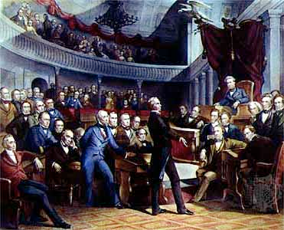
Political Stability
A stable government can help long-term planning and investment flourish.
Consistency in policy-making promotes investor confidence and provides a climate conducive to economic growth.
Ex: Each time we approach a sovereignty referendum in Quebec, confidence (both foreign and domestic) are shaken, and the Canadian economy suffers.

Slide 27
Reduced Public Debt
Public debt is the total debt held by federal and provincial governments accumulated from their past borrowings, on which interest must be paid.
When the public debt grows, interest rates rise, as do the prices of consumer goods, which negatively affect the economy.

Slide 28
Economic Growth
An increase in the economy’s total production of goods and services.
i.e. An outward shift in the economy’s production possibilities frontier.
Economic growth can be the result of:
The discovery of new natural resources
An increase in the skilled labour force
Technological innovations
More efficient production processes.

Slide 29
Increased Productivity and Efficiency
Maximizing productivity means that scarce productive resources are put to efficient and wise use in order to get as much as possible out of them.
Economic efficiency is often the result of healthy competition, as the companies with the most efficient practices will maximize profits, prevail in the marketplace, and set new standards for others.

Slide 30
Equitable Distribution of Income
The equitable, or fair, distribution of income is the most value-laden and controversial of all economic goals. There are so many interpretations of what makes a fair division of wealth.
In Canada, the issue is further complicated by regional differences.
Ex: Average incomes for Ontario are statistically higher than those in the Atlantic provinces. The federal government uses transfer payments, which is using revenues from one province to make additional social program payments in another, in an attempt to redistribute national wealth.

Slide 31
Price Stability
Stable prices generally indicate that an economy is healthy.
On the other hand, inflation (a general rise in prices) and deflation (a general fall in prices) are symptoms of an unhealthy economy.
Inflation erodes the dollar’s purchasing power and increases the cost of living.
Deflation is associated with periods of great economic crisis (ex: the Great Depression)

Slide 32
Full Employment
Sustained periods of high unemployment usually indicate a country in poor economic health.
An unemployed labour force results in total output levels well below the national production possibilities curve
Governments try to promote full employment (usually defined as between 6-7% of the labour force being unemployed) in order to reach their optimal production targets.

Slide 33
Viable Balance of Payments and Stable Currency
The balance of payments accounts summarize all currency transactions between Canadian and foreign economies, including importing, exporting, borrowing, and lending.
Imports and exports should roughly balance each other
Ex: More imports than exports will decrease employment rates and the foreign exchange value of the Canadian dollar
Money flows in and out of the country need to be balanced in order to foster a stable Canadian dollar in foreign money markets.

Slide 34
Economic Freedom
Economic freedom refers to the freedom of choice available to workers, consumers, and investors in the economy.
People should be free to choose when and how to consume, save, or invest their money.
In a market economy, consumers should be free not only to purchase the goods and service of their choice but also, through their purchasing decisions, to determine what goods and services are actually produced. This is known as the principle of consumer sovereignty.

Slide 35
Environmental Stewardship
Economic activity must be carried out without significantly harming the natural environment.
Problems can arise when environmental laws are set in Canada but not other countries.
Increases the price of Canadian products, making them less competitive
Raises a moral issue about trading with these countries, as they are contributing to environmental harm

Slide 36
Assignment
What are the 5 Economic Goals discussed in class? Explain each one. Which economic goal do you think is most important? Why?
After graduation, do you plan to continue your education, get a job, or travel? What are the opportunity costs of each alternative?
Create a comparison chart to show how different types of political economies make basic production decisions

