Slide 1
Chapter 3
Mr. Singh

Slide 2
Young Entrepreneurs
On a survey of 18-35 year old people, which profession was the most desirable?
Entrepreneur, film maker or artist, executive at a large company, teacher, lawyer, doctor, politician
Ranked 1st – Entrepreneur
Ranked 4th – Teacher

Slide 3
Challenges facing young entrepreneurs
Experience – People will invest and trust someone with experience
Knowledge – young people will not be as knowledgeable as someone who has been working in the field for years
No credit history
No collateral
No track record to pay off debt
Need a lot of help with paper work and administrative work known as red tape

Slide 4
The Value of Experience
Working part time, summer work, volunteer opportunities or school leadership positions are an asset to have
You can learn about:
Infrastructure
Develop a positive reputation in the industry
Build a network of contacts
Earn money you can save for the future
Learn firsthand about the industry

Slide 5
Setting Goals
Goal – The objective you wish to reach and the purpose of your work
Milestones and Steppingstones are important
These are small steps you achieve along the way
Ex. You want to graduate High School, your stepping stone is passing each grade
Goals should follow the SMART principle
Simple, Measureable, Achievable, Realistic & Timely

Slide 6
Setting Goals
Simple – goals should not be complicated. Simple and written down
Measurable – important because if its measurable you’ll be able to tell when you’ve reached it
Achievable and Realistic – If you set a goal for yourself and you don’t have the resources to make it happen, you are likely to fail.
Timely – Set target dates for achieving your goals and this will help you track and see if your on schedule.

Slide 7
Setting Goals
You may have goals that you set in your head or talk about with your friends
Goals can be financial goals, family goals, social goals, spiritual goals etc.

Slide 8
Edison or Einstein?
Thomas Edison invented the light bulb
He tried many different ways and hundreds of attempts until he got it
This is called incremental problem solving – trying many different ways to solve a problem
Albert Einstein developed the theory of relativity
His predictions were from out-of-the-box thinking rather than hands on experiments

Slide 9
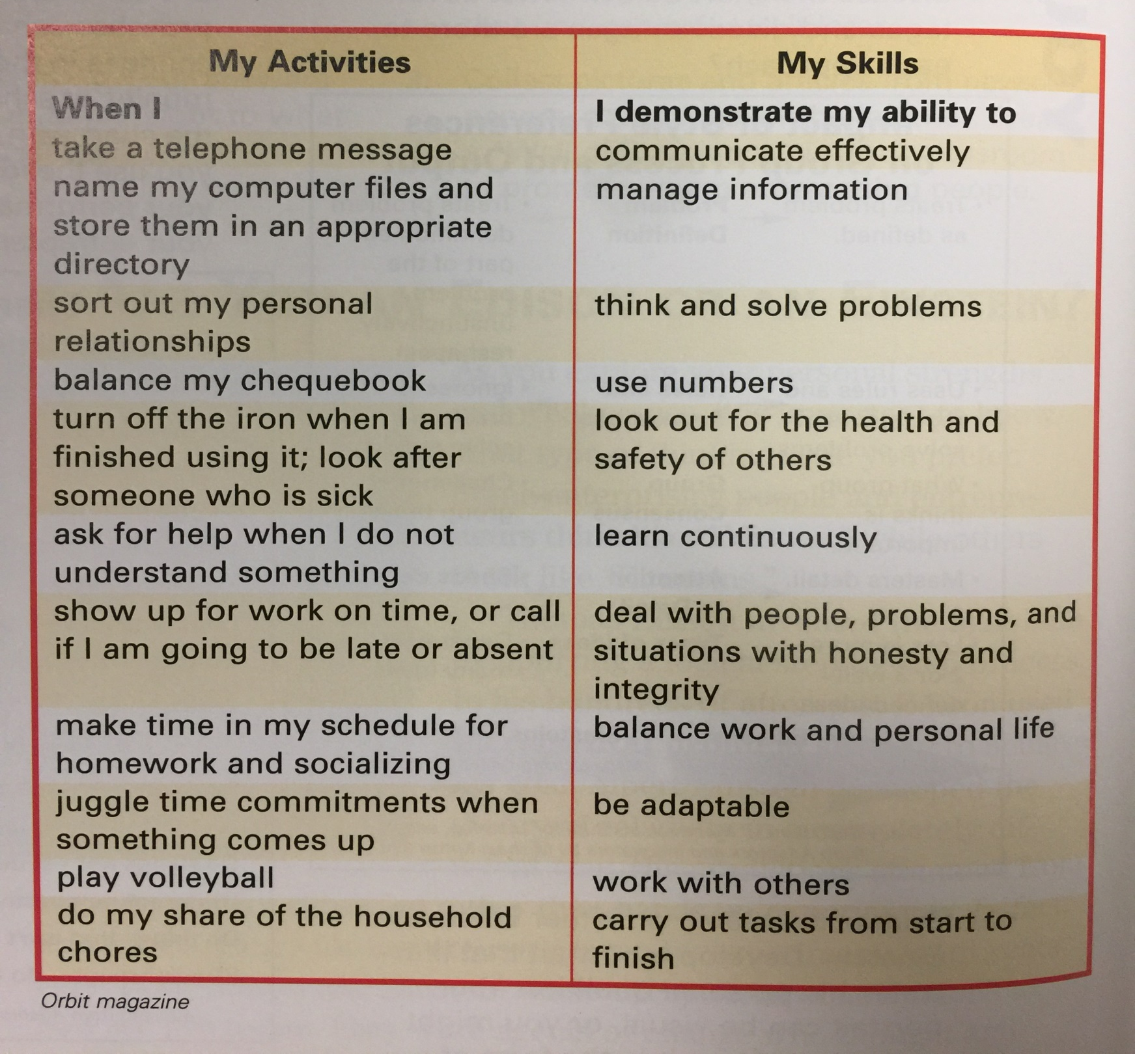

Slide 10
Interpersonal Skills
Being able to talk to others especially those different from you
Ability to listen and understand what others are saying
The ability to motivate and encourage others
Skills for negotiating and resolving conflicts
Caring for yourself and others

Slide 11
Critical and Creative Thinking Skills
Ability to solve problems by looking at a variety of different solutions or options
Having confidence to make decisions and act on it
Ability to set goals, plan to achieve them and carry out that plan
Ability to generate ideas and identify opportunities

Slide 12
Practical Skills
Being able to use special tools designed for a specific job
Working with digital media you’ll have to know to software, advance camera equipment, etc.

Slide 13
Strategies for Entrepreneurial success
Think first - got to plan!
Take the time to think before you do anything
See potential problems and beat your obstacles before they even happen
Believe in yourself – Be confident
Trust your abilities and set goals for improving your own performance

Slide 14
Strategies for entrepreneurial success
Know yourself – When planning take time to consider your own abilities, skills, and traits
Know what your weaknesses and strengths are so you know where you need work
Enjoy the challenge – for it to be worth it it’s going to be challenging
A venture will challenge your abilities and encourage you to be creative
When a problem arises, look at it as an opportunity rather than a threat

