Slide 1
Chapter 4: Demand and Supply
Mr. Singh
May 24 2016

Slide 2
The Market
The market is where we do business
4 distinct features in the market:
A market can be a physical place where products are bought and sold
The term market can be used to refer to all buyers and sellers of a particular good or service
A market can be the demand that exists for a particular product or service
The term market can describe the process by which a buyer and seller arrive at a mutually acceptable price and quantity

Slide 3
The Market
So a market can be a location, the network of buyers and sellers for a product, the demand for a product, or a price-determination process

Slide 4
Market Prices
Who determines what the price will be for the various goods and services in a market?
The market itself determines price by matching buyers and sellers of a particular product or service
Buyers want the price to be as low as possible, while sellers want the price to be high
They often agree on a price in the middle, but there can be wide fluctuations

Slide 5
Demand
Demand is the quantity of good or service that buyers will purchase at various prices during a given period of time
What the buyer wants!
Whether or not you have a demand for a product depends on two factors:
What you want to buy (what’s in your head)
What you can afford to buy (what’s in your wallet)
If you have both of these things, it is likely you will make the purchase

Slide 6
Demand and Price
Price is also an important factor to consider when thinking about demand
The quantity of the product that a customer will purchase depends on its price
The higher the price, the less it will be purchased; the lower the price, the more it will be purchased

Slide 7
Law of Demand
The law of demand: The quantity demanded varies inversely with price, as long as other things do not change

Slide 8
The Law of Demand
The substitution effect
As the price of the good rises, we tend to substitute similar goods for it, if possible
Ex: If the price of a name-brand soda rises, many people will buy cheaper no-name brands instead. Conversely, if the price of the name-brand soda falls, consumers will start to substitute the name-brand for the no-name soda, thereby increasing the quantity demanded for the name-brand type

Slide 9
The Law of Demand
The income effect
As the price of the good rises, buyers must pay more to receive the same amount. As a result, their real income has declined, and they buy less, thereby decreasing the quantity demanded.
Conversely, if the price of the good falls, buyers can buy the same amount for a lower price. This increases their real income, and they buy more, thereby increasing the quantity demanded

Slide 10
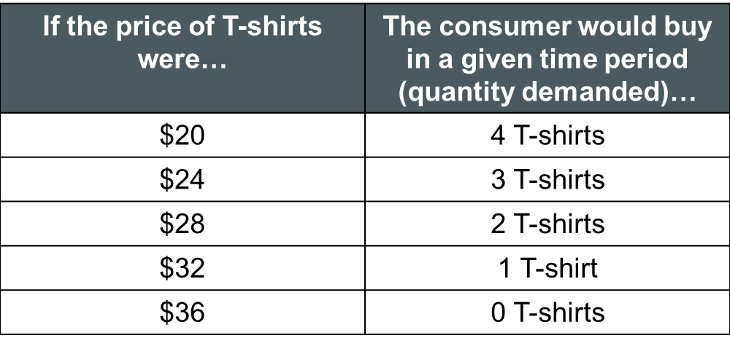
A Demand Schedule
Demand schedule: a numerical tabulation, usually organized into a table, of the quantities demanded at selected prices

Slide 11
Demand vs. Quantity Demanded
Quantity demanded refers to one relationship that is determined by price
Demand refers to all relationships determined by price (i.e. the entire demand schedule)
If we were to compare when T-shirts are $24 to when they are $28, we would say the quantity demanded has fallen by 1, not that the demand decreased by 1

Slide 12
Demand Curve
Demand schedules can also be graphed, with price on the y-axis and quantity demanded on the x-axis.
The resulting line is called a demand curve (even if it’s a straight line)
This inverse relationship between price and quantity demanded holds for the majority of goods we buy.
Price
Quantity Demanded

Slide 13
Market Demand
Up to this point we have only looked at the demand for T-shirts by an individual consumer
The buying habits of thousands of consumers decide the demand for most goods
The sum total of all consumer demands for a product is called the market demand schedule

Slide 14
The market demand schedule for T-shirts
Price of T-shirt | Buyer 1 | Buyer 2 | Buyer 3 | Buyer 4 | Total Quantity Demanded
$20 | 4 | 3 | 5 | 4 | 16
$24 | 3 | 2 | 4 | 3 | 12
$28 | 2 | 1 | 3 | 2 | 8
$32 | 1 | 0 | 2 | 1 | 4
$36 | 0 | 0 | 0 | 0 | 0

Slide 15
The market demand curve for T-shirts
$36
32
Price of T-shirt
28
24
20
0
4
8
12
16
20
Quantity demanded

Slide 16
Examining Supply
Supply is the quantities that sellers will offer for sale at various prices during a given period of time
As price rises, suppliers want to supply more, while consumers want to purchase less
Suppliers want to make a profit. If their costs of doing business remain unchanged, their profits will increase as the price of their product rises
They want to supply more of their product at higher prices because they can make more money
If prices fall, sellers prefer to supply less of their product because their profits will also fall

Slide 17
The Law of Supply
The law of supply: The quantity supplied will increase if price increases and fall if price falls, as long as other things do not change.
Unlike demand, where there is an inverse relationship between price and quantity demanded, quantity supplied is directly related to price

Slide 18
A Supply Schedule
Supply schedule: a numerical tabulation, usually organized into a table, of the quantities supplied at selected prices
If the price of T-shirts were… | The seller would like to sell in a given time period (quantity supplied)…
$20 | 0 T-shirts
$24 | 4 T-shirts
$28 | 8 T-shirts
$32 | 12 T-shirt
$36 | 16 T-shirts

Slide 19
Supply Curve
Supply schedules can also be graphed, just like demand schedules
The resulting line is called a supply curve (even if it’s a straight line)
Shows that suppliers supply less at lower prices and steadily increase quantity supplied as prices increase
Price
Quantity Supplied

Slide 20
Supply vs. Quantity Supplied
Supply refers to the whole series of price and quantity relationships
Quantity supplied refers to one relationship that is determined by price
If we were to compare quantities supplied when T-shirts are $24 to when they are $28 we would say that quantity supplied rose by 4 T-shirts, not that supply increased by 4.

Slide 21
Market Equilibrium
In the real world, the prices consumers pay and sellers receive are determined by the interaction of demand and supply
We can combine our two schedules for T-shirts so we can see how this occurs

Slide 22
Price at equilibrium for T-shirts
$36
Supply
32
Price of T-shirt
28
Equilibrium point
24
20
Demand
0
4
8
12
16
20
Quantity demanded

Slide 23
Market Equilibrium
When the price is set lower, the quantity demanded will higher than the quantity supplied, and a shortage will occur
The seller will raise the price since the shirts are selling so quickly
If the seller raises the price too high, the quantity supplied will be more than the quantity demanded, and there will be a surplus of shirts
The seller will have to lower the price to encourage consumers to buy.
$28 is the only price where no shortage or surplus occurs, so this price is the equilibrium price because there is not tendency for it to change
It is the only acceptable compromise between consumers who want the lowest prices possible and sellers who want the highest

Slide 24
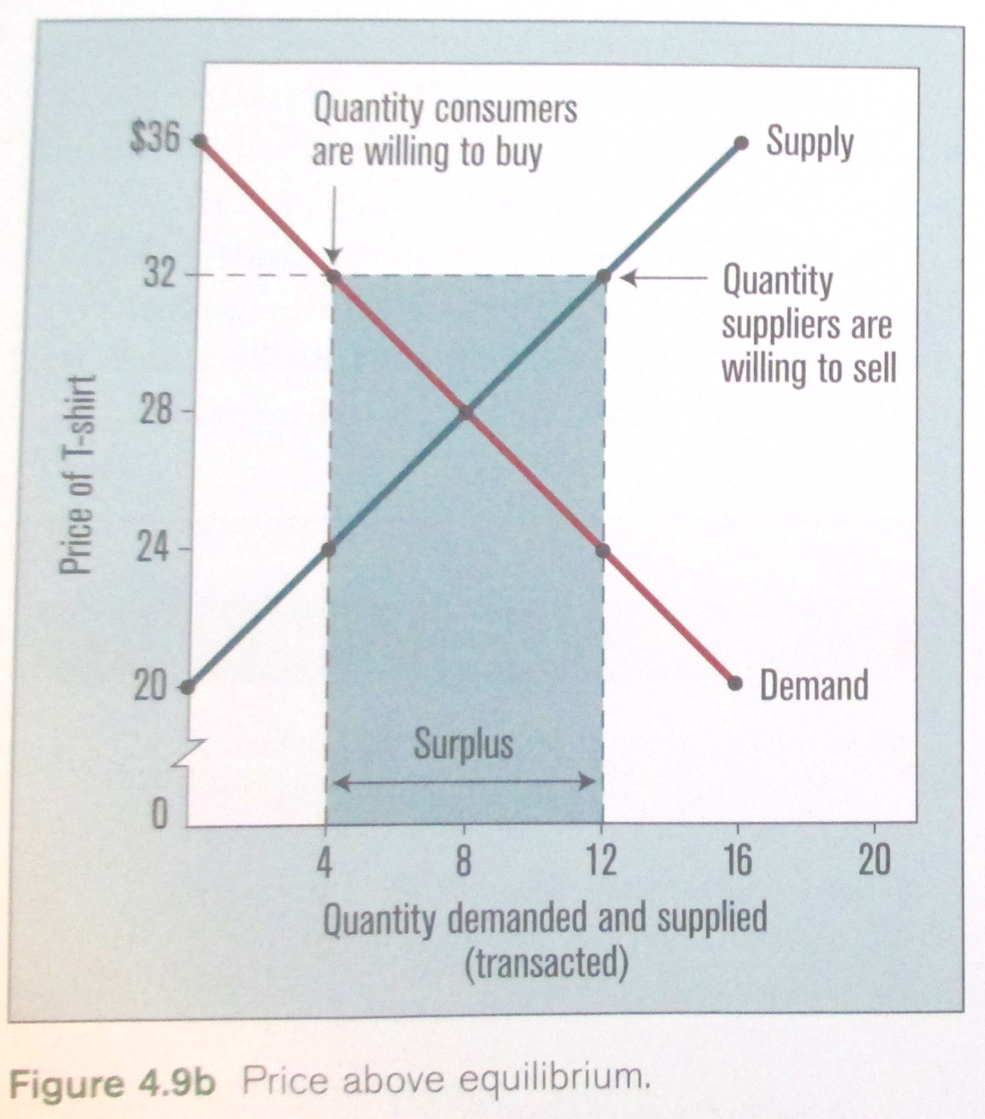

Slide 25
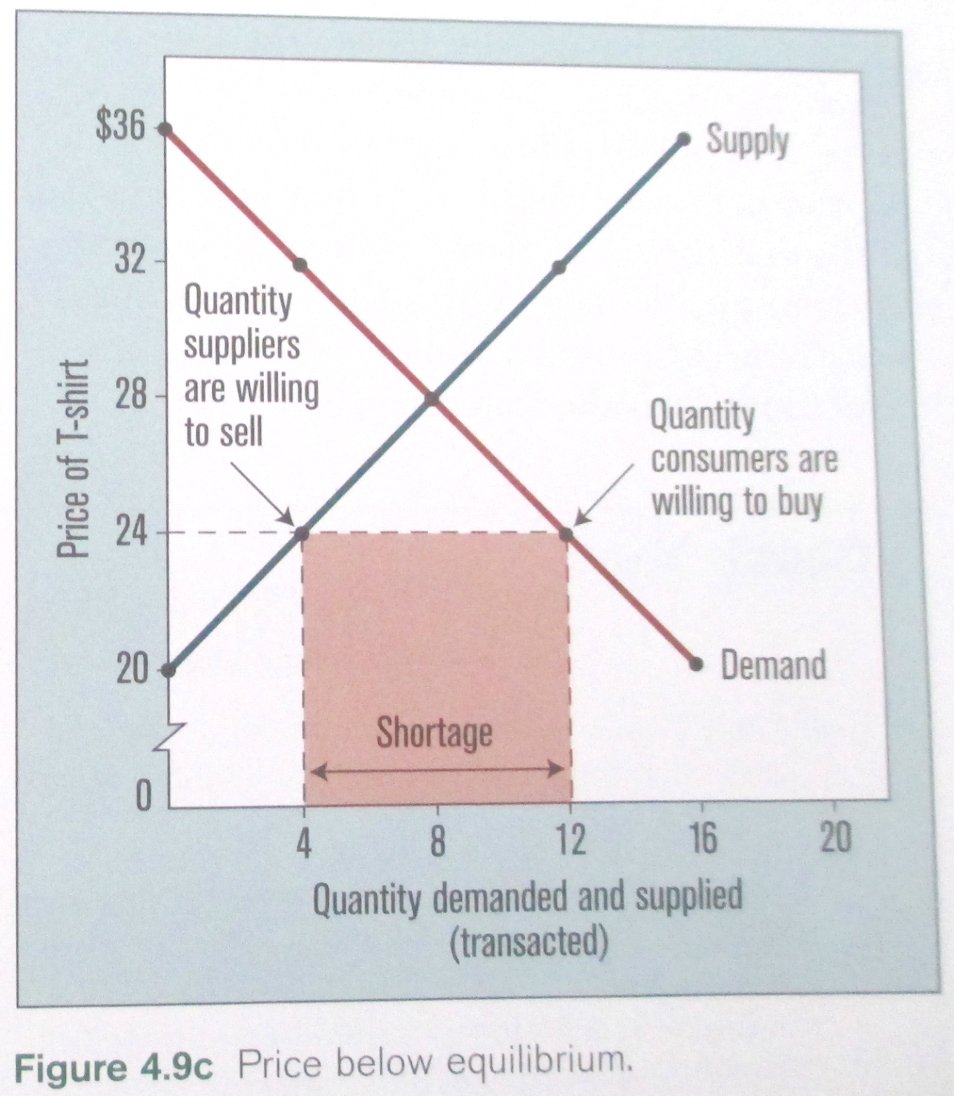

Slide 26
Prices and Market Equilibrium
By examining these graphs, we can draw the following general conclusion:
A price above equilibrium will result in a surplus of goods, while a price below equilibrium will result in a shortage of goods, as long as other things do not change.

Slide 27
Prices and Market Equilibrium
In the real world, where markets can consist of thousands or millions of buyers and sellers, the laws of demand and supply operate in the same way as we have seen them operate on a small scale with our T-shirt example
A price set below equilibrium by the sellers will result in many frustrated customers who are unable to buy the item in question. Some will start to offer more than the stated price. As they try to outbid each other, they will force the price to rise.
In contrast, a price set above equilibrium will result in many unsold goods. In this case, sellers will try to undercut each other by lowering their price.
This process will continue until the quantity demanded equals the quantity supplied, that is, until the market reaches equilibrium.

