Slide 1
Market conditions and business environments
Mr. Singh
BBI2O

Slide 2
demand
Demand – quantity of a good or service that your willing to buy
Law of Demand – When the market demands a high quantity of a good or service, the prices for that good or service will be high
When the market demands a low quantity, the prices will be low
Example: A new phone

Slide 3
demand
Consumers’ demand for a good or a service depends on a number of factors:
Price for good or service
Prices of substitute or complementary good
Consumers’ income
Their future expectations about either income or price
Their taste or desire for the good or service

Slide 4
demand
Consumer Behaviour
Consumers are likely to buy if they expect the price of a good or a service to rise soon
Also buy if they think an item will sell quickly
Consumers may wait if they think the price will go down
Also may wait if they think manufacturer will make a special offer
If enough people think the price is too high and they stop buying, demand will go down

Slide 5
demand
Price of Substitute good
A good that is easily replaced by another is called a substitute good
Ex. Coke & Pepsi, Butter & Margarine, Tea & Coffee
If the price for Coke increases, consumers would switch to Pepsi
Result → An increase in the quantity of Pepsi demanded and a decrease in the quantity of Coke demanded

Slide 6
demand
Price of Complimentary good
Two goods that are usually used with one another are called complementary goods
Demand for one of these products will affect the demand for the other
Ex. Cars & Gas, Printer & Cartridges, Pencils & Erasers
When the price of the pencils decreased and more people buy them, the demand for erasers will increase

Slide 7
demand
Consumer Income
The more money consumers have to spend, the higher their demand for goods and services will be
This also applies to communities and countries
As the level of income in a region or country increase, so does the demand for goods and services
When income decreases, demand decreases as well

Slide 8
demand
Taste and Preferences
What consumers like or choose also affects demand
Consumer trends (fitness & health) have influenced the demand for certain goods and services
Ex. Gym, fitness memberships, types of food etc.
Image also influences people’s choices (How?)
Advertising also influences consumes’ tastes (How?)

Slide 9
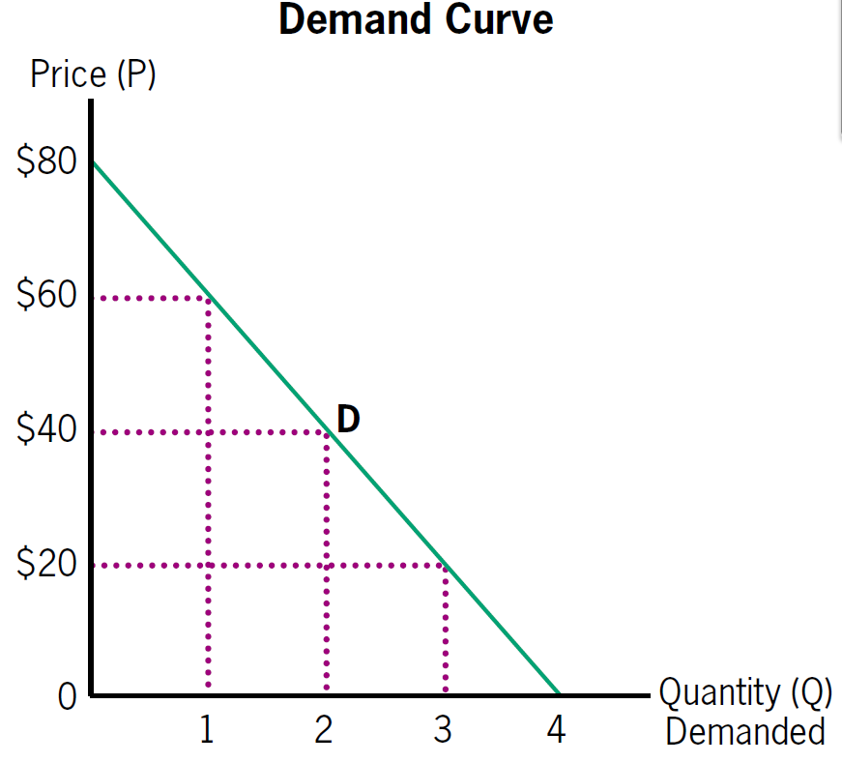
Demand curve

Slide 10
supply
Supply – quantity of goods and services that producers and sellers are willing or able to sell to consumers
Law of Supply – As prices rise, the quantity supplied by producers tends to increase
As prices fall, quantity supplied tends to decrease
Ex. Cell phone

Slide 11
supply
A producer’s decision to supply a good or service depends on:
The costs of producing the good or service
Changes in technology that affect costs
The producer’s desire to own and operate a business
Environmental and other conditions

Slide 12
supply
Production Costs
Let’s say we were a t-shirt company
We need to consider production costs on everything involving making t-shirts
Fabric, sewing machines, office equipment, hiring employees perhaps, etc.
Labour is one of the highest cost to a company because people don’t work for free
Even if you work on your own, you have to take money home at the end of the day

Slide 13
supply
Changes in Technology
Changes in technology and machinery also affect the supply of goods and services
Ex. T-shirts
How can changes in technology help us save money on our t-shirt business?

Slide 14
supply
Owner’s Desire
Sometimes the owners desire could lead to supply changes
Ex. Coach B Training
Registration is only open for a specific amount of time

Slide 15
supply
Environmental Conditions
If you’re in the farming or fishing industry, the environmental can affect your supply
What if there is not enough fish to supply the demand
What if winter is longer than normal

Slide 16
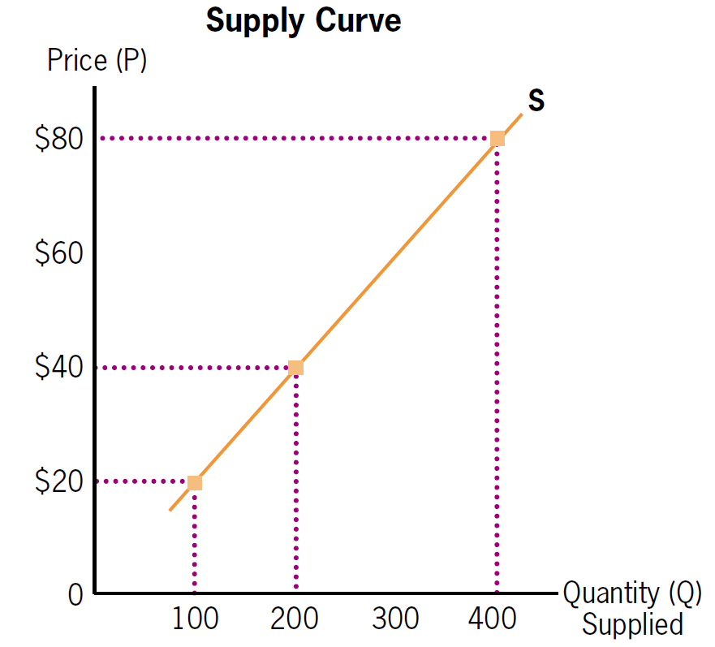
supply

Slide 17
Equilibrium
The point where forces of supply and demand are balanced and intersect
Demand tends to increase the price of a good
Supply tends to reduce the price of a good
When the two forces are in balance at the equilibrium prices are stable
Consumers can afford and are willing to buy a product at that price
Producers can afford and are willing to supply a product at that price

Slide 18
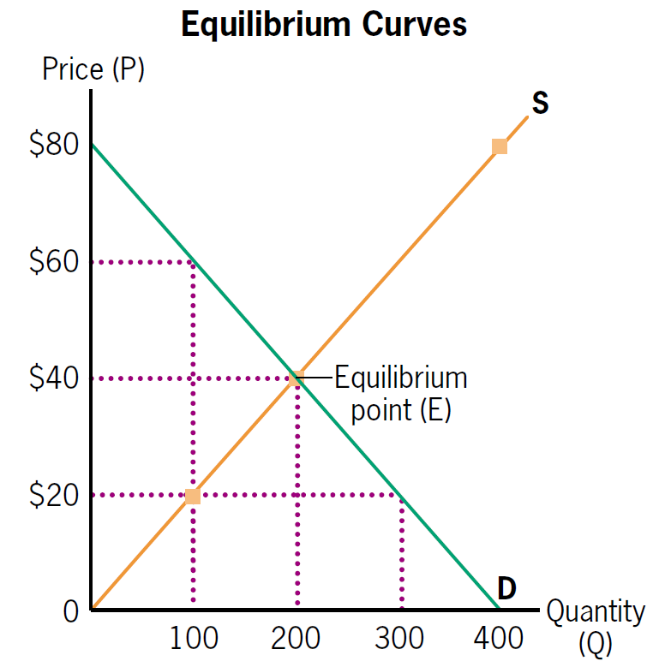
Equilibrium

Slide 19
Equilibrium
The point where forces of supply and demand are balanced and intersect
Demand tends to increase the price of a good
Supply tends to reduce the price of a good
When the two forces are in balance at the equilibrium prices are stable
Consumers can afford and are willing to buy a product at that price
Producers can afford and are willing to supply a product at that price

Slide 20
Equilibrium

Slide 21
The business cycle
Prosperity
Good economic times
Levels of employment are high
Workers are well paid
Businesses are spending more money on R&D
Businesses are expanding
Consumers are buying more products

Slide 22
The business cycle
Inflation
Prices tend to rise over time
Businesses are willing to increase quantity of goods and services they supply
Inflation also increases the cost of doing business
If wages do not go up at the same rate as prices, employees wont have enough money to buy the same quantity of goods and services
Then suppliers end up with unsold stock and lose money

Slide 23
The business cycle
Recession
Entire economy slows down and businesses are no longer creating as much profit
When business can no longer afford higher employees, unemployment increases
People stop spending money
People’s incomes are no longer keeping up with the standard of living
As demands drop, prices start to fall

Slide 24
The business cycle
Depression
If a recession lasts a long time, it may become a depression
Economic activity is very low and unemployment is very high
People can’t afford to buy things
Companies goes out of business
Demand for gov’t services is really high
Even when prices drop, people still can’t afford things

Slide 25
The business cycle
Recovery
Economy starts to improve
Manufacturers slowly begin production again
Unemployment is still high until businesses feel confident enough to hire employees
Slowly as more people are hired, consumers start spending money slowly again
Economy gets healthier but it’s a slow process

Slide 26
Competition
Competition is a rivalry among suppliers of a good or service
Fewer suppliers often mean less choice = higher prices – Consumers lose
If a big store cuts prices significantly, smaller stores will find it hard to compete
How does quality affect competition? Tim Hortons? Canada Goose?

Slide 27
Consumer protection
In Canada, the provincial and federal gov’t try to protect consumers
Consumers have rights
Competition Act – Federal law that governs advertising and business practices
Anyone who violates it may be prosecuted in criminal court
They could be fined or even go to prison

Slide 28
Consumer protection
False Advertising
You cannot make an untrue statement about a product or service
Ex. All real leather couch (Could be fake leather?)
Misleading Advertising – Distorts the truth about the goods being offered so that you’re led to believe one thing when it’s not true
False Sales price – Marks products up and then puts them on sale at regular price

Slide 29
Consumer protection
LAWS
1. Price Fixing
Not allowed to decide as a group what to charge consumers for a specific product
But businesses can copy prices

Slide 30
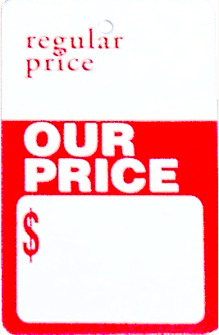
Consumer protection
LAWS
Retail Price Maintenance
Can’t force another company to charge a certain price for a product you provide
A company can suggest a price (Manufacturer’s Suggested Retail Price or MSRP)

Slide 31
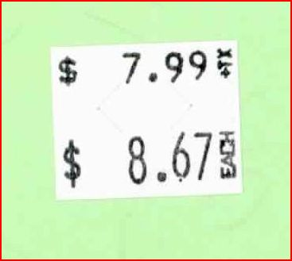
Consumer protection
LAWS
3. Deceptive Pricing Practices
Double Ticketing – In Canada, it is illegal to charge a higher price if two prices appear on a product
Bait & Switch Pricing –Cannot advertise a sale price and then attract a customer to a more expensive product
Predatory pricing is the practice of charging very low prices in order to reduce competition

