Slide 1
Chapter 7: Pricing
Mr. Singh

Slide 2
7.1 DETERMINING THE PRICE
2 key factors that determine price:
1. Cost of doing business
2. Profit that a company hopes to make
Break-Even Analysis (First Step)
How many units must be sold at a given price to cover costs
This is a starting point for setting the actual price

Slide 3
7.1 DETERMINING THE PRICE
Variable costs
Depends on the # of goods or services rendered
Ex: Materials needed to make a product
Ex: Labour – amount of people you hire to get a job done
Fixed costs
Constant, independent of sales or other variables
Ex: rent, insurance, salaries, etc.

Slide 4
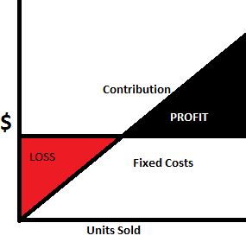
7.1 DETERMINING THE PRICE
Gross Profit/Contribution Margin
The selling price minus the variable cost
Ex: discussed in class
Breakeven Point:
Breakeven Point (BEP) = fixed costs / gross profit
# of units that need to be sold to break even

Slide 5
7.1 DETERMINING THE PRICE
Break-Even Point
Ex: Nemesis Sports sells basketballs to retailers like Sports Check for $20. Cost of a ball is $10. Company has a fixed cost of $100 000. What is the break even point?
Answer:
Gross Profit = selling price – variable costs
Gross Profit = $20 - $10 = $10
BEP = 100 000 / $10 = 10 000 balls
What does this mean? Discussed in class

Slide 6
7.1 DETERMINING THE PRICE
Break Even Point Cont’d
The company has decisions to make
⬇ variable costs to ⬆ gross profit and ⬇ break even point
⬆ selling price to ⬆ gross profit and ⬇ break even point
⬇ selling price to increase demand – higher sales mean we can reach break even point faster
⬇ fixed costs to ⬇ break-even point

Slide 7
7.1 DETERMINING THE PRICE
Economies of Scale
The more products a company makes, the lower the cost of production
Example discussed
in class

Slide 8
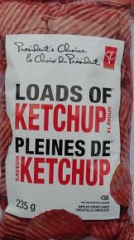
7.1 DETERMINING THE PRICE
FOUR pricing strategies dependent on economies of scale:
1. Developing Products for Private-Label Companies
Same potato chips
Brand name – higher price
Store-brand name – lower price
2. Creating a Barrier to Entry (low pricing)
3. Creating New Brands
4. Merging with Competitors

Slide 9
7.1 DETERMINING THE PRICE
What are the 5 most common pricing mistakes?

Slide 10
5 MOST COMMON MISTAKES
Price War – slashing prices because competitors are doesn't always work
Lost Value – If a cost or service is not factored into a price
Cost-Based Pricing – Better to have a markup based on the value received by the customer (not cost)

Slide 11
5 MOST COMMON MISTAKES
Underpricing Your Service – May cause too much demand that cannot be met
The Psychology of Price
Image may dictate pricing
Convenience for the consumer can be created (Ex: total comes to $5 rather than $5.09)

Slide 12
7.1 DETERMINING THE PRICE
What are some fixed and variable costs of your daily life?
What is the biggest problem with a business being too big?

Slide 13
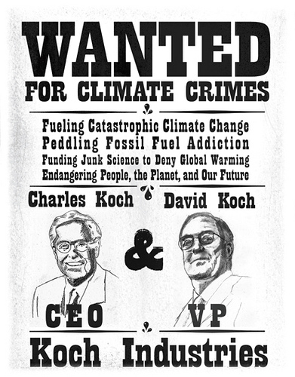
7.2 Factors Affecting Price
LAWS
1. Price Fixing
Not allowed to decide as a group what to charge consumers for a specific product
But businesses can copy prices

Slide 14
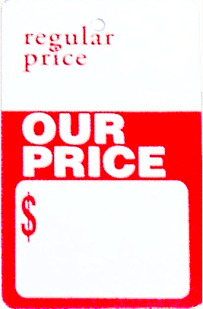
7.2 Factors Affecting Price
LAWS
2. Retail Price Maintenance
Can’t force another company to charge a certain price for a product you provide
A company can suggest a price (Manufacturer’s Suggested Retail Price or MSRP)

Slide 15
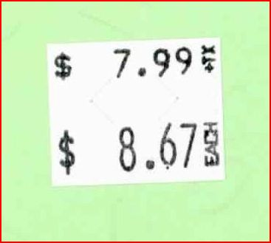
7.2 Factors Affecting Price
LAWS
3. Deceptive Pricing Practices
Double Ticketing – In Canada, it is illegal to charge a higher price if two prices appear on a product
Bait & Switch Pricing –Cannot advertise a sale price and then attract a customer to a more expensive product
False Sale Price – Marks products up and then puts them on sale at the regular price

Slide 16
7.2 Factors Affecting Price
Product Positioning
Premium Pricing – businesses use this type of pricing if its positioning itself as a premium product
Ex. Mercedes, Prada, etc.
Consumers believe that a higher priced product will be better quality even if the cost to make the product is low
Starbucks – Sell coffee that’s relatively the same as other shops but priced higher

Slide 17
7.2 Factors Affecting Price
Discount Pricing – This is a reduction in price from what the consumer would regularly pay for a product
If a retailer maintains very low fixed costs & then its possible for them to sell at low costs

Slide 18
7.2 Factors Affecting Price
Consumer Demand
When pricing your product, you must consider what the consumer is willing to pay for it
If you have a product that not many other places have, you may be in a position to raise your price
Don’t always stick to a formula because sometimes consumers will pay more than the formula suggests

Slide 19
7.2 Factors Affecting Price
Competition
If there are stores that have the same product as you, you may have to price accordingly
If your price is too high you may lose business unless you can prove that your quality is much better than your competitors

Slide 20
7.3 Pricing Strategies
Most businesses develop a pricing strategy
A plan to price a product to achieve specific marketing objectives
There are 3 possible pricing strategies:
1. Market Skimming
2. Penetration Pricing
3. Competitive Pricing

Slide 21
7.3 Pricing Strategies
If you enter the market first you have a window of opportunity
Market Skimming is setting an initial high price for a product or service before competitors enter the market
Because there is no competition, businesses want to reach that break even point quickly
Then the business can lower the price when competitors enter the market

Slide 22
7.3 Pricing Strategies
Penetration pricing is initially setting a low price for a new product or service to attract customers
Can be effective but very risky
If you set your price too low, it will take you longer to reach that break even point
If competition enters the market, and your price is too low, it will be harder to make profit

Slide 23
7.3 Pricing Strategies
Usually competitors follow a leader who sets the benchmark price (aka customary price) which is the standard price
The leader is usually the biggest business but it could also be whoever was first to come out with the product
Ex. Tim Hortons sets a benchmark price for coffee

Slide 24
7.3 Pricing Strategies
Competitive Pricing
Most popular pricing strategy
Products in a particular category match or follow the price of their competitors very closely
With this strategy, selling your product becomes more about advertising and promotion, distribution and unique product features

Slide 25
7.4 – Pricing Policies
Leader pricing
Offering a popular product at a low price to attract customers to the store.
Price Lining
Putting all the products that are one price in one place in the store.
Everyday Low Prices
Stores use sale pricing to position themselves as low-priced stores. They guarantee the customer that the price they pay in the store is the lowest price available.

Slide 26
7.4 – Pricing Policies
Purchase Discounts
Price reductions in goods and services offered by the seller to the buyer to increase the volume of an order
Super Sizing
Paying a slightly higher price for a larger portion of an item.
Premium Prices
Use a high price where there is a uniqueness about the product or service. This approach is used where a substantial competitive advantage exists.

Slide 27
7.4 – Pricing Policies
Interest-Free Pricing
Offering consumers the opportunity to finance their purchase with low or no interest charges for the extent of the contract.
Negotiated Pricing
A buyer makes offers to purchase and a seller makes offer to sell a particular product or service for less than the published price

Slide 28
7.4 – Pricing Policies
Combo Pricing (bundling)
Sellers combine several products in the same package. Offering a customer a deal on a part of the sale but make a large profit on the other part
Psychological Pricing
Using typical consumer behaviour to set prices.
Selling a product for$9.99 instead of $10
Return on Investment (ROI)
Prices products to sell them quickly and then invests the money made

