Slide 1
CHAPTER
9
Depreciation of Fixed Assets

Slide 2
CAPITAL ASSETS
Fixed/Capital assets are long-lived assets that are used in the operations of a business and are not intended for sale to customers.
Capital assets are recorded at cost in accordance with the cost principle.
Cost consists of all the list price plus tax if applicable

Slide 3
Depreciation/Amortization
Depreciation is the process of allocating to an expense account the cost of a capital asset over its useful (service) life in a rational and systematic manner.
Cost allocation is designed to provide for the proper matching of expenses with revenues in accordance with the matching principle.
During an asset’s life, its usefulness may decline because of wear and tear or obsolescence.
Land is the only capital asset that is not depreciated.

Slide 4
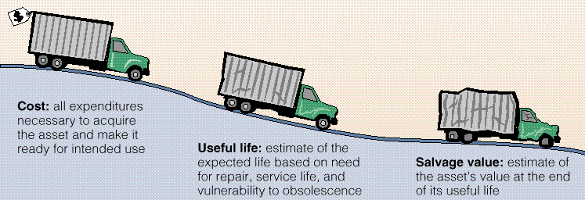
FACTORS IN CALCULATING depreciation
Illustration 10-6

Slide 5
DEPRECIATION METHODS
Three methods of recognizing amortization are: 1. Straight-line, 2. Units of activity, and 3. Declining-balance. Each method is acceptable under generally accepted accounting principles. Management selects the method that is appropriate for their company. Once a method is chosen, it should be applied consistently.

Slide 6
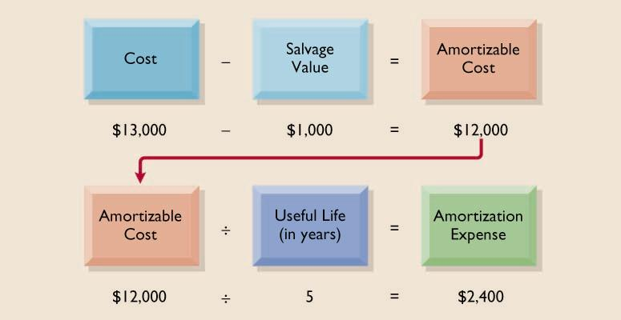
STRAIGHT-LINE METHOD

Slide 7
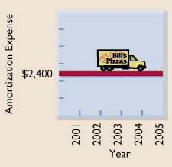
STRAIGHT-LINE METHOD
depreciation is constant for each year of the asset's useful life

Slide 8
DECLINING-BALANCE METHOD
The calculation of periodic depreciation is based on a declining net book value (cost less accumulated depreciation) of the asset.
The depreciation rate remains constant from year to year, but the net book value to which the rate is applied declines each year.
Net Book Value (at beginning of year)
Net Book Value (at beginning of year)
Net Book Value (at beginning of year)
Revenue Canada’s Rate
(p345)
Revenue Canada’s Rate
(p345)
Revenue Canada’s Rate
(p345)
Depreciation Expense
Depreciation Expense
Depreciation Expense

Slide 9
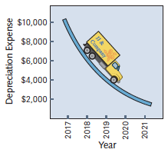
Diminishing-Balance Method
Depreciation expense based on asset’s diminishing carrying amount (cost less accumulated depreciation)
Depreciation rate remains constant, but depreciation expense declines each year

Slide 10
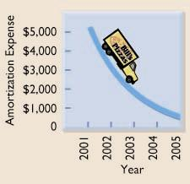
DECLINING-BALANCE METHOD
Accelerated methods result in more depreciation in early years and less in later years

Slide 11
UNITS-OF-ACTIVITY METHOD
To use the units-of-activity method,
1) the total units of activity for the entire useful life are estimated,
2) the amount is divided into amortizable cost to calculate the amortization cost per unit, and
3) the amortization cost per unit is then applied to the units of activity during the year to calculate the annual amortization.
Total Units of
Activity
Amortized Cost
Amortizable
Cost per Unit
Units of
Activity during the Year
Amortizable
Cost per Unit
Amortization Expense

Slide 12
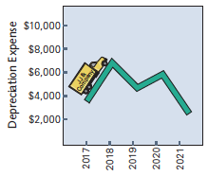
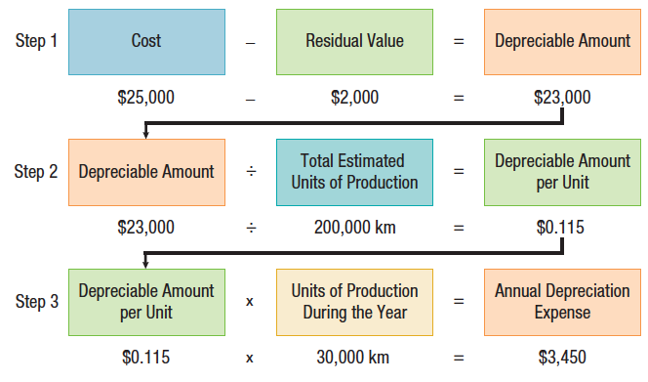
Units-of-Production Method
Useful life expressed as total units of production or activity
Must estimate the total units of production that will be obtained from asset

Slide 13
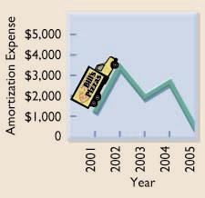
UNITS-OF-ACTIVITY METHOD
Useful life is expressed in terms of total units of production or activity expected from the asset

