Slide 1
Community
Ms Levy

Slide 2
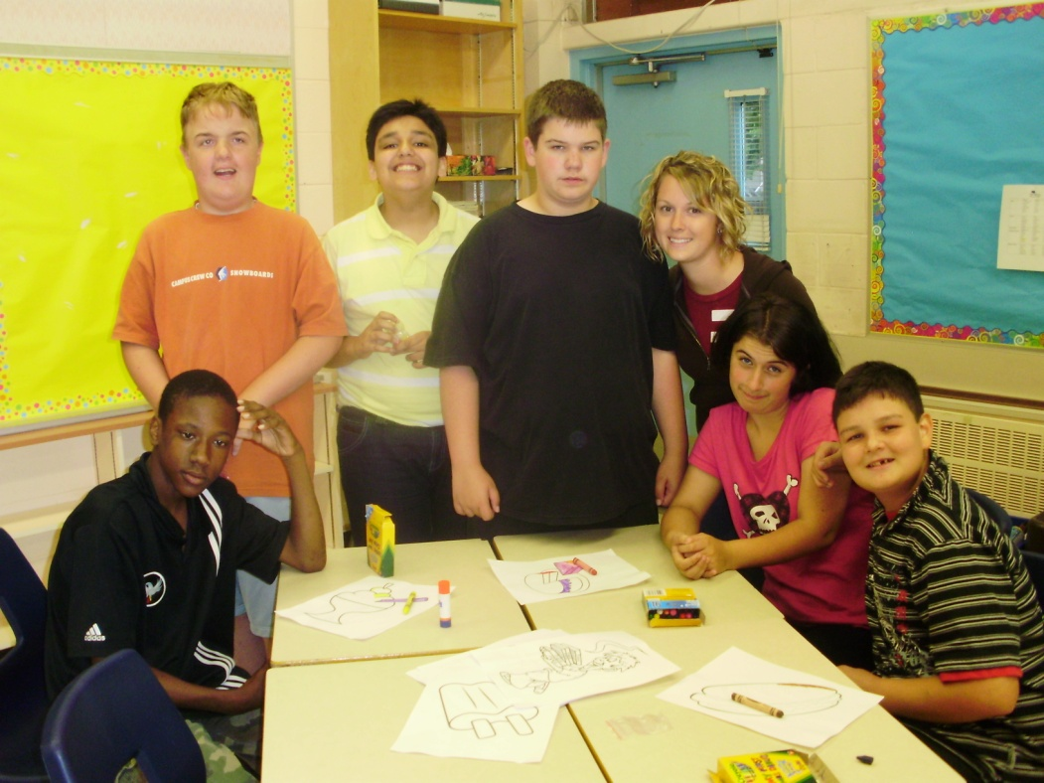
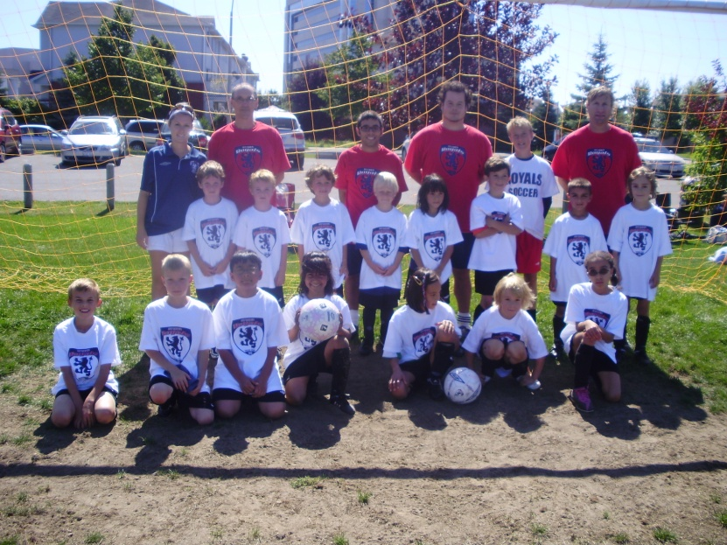
What is a community?
A group of people who have joined together to pursue common needs and goals.

Slide 3
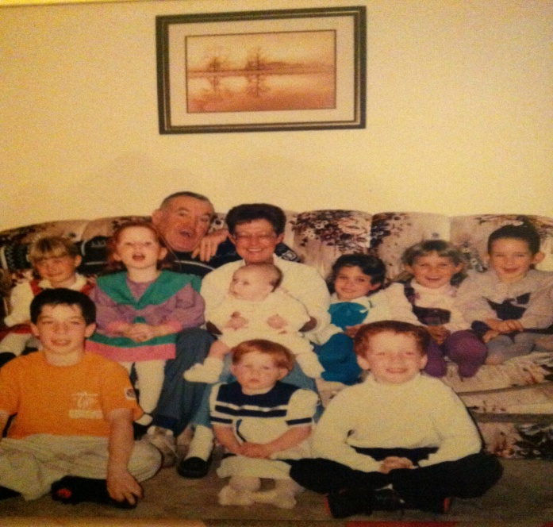
We are family!
Could you survive alone?
Since the beginning of human existence, people have chosen to live together in communities.
Why?
To deal with the challenges that threaten our survival!
Food
Clothing
Shelter
Security
Companionship

Slide 4
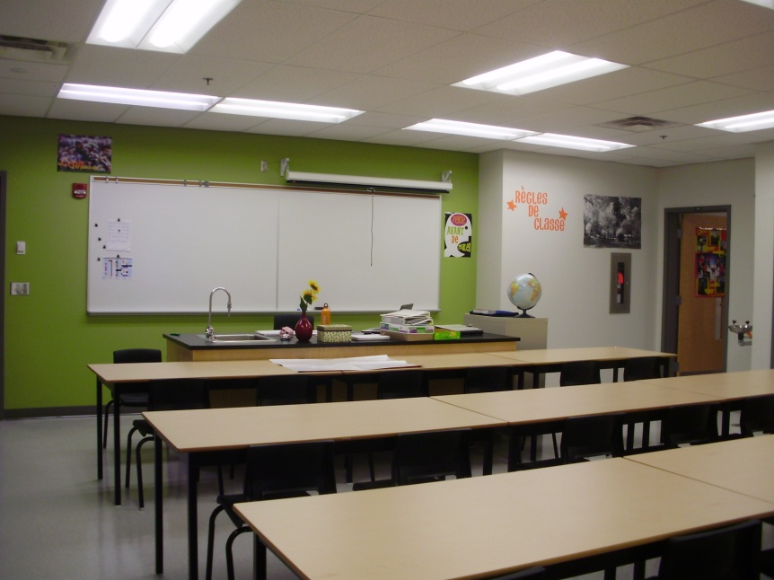
The Give and Take of Community Living
Positives:
Negatives:
Safety
Security
Support
Common good (beliefs, values, bylaws etc)
Give up personal preferences
Accept routines
Follow rules that we don’t always fully understand or appreciate
Social trade-offs – sacrifices to achieve other things (ex. Noise bylaws)

Slide 5
Community unrest
Communities are full of different personalities, interests and viewpoints.
My community activity (see handout)
Pick someone you don’t know in the class and take a minute to tell them about one of your communities.
Answer the following questions after you had your discussion:
1. What are some of the values that this community builds itself on?
2. Do you feel like you would fit into this community? Why? Why not?
3. Were you interested in being a part of this community? Why? Why not?

Slide 6
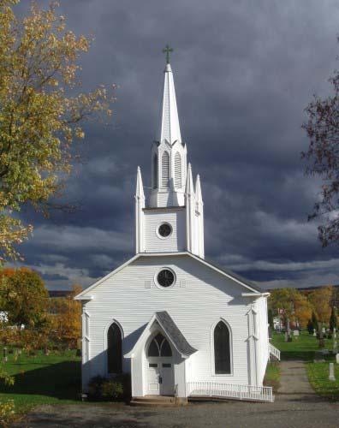
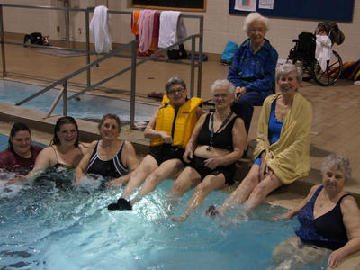
Examples of communities:

Slide 7
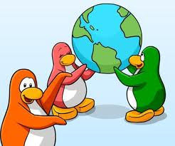
What is citizenship?

Slide 8
More than just a resident or inhabitant......
A citizen has responsibilities to the community or group.
IN RETURN FOR:
The community providing specific responsibilities to its members.
Civics is the study of how a society chooses to find a balance between individual freedom and collective needs and goals.
- peace
-security
-order
-responsible government

Slide 9
Civics also studies how decisions are made about public issues or concerns
Individual
family
Friends
School/work
Neighborhood
Religions groups
Teams/Clubs
City/town/Village
Province
Nation
World

Slide 10
How to ensure effective community living?- Can’t we all just get along??
Members must live by the same rules!
Although many rules are unwritten and based on tradition, they still must be followed. (ex. It does not say that all students must push in their chairs at the end of each class, however the classroom community traditionally does so and appreciates when this is done)
The most important rules or complicated ones are recorded into a code or law or behaviour.
Communities hope these will be practised, ideally without force!

Slide 11
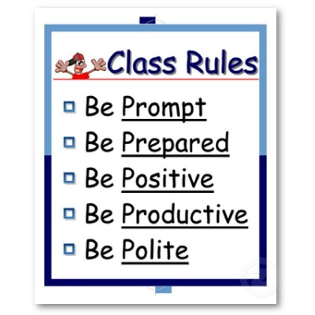
These rules often include:
How members are to treat one another
How duties and chores will be divided among the group
How disputes will be settled
How offenders will be dealt with
How the group will pursue its goals and ensure its future

Slide 12
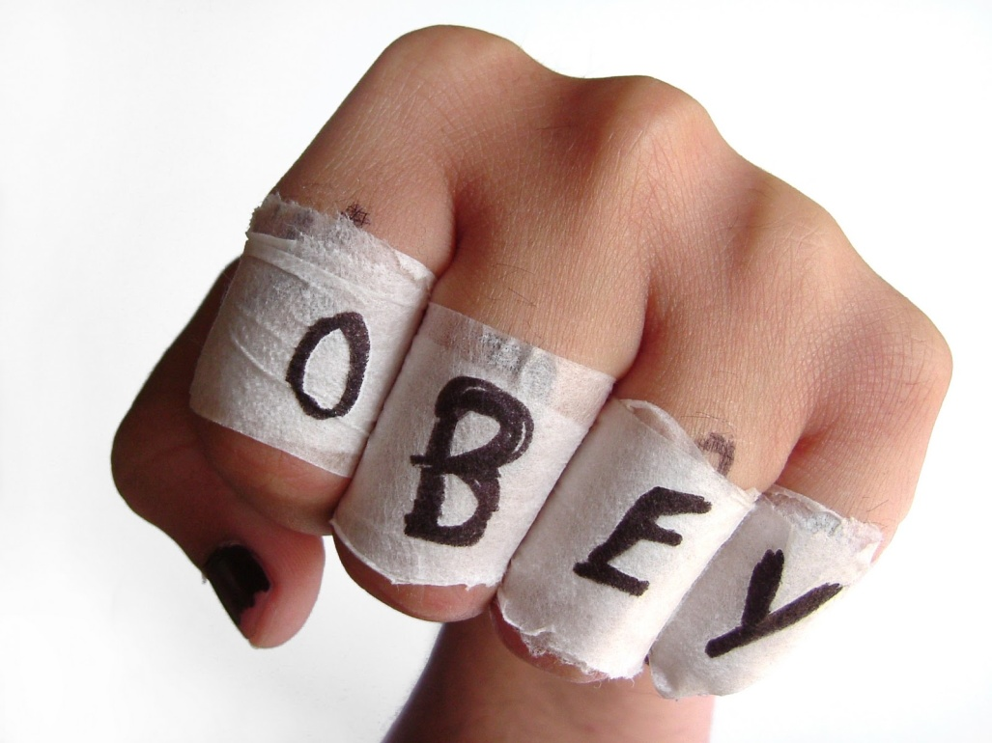
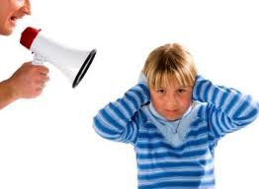
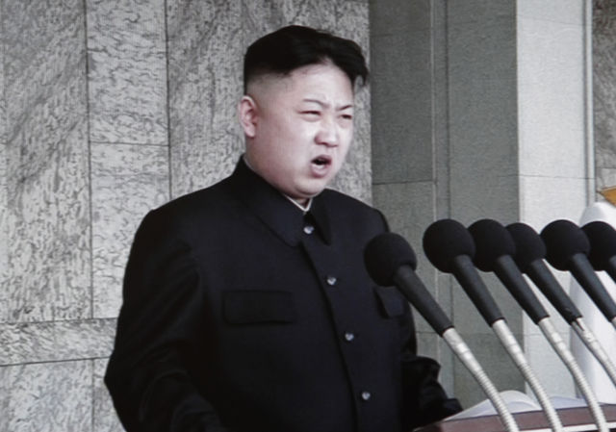
CONFLICT ARISES WHEN.....

Slide 13
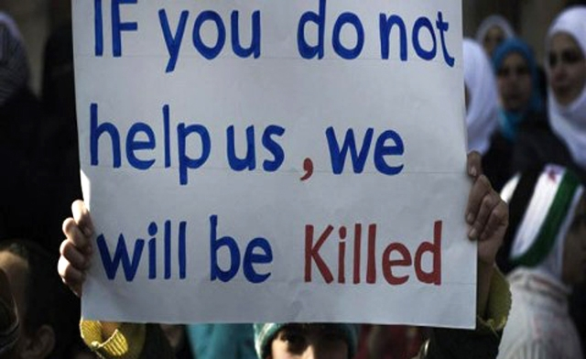
How you can make a difference!
Spend 5 minutes brainstorming about a conflict or issue that bothers you.
Something you feel is unjust. Where peoples voices aren’t being heard by their communities.
Ex. School dress code, curfew, attending a religious ceremony, people in Syria, War in the Middle East, deforestation, no more coke in the vending machines, child soldiers, elderly abuse, animal cruelty, Aboriginal education etc.

