Slide 1
Computer Hardware
Mr. Singh
ICS2O

Slide 2
Terms
Motherboard
CPU
Memory (RAM)
Hard Drive
Video Card
Network Card
Sound Card
Solid State vs. Spindle State Hard Drive
Input/Output Devices

Slide 3
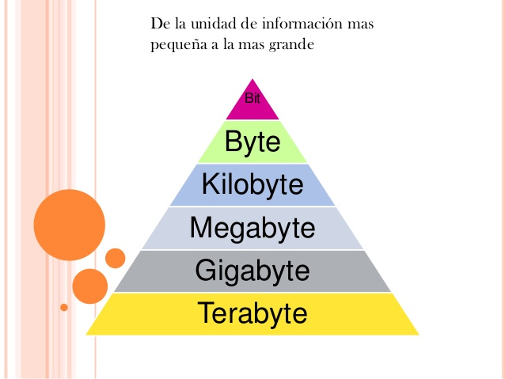
KB/MB/GB/TB

Slide 4
KB/MB/GB/TB
So how many Bytes in 1 MB?
Each Megabyte has 1000 Kilobytes
1 * 1000 = 1000 Kilobytes
Each Kilobyte has 1000 bytes
1000 * 1000 = 1 000 000 bytes
So how many Megabytes in 1.5 Terabytes?
1.5 * 1000 (into G) * 1000 (into M) = 1 500 000 Megabytes

Slide 5
Hardware
Case
Motherboard
CPU
Memory (RAM)
Hard Drive
Video Card
Network Card
Sound Card

Slide 6
The Hard Drive
The biggest place to store information
The only place that keeps that information when powered off
500 GB
7200 RPM 16MB Cache
SATA 3.0Gb/s

Slide 7
The Hard Drive
Two physical sizes
3.5’’ – Desktop
2.5’’ – Laptop
3 speed types
5400 RPM
7200 RPM
Solid State

Slide 8
CPU – Central Processing Unit
The brain of the computer
The part of the computer that:
Does calculations
Moves data around (into and out of memory)
Sends requests to other devices

Slide 9
RAM – Random Access Memory
The temporary working area where data and programs are stored, that have either recently been used or are currently being run
Much faster to read and write to than the other kind of storage in a computer
RAM can be compared to a person’s short-term memory and the hard disk to the long-term memory

Slide 10
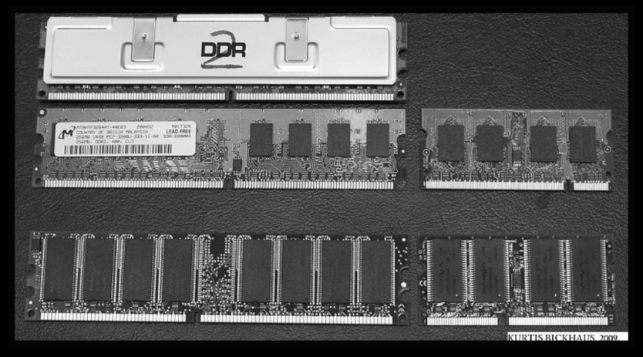
RAM – Random Access Memory
Much smaller than a hard disk
Typically 2-16GB
Hard Drives typically 250-2000 GBs

Slide 11
Video Card
A.K.A graphics card, graphics adapter, video adapter
Function is to generate and output images to a display
Many video cards offer added functions, such as accelerated rendering of 3D scenes, video capture, TV-tuner adapter, TV output, or the ability to connect multiple monitors

Slide 12
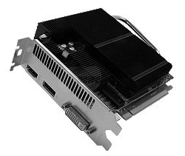
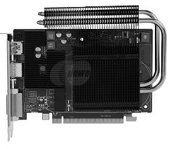
Video Card Cont’d

Slide 13
Putting it all together
The motherboard
The CPU is the brain, and the motherboard is the nervous system
The motherboard is the circuit board to which all the other components of the computer connect in some way
Some motherboards have many features, including built-in sound, video, and networking

Slide 14
Input/Output
What is defined as an input device or output device?
When a computer is receiving information (input)
When a computer is sending information (output)
Examples – DVD, Mouse, Hard Drive, Monitor

