Slide 1
Income Statements
Mr. Singh

Slide 2
Income Statement
Financial statement that shows a business profit (or loss) over a stated period of time – week, month, quarter & year.
Revenue - money, or the promise of money, received from the sale of goods or services
Expenses - expenditures that help a business generate revenue.
Notes:
PREPARTING AN INCOME STATEMENT
An income statement is like a movie that shows what happened over a period of time (week, month, quarter, or year).
Examples of expenses include salaries, advertising, maintenance, and utilities.
Shows profitability

Slide 3
Income Statement
BS - snapshot of one day in the life of a business
IS - movie that shows what happened over a period of time
Important? YES!!
Are you making a profit?
Investors - invest
Bankers - loan money
Taxes – pay or deduct

Slide 4
4 Steps to Prepare Income Statement
Fill in the Statement Heading
Three line heading:
Who? (Name of individual, business or organization)
What? (Name of the financial statement)
When? (Date on which the financial position is made)

Slide 5
Income Statement
Jackson’s Shoe Cleaning Company Income Statement Year Ending December 31, 2012
Revenue
Sales | $150,000.00
Total Revenue |  | $ 150,000.00
Expenses
Rent Expense | $ 10,000.00
Salaries Expense | 10,000.00
Supplies Expense | 5,000.00
Total Expenses |  | 25,000.00
Net Income |  | $ 125,000.00
WHO?
WHEN?
WHAT?

Slide 6
4 Steps to Prepare Income Statement
Organize the Revenue Section
The money, or the promise of money, received from the sale of goods or services is called REVENUE
All sources of revenue should be listed

Slide 7
Income Statement
Jackson’s Shoe Cleaning Company Income Statement Year Ending December 31, 2012
Revenue
Sales | $150,000.00
Total Revenue |  | $ 150,000.00
Expenses
Rent Expense | $ 10,000.00
Salaries Expense | 10,000.00
Supplies Expense | 5,000.00
Total Expenses |  | 25,000.00
Net Income |  | $ 125,000.00
REVENUE

Slide 8
4 Steps to Prepare Income Statement
Organize the Expenses Section
OPERATING EXPENSES are the costs of operating the business; used to help generate revenue
Ex: salaries, advertising, maintenance, and utilities
MATCHING PRINCIPLE: All the costs of doing business in a particular time period are matched with the revenue generated during the same period.

Slide 9
Income Statement
Jackson’s Shoe Cleaning Company Income Statement Year Ending December 31, 2012
Revenue
Sales | $150,000.00
Total Revenue |  | $ 150,000.00
Expenses
Rent Expense | $ 10,000.00
Salaries Expense | 10,000.00
Supplies Expense | 5,000.00
Total Expenses |  | 25,000.00
Net Income |  | $ 125,000.00
EXPENSES

Slide 10
4 Steps to Prepare Income Statement
Calculate Net Income or Net Loss
Use the information from steps 2 and 3 (and the equation for calculating profit) to determine a NET INCOME or NET LOSS
Total Revenue – Total Expenses = Net Income
Net income occurs when revenues > expenses
Net loss occurs when revenues < expenses

Slide 11
Income Statement
Jackson’s Shoe Cleaning Company Income Statement Year Ending December 31, 2012
Revenue
Sales | $150,000.00
Total Revenue |  | $ 150,000.00
Expenses
Rent Expense | $ 10,000.00
Salaries Expense | 10,000.00
Supplies Expense | 5,000.00
Total Expenses |  | 25,000.00
Net Income |  | $ 125,000.00

Slide 12
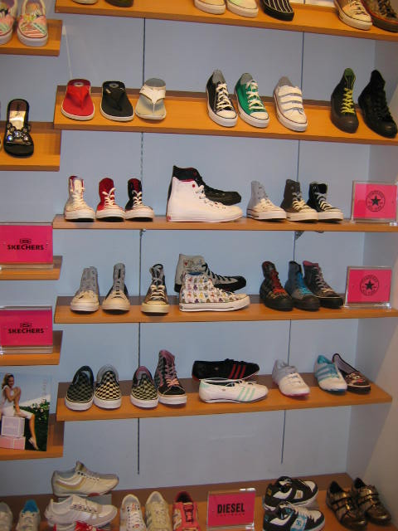
Income Statements for Retail Businesses
Retail businesses also need to include the cost of the goods (inventory) that were sold.
Inventory is the goods and materials kept on hand by a business.
Notes:
Income Statement for Retail Businesses
Inventory is the goods and materials kept on hand by a business.
Income Statement Equations
Gross profit, or gross margin, is the money left over after deducting the cost of goods sold from the revenue, but before deduction the business expenses that helped generate the revenue.
The cost of goods sold is calculated by starting with the opening inventory figure (goods and services purchased in previous months but not yet used), adding the new purchases made during the period, and subtracting the inventory remaining at the end of the time period.

Slide 13
Income Statement
Gross profit, or gross margin, is the money left over after deducting the cost of goods sold from the revenue, but before deduction the business expenses that helped generate the revenue.
The cost of goods sold is calculated by starting with the opening inventory figure (goods and services purchased in previous months but not yet used), adding the new purchases made during the period, and subtracting the inventory remaining at the end of the time period.

Slide 14
Income Statement Equations
Income statement equation for a service business (no goods sold!)
Revenue – Expenses = Net Income
Income statement equation for a retail business (goods sold!)
Revenue – Cost of Goods Sold = Gross Profit
Gross Profit – Expenses = Net Income
Notes:
Income Statement for Retail Businesses
Inventory is the goods and materials kept on hand by a business.
Income Statement Equations
Gross profit, or gross margin, is the money left over after deducting the cost of goods sold from the revenue, but before deduction the business expenses that helped generate the revenue.
The cost of goods sold is calculated by starting with the opening inventory figure (goods and services purchased in previous months but not yet used), adding the new purchases made during the period, and subtracting the inventory remaining at the end of the time period.

Slide 15
Cost of Goods Sold
Beginning Inventory, Jan. 1, 20__ | $50 000
Inventory Purchased | +75 000
Costs of All Goods for Sale | 125 000
Ending Inventory, Dec 31, 20__ | -40 000
Costs of Goods Sold | 85 000
Sales Revenue | $150 000
Cost of Goods sold | -85 000
Gross Profit | 65 000
Gross Profit | $65 000
Expenses | -25 000
Net Profit | $40 000
Operating expenses are deducted from the gross profit to determine the net profit
Notes:
ACCOUNTING AND INDIVIDUALS
A fiscal year, or business year, is any 12-month operating period.
The fiscal year often, but not always, corresponds to the calendar year,; it could be January 1 to December 31, or April 1 to March 31.
At the beginning of the fiscal year (Jan. 1, 20__) the shoe store had $50 000 in inventory.
The shoe store, through the year, buy $75 000 worth of additional inventory.
Over the whole year the store has a total of $125 000 in inventory to sell.
At the end of the twelve month period an actual physical count is done. There is $40 000 in unsold inventory.
Subtract the $40 000 (ending inventory) from the $125 000 (cost of all goods available for sale) and the cost of goods sold in $85 000.
Remember the cost of goods sold is not the price the customer paid.
The store collected $150 000 in sales revenue (from goods sold) during the year.
$85 000 (cost of goods sold) is deducted from $150 000 (sales revenue) and the gross profit is $65 000 (this is the amount before deducting the business expenses that helped to generate the revenue).
Expenses ($25 000) are deducted from gross profit ($65 000) and it results in net profit ($40 000).
Net profit is the amount the storeowner can declare as income for income tax purposes.

Slide 16
Owner’s Equity Account
Net profit is calculated first then transferred to the balance sheet as part of owner’s equity
Creditors and owners have claims on the assets of the business
“Capital is added to identify the owner’s account
Owner’s Equity
A. Jackson. Capital Jan. 1, 20__ | $75 000
Add: Net Income | $40 000
A. Jackson, Capital. Dec. 31, 20__ | $115 000

