Slide 1
Invention & Innovation

Slide 2
Ideas
Every venture starts with an idea – but where does the idea come from?
Good ideas that turn into ventures have 2 features in common:
1. They are innovative – often something new that no one has thought of before or something that has never been made to work before
2. They suggest a way to satisfy a need

Slide 3
Ways to find new ideas
Newspapers – classified advertisement can show what local needs and wants are and list available jobs
Business services ads can help you find out what services are in demand
Trade Shows – manufacturer and distributors display their newest products and services
At crafts shows or hobby shows individuals and small businesses can sell products or services to customers, often at low prices to attract new customers

Slide 4
Ways to find new ideas
TV Commercials or ads on social media – See what is trending and what people want
Kijiji – look at what jobs are in demand
Magazines - consumer magazines predict and report changes in consumer buying
Specialty magazines offer advertisements and articles about goods and services that appeal to their target market

Slide 5
How well do you observe?
To become aware of business ideas around you everyday, you need to be a good observer.
You might be surprised at how much you can see when you take the time to look
You need to be able to out think your competition. You need to see what they don’t see
We are going to test how well you can observe situations.

Slide 6
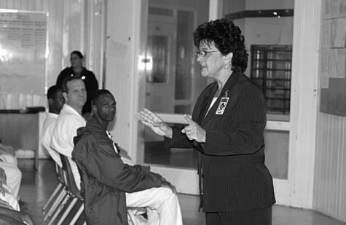
Observation Test

Slide 7
Question 1
How many offenders were seated in the front row
A) 2
B) 4
C) 3
D) 6
Answer: 3

Slide 8
Question 2
How many offenders in the front row are wearing a jacket?
A) 0
B) 1
C) 2
D) 3
Answer: 1

Slide 9
Question 3
How many other individuals (not offenders) are in the picture?
A) 3
B) 4
C) 2
D) 1
Answer: 2

Slide 10
Question 4
What object is clipped onto the instructor’s jacket?
A) Handcuffs
B) Two-way radio
C) ID badge
D) Keys
Answer: ID badge

Slide 11
Questions
How many bottles are there on the shelf above the refrigerator?
Answer: 3
What dish is being cooked in the oven?
Answer: Chicken or Turkey
What time is shown on the clock?
Answer: 1:30

Slide 12
Observation Test 2

Slide 13
Observation Test 2 Cont’d
How many magnets are there on the refrigerator?
Answer: 2
Can you make coffee in this kitchen?
Answer: Yes, there is a coffee maker
How many windows are there in the room
Answer: 2

Slide 14
Looking for patterns
Once you become more aware of your surroundings, you will begin to notice what people in your community are doing
The most important thing to watch for is change because change can spur an idea for a new venture
Ex. If the price of a popular item just went up, there might be room for a competitor to step in
Ex. If people are just beginning to buy a new product or service, there might be something related to it that they might be interested in buying

Slide 15
Observation Test 2 Cont’d
What objects are lying on the table beside the fruit bowl
Answer: A knife and an apple

Slide 16
Developing your ideas
Not all good ideas make good ventures
Once you’ve found an idea, research it
Talk to people
Who will your customers be?
What problems might you encounter?
Look for help from experienced people

Slide 17
Invention and Innovation
What is the difference?
Invention – creation of something new
Innovation – a change to something that already exists
After you come up with an idea, you need to protect it. Your idea is your intellectual property
What are a few ways you can protect your idea?

Slide 18
Protecting your ideas
Patent
a grant made by the government that gives the creator of an invention the sole right to make, use, and sell the invention for a set period of time
You can apply for a patent through the federal government
You may have a patent for Canada but not the US.
You’d have to apply to the US for a patent on your product

Slide 19
Protecting your ideas
Copyright
Protects literary works, musicals works, artistic works, and software
By law, all Canadians hold the copyright to any original work they have created unless….
They were hired or employed to create it
No one can publish, perform, translate, or adapt another persons work without permission

Slide 20
Protecting Your Ideas
Trademark
Words, symbols, or designs – or a combination of these – used to identify a product or service
Trademarks are valuable as it represents the reputation of the producer
What is a type of trademark?
Logo – symbol that is associated with the company or product

Slide 21
Branding
Logo
symbol that is associated with the company or product
Logo forms:
Monogram Visual symbol Abstract symbol
Stylized writing Represents Not representative something of actual things
HELPS PRODUCT COMPETE FOR CONSUMER AWARENESS
Notes:
BRANDING
Brand Name
A brand name is how a product and company are identified and it is important to organizational success.
When people talk with others about brand preference this is free publicity for the company.
Logo or Trademark
A logo or trademark helps a product compete for consumer awareness.
Monogram: a stylized rendering of a company’s initials or a combination of initials and numbers.
Examples include IBM (International Business Machines) who wanted to consumers to associate them with computers not adding machines, and KFC (Kentucky Fried Chicken) who did not want consumers seeing the work “Fried”, etc.
Visual symbol: These are line drawings of people, animals, or things such as Apple Computer’s apple and Kellogg’s Frosted Flakes’ Tony the Tiger.
Abstract symbol: These are shapes that carry a visual message but are not representative of actual things.
The Nike “swoosh” is an example and one of the world’s most well recognized logos.

Slide 22
Protecting Your Ideas
Industrial Designs are protected by the Industrial Design Act
An industrial design is anything made by hand, tool, or machine that has distinctive features
Such as the shape of a chair or the decoration on the handle of a spoon
Once you register the design, you have exclusive rights to the resign for 10 years\
The person who registers the design is called the proprietor – owner of the design

Slide 23
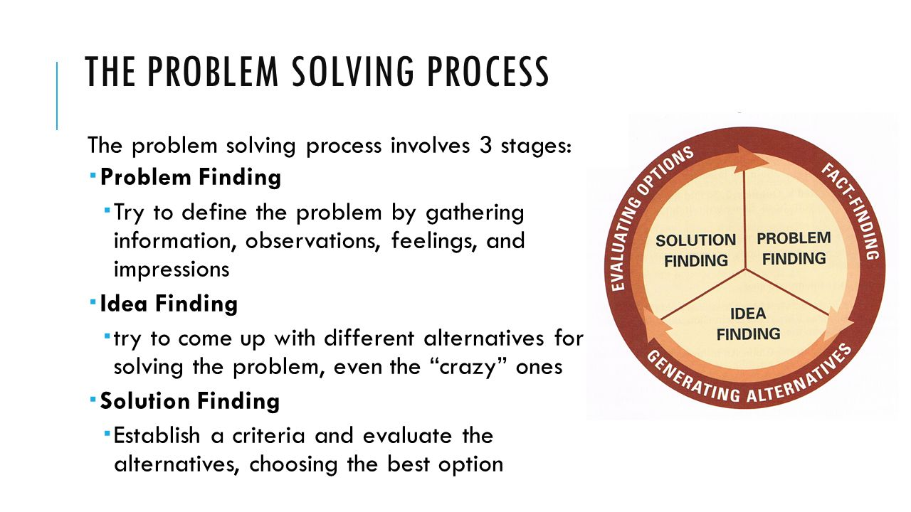

Slide 24
Lateral Thinking
Lateral Thinking
Generating ideas by being flexible and creative
Lateral thinking moves sideways rather than up and down
Involves a number of different perceptions and methods – thinking outside the box
Typically viewing the problem in a new and unusual light

Slide 25
Brain & Problem Solving
The human brain is divided into 2 hemispheres – Right Brain and Left Brain
Left brain is sequential, analytical and linear
It contains the function of language and all language related activities
Right brain – works with the left brain and deals with the creative, imaginative, emotional and intuitive parts.
Both sides of the brains are a team and work together

Slide 26
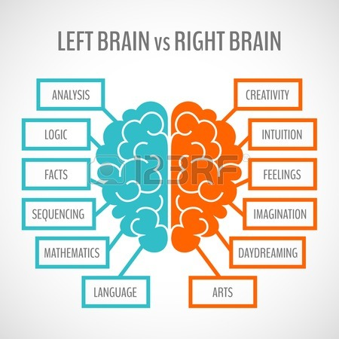

Slide 27
More ways to generate ideas
Word Clustering
This helps stimulate the right brain
Begin with writing a word or phrase in the middle of a page
Then circle it
Now write other words or phrases that come to mind as you consider the idea at the centre
Circle each new idea
Draw lines between the circles that are connected in your mind
When you’re finished, look for patterns

Slide 28
More ways to generate ideas
Mind Mapping
Same idea as word clustering except this time your drawing a pic at the centre
You can draw more pics or words that connect to the centre
You can draw arrows that direct you towards ideas
Starting at the centre allows lateral thinking
This is a great way to study as well

Slide 29
More ways to generate ideas
Brainstorming
Completing a word cluster or mind map is a form of brainstorming
This can generate a large number of ideas
Record every single idea you generate, even crazy ideas
You never know when an idea can lead to something
After you’re done, you evaluate your ideas
People think more creatively when they’re not worried about the right answer

Slide 30
More ways to generate ideas
Visualization
Closing your eyes and visualizing different scenarios in your mind can help you come more comfortable with new ideas
Many professional athletes visualize their new routines before they try them
Visualize your business
You may see problems or opportunities when you sit back, close your eyes, and visualize everything

