Slide 1
Overcoming Errors

Slide 2
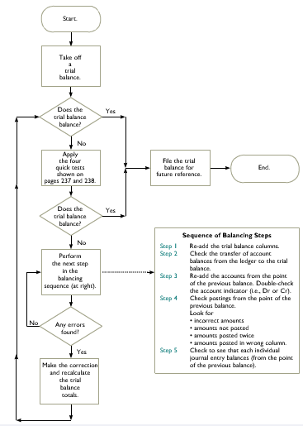
Multiple Errors??

Slide 3
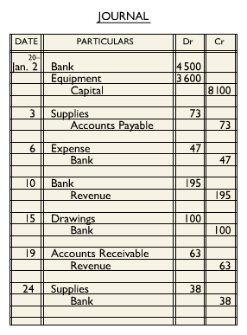
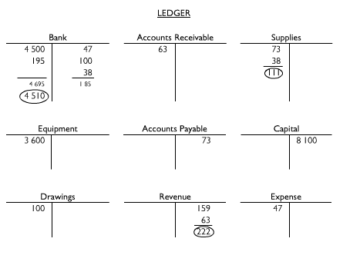
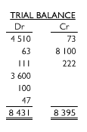
Let’s do some Practice
Notes:
Is the error divisible by 10? Is there a value of 36 or 72? That means that the first three methods we learned do not work. It is a transposition error. We can divide 36 by 9. Look for a transposition error.

Slide 4
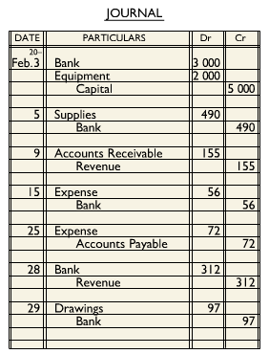
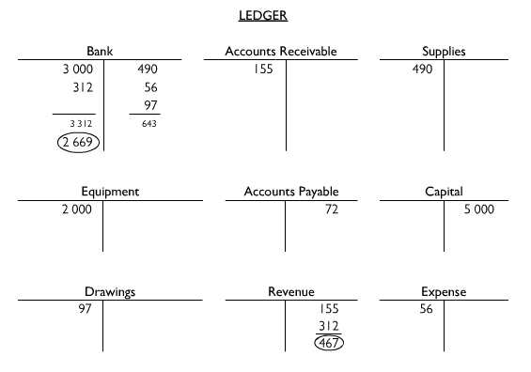
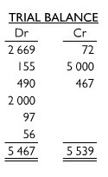
Let’s do some Practice
Notes:
This is a posting error. You have to calculate the difference in the trial balance (72$) You cannot divide this by 10 so the first test does not work. Second test works because there is an amount for 72 dollars that was not posted to the expense account.

Slide 5
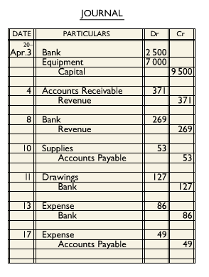
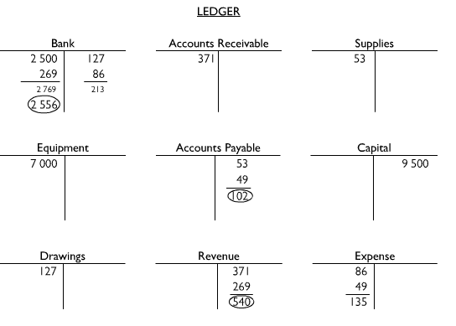
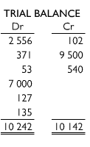
Let’s do some Practice
Notes:
This is an addition error. First, I calculated the trial balance difference of 100. This amount is divisible by 10 so we can use the first test. Add up all the amounts and you will find the error in the revenue accounts.

Slide 6
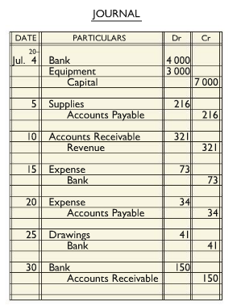
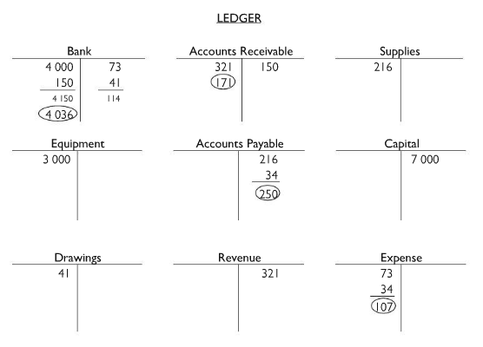
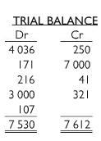
Let’s do some Practice
Notes:
This is a transferring error. First, we calculate the trial balance difference of $82. This is not divisible by 10 and there is no entry for 82 so the first and second tests do not work. Look for an entry of 41 (half of 82) and you see that there is a value of 41 but it is on the wrong side of the trial balance.

