Slide 1
Overcoming Errors

Slide 2
Overcoming Errors
We need to be accurate all the time.
Owners, bankers, investors, employees, and tax authorities rely on accurate information.
ERRORS SHOULD NOT HAPPEN…but they do. So we have to find them and correct them when we do.

Slide 3
Correcting Errors in the Books
Accounting has traditionally been done in pen. Still…if mistakes were made, it was not a good idea to erase or use white-out. Why do you think this is?
Even software does not cover it up.
Notes:
We do not want to hide mistakes. We want to correct them, but leave them visible.

Slide 4
Errors Found Immediately
If we find an error right away, we STROKE through the incorrect numbers or letters and write the correction above.
Notes:
We have to always write very clearly, and small.

Slide 5
Errors Found Later
Sometimes, our accountants only learn about errors after time has passed.
A lot of the time, we create a new accounting entry .
So lets imagine that on July 5, our accountant noticed that an invoice for $752 had been debited to the wrong account.
The invoice was for supplies, but had been debited to the Equipment account.
The error was made on January 17.
Notes:
In a perfect world, we catch errors as soon as they were made. BUT…it is not a perfect world.
The

Slide 6
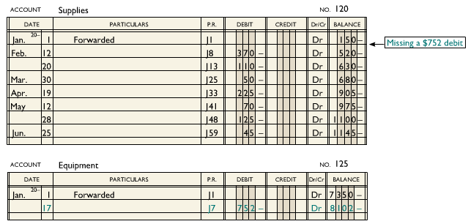

Slide 7
Errors Found Later
To fix this, we need to use a correcting journal entry. These cancel the effect of the error.
The $752 in the Equipment Account needs to be cancelled and shifted to Supplies.

Slide 8
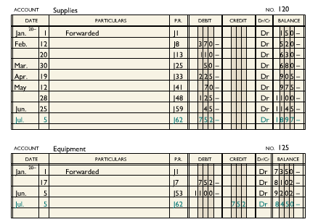

Slide 9
Trial Balance Out of Balance
So we know that information moves from a source document to a trial balance.
1. Equal debit and credit amounts are recorded in a journal entry.
2. Debit and credit journal amounts are posted to the proper columns in the ledger accounts.
3. New ledger account balances are calculated every time journal amounts are posted.
4. Final balances of each ledger account are identified as either debit or credit. Then transferred to the Trial Balance.
5. The totals of the two columns of the trial balance are calculated. If the totals are the same, things are in balance. These are then used for the income statements and balance sheet.
Notes:
How does that information move? ***draw the flow chart on the board.***

Slide 10
Trial Balance out of Balance
If there is just ONE mistake when we put the information into their places, trial balances will not equal. This means we cannot prepare financial statements.
WE HAVE TO FIND IT!!

Slide 11
Quick Tests for Detecting a Single Error
There are 4 tests to figure out an error quickly. WE WANT ZERO DIFFERENCE.
1. If the difference is a multiple of 10 (10 cents, 1 dollar, etc) an addition error is probably to blame. Try adding again.
2. Check the ledger and journal to see if the difference is equal to an amount entered in the ledger or journal. If you find one, check to see it has been placed properly.

Slide 12
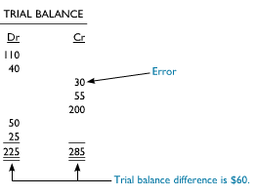
Quick Tests for Detecting a Single Error
3. Divide the difference by two. Search the trial balance and ledger accounts for the divided amount. If you find one, check it. You may have posted a debit as a credit, or a credit as a debit.
Notes:
This type of error always results in a difference double that of the error.

Slide 13
Quick Tests for Detecting a Single Error
4. If the difference is a multiple of 9, we probably made a transposition error or a decimal point error.
A transposition error means we mixed the order of digits. The difference will always be a multiple of 9.
A decimal point error is when we put the decimal in the wrong place. $1.19 being entered as $119.00 (119-1.19 = 117.81 which, divided by 9 equals 13.09.
Notes:
Like writing 198 as 189, or 203 as 230. Like writing 1.19 as 119.00, or 254.00 instead of 25.40

Slide 14
Multiple of 9 Errors
The number of digits in the trial balance difference may help you save time looking for the error. For example, if the difference between debit and credit totals is a multiple of 9 and has two digits – like 54 – then digits in the “tens” could have been switched (like 5693 to 5639).
If the difference has four digits – for example, 4500 – look for numbers in the “thousands” that could have been transposed (like 9438 to 4938).

