Slide 1
Ratio and Percentage Analysis
Mr. Singh

Slide 2
Comparative Statements
Comparative financial statements illustrate changes over several years
Will list two or more years’ financial data, with the dollar change from year to year indicated beside each item
Look for unusual changes (very high increases or decreases)
Can be examined further to determine why

Slide 3
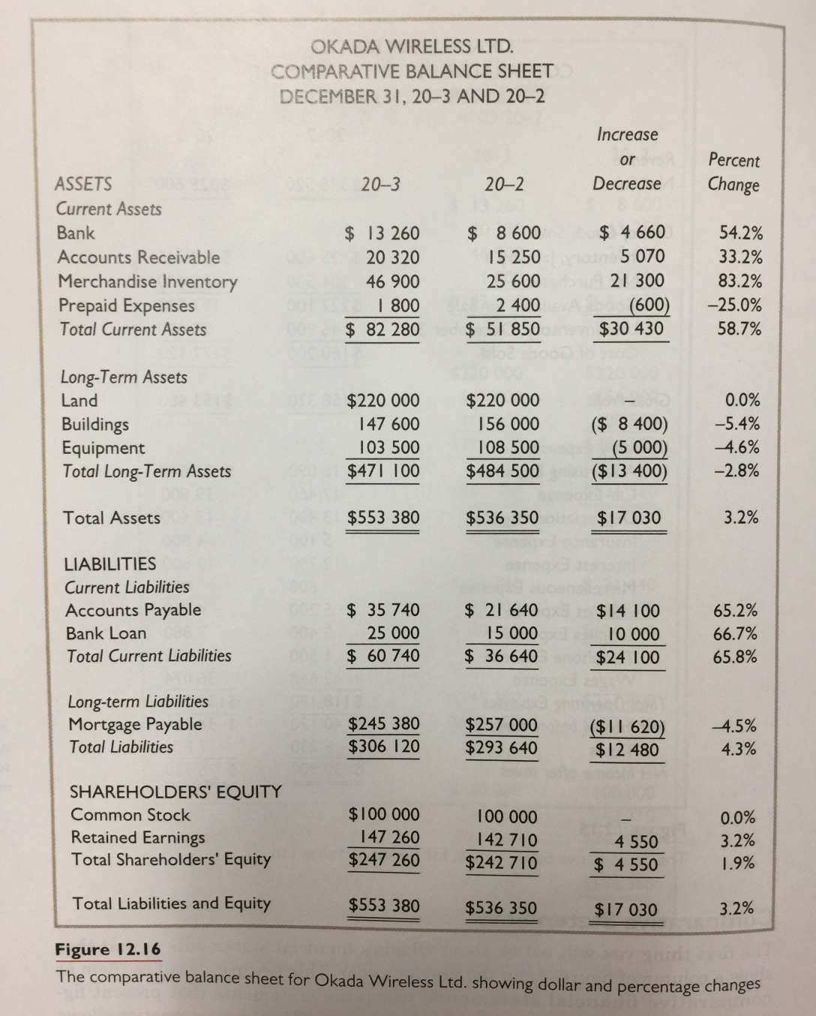
Comparative Balance Sheet

Slide 4
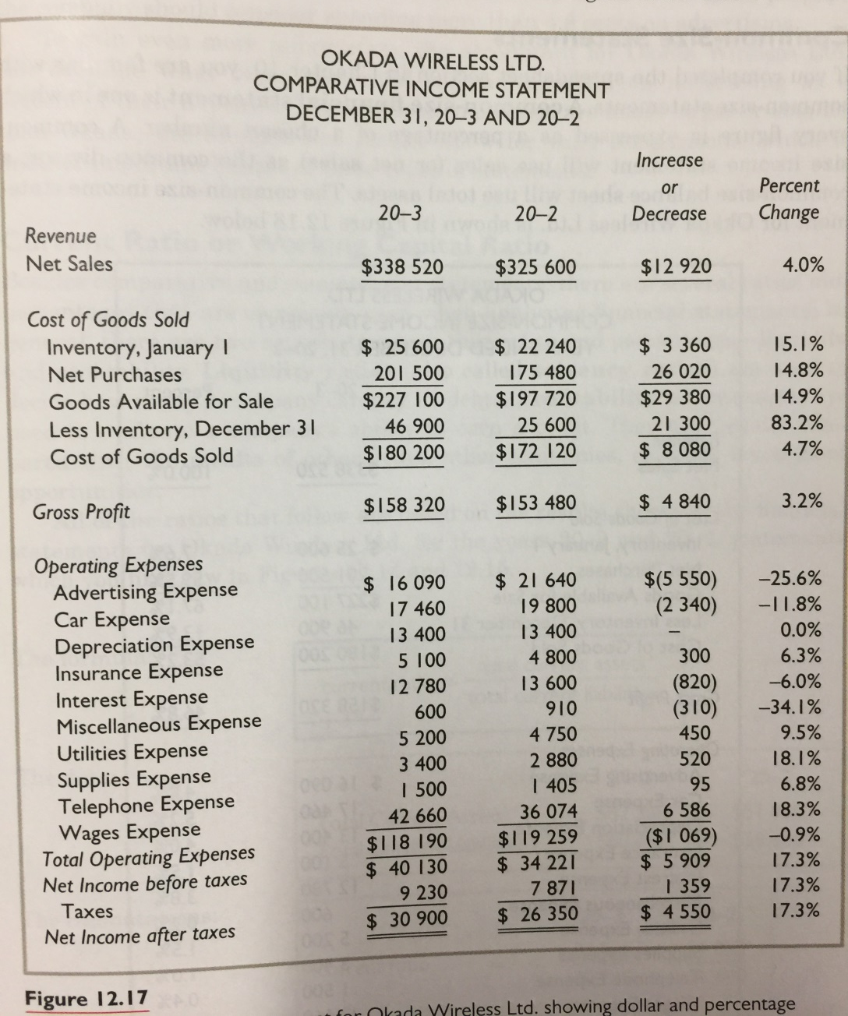
Income Statement

Slide 5
Analysis
Balance Sheet – Accounts Recievable grew by 33%
This could be good if we have sales to back that up.
Or it could be bad meaning people are taking too long to pay
Income Statement – Sales rose by 4%, therefore customers are taking longer to pay their debt

Slide 6
Current Ratio or Working Capital Ratio
2 main analysis:
Liquidity Ratio (Solvency Ratios) – used to decide how easily a company can pay its debt
Profitability Percentages – Used to evaluate a company’s ability to earn a profit (normally they are used with results of other years)

Slide 7
Current Ratio
Formula: Total Current Assets / Total Current Liabilities
This ratio measures a businesses ability to pay its debts
It’s important because if a business cannot pay its debt it can shut down
2.5 ratio = very good, 2.0 ratio = good, 1.5 ratio = fair, 1.0 ratio = poor, less than 1.0 = precarious
1.35:1 → we have $1.35 for every dollar of liability

Slide 8
Working Capital Ratio
Current ratio is also referred to as the working capital ratio
The working capital is
Total current assets – total current liabilities

Slide 9
Quick Ratio or Acid-Test Ratio
Formula: (total current assets – (inventory + prepaid expenses)) / total current liabilities
This measures the business’s ability to pay its debs within a very short period of time
The difference between a quick ratio and current ratio is that inventory is not considered
This ratio tells us how well a business can meet its current debt without depending on the sale of inventory
A ratio of 1:1 is good

Slide 10
Debt and Equity Percentages
Debt Ratio: Total Liabilities / Total Assets
Equity Ratio: Total Equity / Total Assets
Debt ratio shows that proportion of the total assets is financed with borrowed money
Equity ratio shows what proportion of the total assets is financed with shareholders’ money
These 2 percentages are related and should add up to 100%
A ratio of 50% is considered good
Investors like to see this

Slide 11
Rate of Return on Net Sales
Formula: (Net Income / Net Sales) x 100
This measures the dollars that remain after all expenses are deducted from net sales
If you compare this with other years, this gives an indication of how well a company is performing

Slide 12
Rate of Return on Shareholders’ Equity
Formula: (Net Income / Owner’s Average Equity) x 100
This measures how well the business is doing when compared with other investments the shareholders might make using the capital from the business

Slide 13
Collection Period aka A/R turnover
Can be used to evaluate the health of a business
Formula: Accounts Receivable/Avg. charge sales per day
Make sure you divide sales by 365
This shows us how many days’ sales are represented by the accounts receivable
Lower the number, the better
The figure should be less than one and a half times the usual credit period
Normal credit period is 30 days

Slide 14
Inventory Turnover
Formula: COGS / Avg. Merchandise Inventory
How do you figure out avg. merchandise inventory?
(Beginning + ending) / 2
This number represents the number of times a business has been able to sell and replace its inventory in one year
Turnover of 8 means that the business has been able to sell and replace its goods eight times in a year

Slide 15
Inventory Turnover
You normally need to compare this number over a few years to see change
If it goes down, you may have a situation where an item is not popular anymore
Perhaps a new product came out in the store taking sales away

Slide 16
Times Interest Earned Ratio
Formula: Net Income / Interest Expense
This tells us the ability of the company to cover its interest expense
The higher the ratio, the better
A company with a low figure, say 5 or lower has to be concerned with interest charges
Creditors will be very cautious in dealing with companies with a low figure

Slide 17
Earnings per share
Formula: Net Income (After taxes) / Number of common shares outstanding
This is used to measure the performance of a corporation and its executive officers
You can compare this over a number of periods
Investors will also compare this relative to other companies

Slide 18
Price Earnings Ratio
Formula: Market price per share / earnings per share
This is only for public corporations
This tells us how outside investors feel about the company
Suppose you have 2 companies. Company A has a P/E ratio of 14 and B 19.
Company A is better because it will cost you $14 to a buy a share that will earn $1 as apposed to $19 to earn $1

Slide 19
Price Earnings Ratio
A high P/E ratio indicates high investor confidence
This could also mean investor overconfidence
Advances in tech or positive political events are examples of things that excite investors

