Slide 1
Recording share transactions
Mr. Singh

Slide 2
Shares have a stated (or nominal) value – the amount of which they are issued
Rarely shares will have a par-value – the amount stated in the charter
Assume New World Corporation is authorized to issue share capital consisting of an unlimited number of voting common shares and 100,000 non-voting preferred shares

Slide 3
Transaction 1: On Jan 1st 2015, New World Sells 1,000 common shares to its first shareholders for $10 per share, or $10 000 cash. Journal Entry?
General Journal
Date | Account/Explanation | F | Debit | Credit
Jan 1 | Cash |  | 10,000
 | Common Shares |  |  | 10,000
 | To record the issuance of 1,000 common shares at $10 per share.

Slide 4
Transaction 2: On Feb 1st 2015, 2500 preferred shares are issued to the owner of land and buildings that have a fair value of $35,000 and $50,000, respectively. Journal Entry?

Slide 5
Transaction 3: On March 1st 2015, 500 common shares are issued to the organizers of New World to pay for their services, valued at $5000. Journal Entry?
General Journal
Date | Account/Explanation | F | Debit | Credit
Mar 1 | Organization Expense |  | 5,000
 | Common Shares |  |  | 5,000
 | To record the issuance of 500 common shares in exchange for organization efforts.

Slide 6
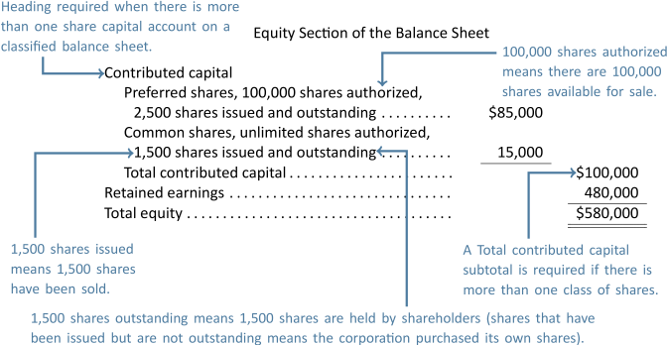
Assume no further transactions and a retained earnings balance of $480,000. Equity section is

Slide 7
Transaction 4: NWC repurchases 200 common shares on Dec 1, 2016 and holds them in treasury. Price of each share is the average issue price of the outstanding common shares, or $10. Journal entry?
General Journal
Date | Account/Explanation | F | Debit | Credit
Dec 1 | Common Shares |  | 2,000
 | Cash |  |  | 2,000
 | To record the repurchase of 200 common shares at $10 per share to be held in treasury.

Slide 8
Notice the repurchase of shares caused a decrease in both paid-in capital for the common shares ($2,000 decrease) and in the number of shares outstanding decreased (decreased by 200 shares). If the 200 shares had been cancelled, both the numbers of shares issued and outstanding would have decreased by 200 shares

Slide 9
Transaction 5: NWC decides to repurchase and cancel 100 common shares on Dec 15 2016. Assume purchase price is $9, which is less than the avg. issue price of $10 per share. Journal Entry?

Slide 10
Contributed surplus account is reported and share capital and contributed capital are subtotalled and reported as total contributed capital of $99,100
Assume no further transactions, the equity section of the NWC balance sheet:

Slide 11
If NWC repurchases and cancels another 150 common shares on Dec 17th 2016, at a price of $11, this is more than the average issue price of $10 per share. Journal Entry?
Why do we debt $50 to retained earnings?

Slide 12
Share Split – Increases the number of shares issued and outstanding, and lowers the cost of each new share
The originally issued shares are exchanged for a larger
Assume NWC declares a 3 for 1 common share split.
3 new common shares replace current issued and outstanding shares
Shares now have been tripled
Market price for each share will decrease to 1/3 of former market price
No change in dollar amount of common shares and no debt/credit entry required

Slide 13
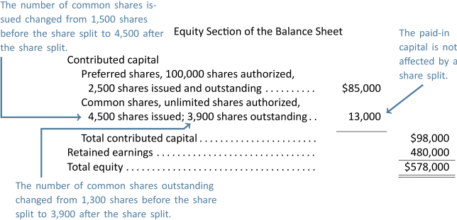
The only change is an increase in the number of issued and outstanding common shares.

