Slide 1
The corporate structure
Mr. Singh
BAT4M

Slide 2
Corporation characteristics

Slide 3
Corporate characteristics
Legally separate from their owners
Owners are called shareholders
Each unit of ownership is called a share
If corporation issues 1000 shares, and you own 100 of them, you own 10%
Corporations can be privately-held shares or publicly-held shares

Slide 4
Corporate characteristics
Corporation has same rights and obligations as individuals
Separately regulated by law (articles of incorporation, a memorandum of association, or letters patent)
Indefinite Life
Limited Liability
Usually can acquire more capital a lot easier than individuals

Slide 5
Creation by law
The document submitted to the gov’t list the classes, & total # of shares of each class can be issued – authorized number of shares
A shareholder or group of shareholders who control more than 50% of the voting shares elect a board of directors
Minority shareholders can delegate their vote to one person who votes on their behalf by signing a proxy statement
Shareholders meet annually to vote for board of directors

Slide 6
Indefinite life
The life of a corporation comes to an end only when 3 things happen
It is dissolved
Becomes bankrupt
Has Charter revoked for failing to follow laws and regulations

Slide 7
Limited liability
For the protection of the creditors, the limited liability of a corporation must be disclosed in its name
Words like “Limited”, “Incorporated”, or “Corporation” are often used as the last word of the name of the company (Ltd., Inc., Corp.)

Slide 8
Ease of acquiring capital
Issuing shares allows many individuals to participate in financing the corporation
Shares are purchased and sold by small or large investors
What is occurring when shares are bought and sold?
Ownership is being transferred
In theory, is ownership in corporation risky?
No, because risks can be spread among many investors
With all this trading back and forth, is the balance sheet affected?

Slide 9
Classes of shares
There are many types of shares, with differences related to voting rights, dividend rights, liquidation rights, and other preferential features
Common Shares:
The right to participate in the management of the corporation by voting at shareholders' meetings
The right to receive dividends
The right to receive assets upon liquidation of the corporation
The right to appoint auditors through the board of directors
The articles of incorporation - grants the shareholders the pre-emptive right to maintain their proportionate interests in the corporation if additional shares are issued.

Slide 10
Classes of shares
Preferred Shares
shareholders are entitled to receive dividends before common shareholders.
These shares usually do not have voting privileges.
they receive only a limited amount of dividends because they have less risk

Slide 11
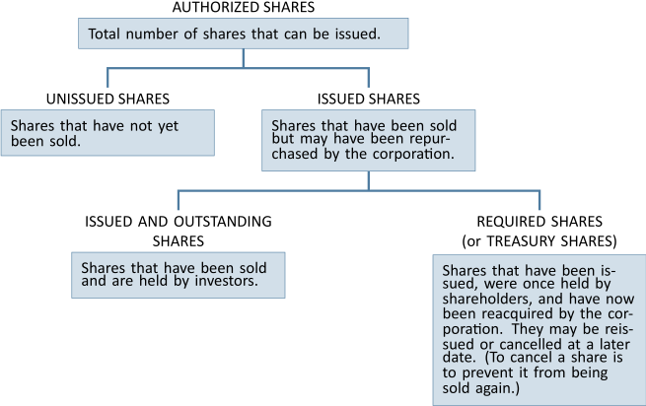
Preferred shares

Slide 12
Debt vs equity financing
Consider the example of Old World Corporation, which has 100,000 common shares outstanding, is a growth company, and is profitable. Assume Old World requires $30 million in cash to finance a new plant.
Management is currently reviewing three financing options:
Issue 12% debt, due in three years
Issue 300,000 preferred shares at $100 each (dividend $8 per share annually)
Issue an additional 200,000 common shares at $150 each.
Management estimates that the new plant should result in income before interest and tax of $6 million.

Slide 13
Debt vs equity financing

