Slide 1
The impact of business on the community
Mr. Singh
BBI2O

Slide 2
Impact of business on a community

Slide 3
Canadian government
Government gets money from taxes that businesses and individuals pay
Businesses in Canada pay between 25 and 40% of their profits to the federal and provincial government in the form of income tax
Businesses also pay municipal property taxes
They also regulate businesses through laws and deal with issues such as minimum wage

Slide 4
Standard of living
Number of goods and services that the residents of that country enjoy
The more money a country has, the higher is its standard of living
One measure that is used to compare the standards of living of different countries is GDP (Gross Domestic Product)
GDP – Annual total value of final market goods produced and services provided in a country
GDP is often calculated per capita – total GDP divided by the number of people in a country or region

Slide 5
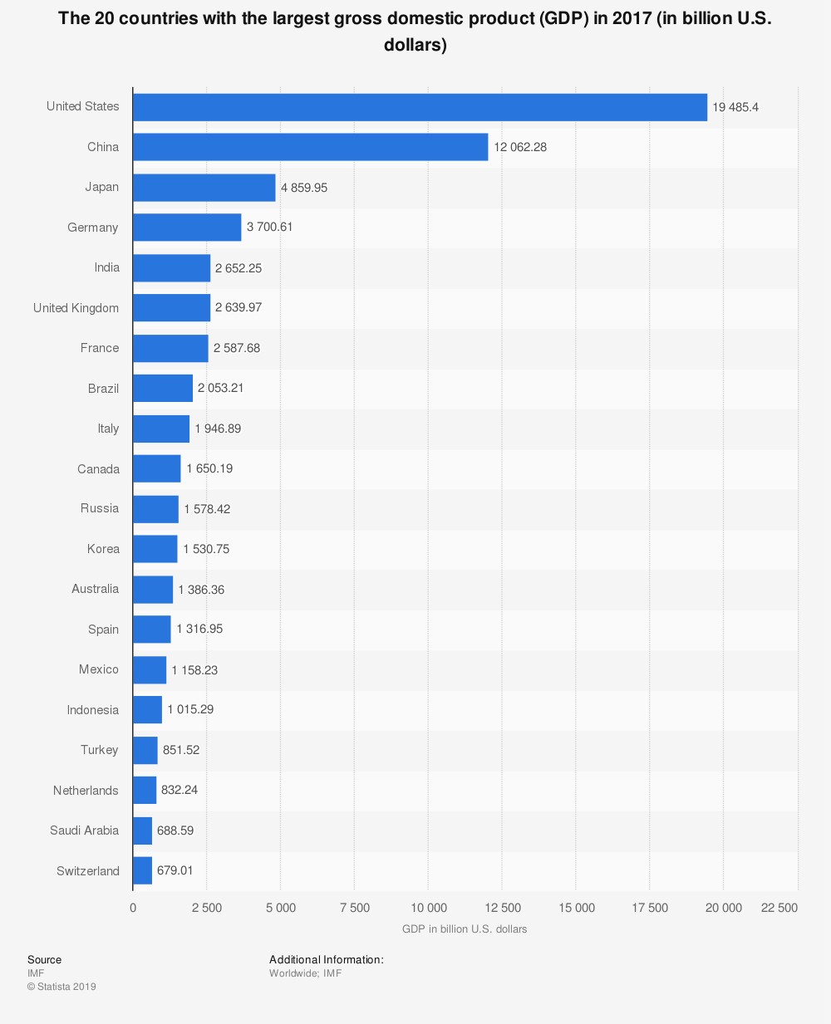

Slide 6
Quality of life
People’s material standard of living
Quality of life includes:
the life expectancy of its citizens
the illiteracy rate
the amount of money spent on education
its communications facilities (telephone, newspapers, television)
its population density
its infant mortality rate

Slide 7
Quality of life
Businesses contribute to the quality of life of Canadians
Hospitals, education, roads, and social programs are all funded by business and personal tax money
Governments also provide grants and loans to businesses
Responsible businesses make sure that they provide a healthy and safe working environment

Slide 8
Wealth, income & employment
A business earns a profit when it has money left over after paying all its expenses
Ex – wages, cost of supplies, taxes, etc.
Revenue – money that a business earns from sales of goods and services
Profit – Revenue – Expenses

Slide 9
Wealth, income & employment
A business has to provide quality and cost effective prices to consumers to make a profit
A successful business meets the needs and wants of consumers
A profitable business also needs to be able to expand and develop new products
Research & Development is key to the long term success of a business

Slide 10
Employment
A strong business environment usually means most people in a community are working
Low paying jobs usually require less skill
High paying jobs generally require higher level of skill, hard to find skills, acceptance of difficult conditions and/or normally require some sort of specialization
What attracts people to jobs?
Location, salary & benefits, opportunity to contribute to the organization or society, or passionate about a certain field

Slide 11
Jobs and the economy
When the economy is healthy, businesses tend employ more workers and create more jobs
They employ more people because more goods are needed to be produced
When economy is unhealthy, employment and job creation decreases
Young people have a hard time getting a job when the economy is unhealthy

Slide 12
Unemployment
Unemployed – Canadians have to be out of work and actively looking for a job
Economic recessions are an important cause of unemployment
How does technology play a role in unemployment and employment?

Slide 13
Level of income
Level of income or the money you earn affects your standard of living and quality of life
If you earn a decent amount of money you’ll be able to satisfy your needs and wants
How does your level of income also impacts your community?
If you can spend money, then you’re creating jobs for other businesses
As you make more money, you will pay a higher income tax

Slide 14
Factors affecting level of income
Education
Education, training and lifelong learning are very important in business
Most jobs need you to specialize in something
Your ability to learn and adapt to change will also play a big part in your employment
In todays world 80% of jobs require at least a high school diploma

Slide 15
Factors affecting level of income
Employability Skills
Skills that employers are most concerned about
Critical thinking skills, teamwork skills, communication skills etc.
Many of the skills you learn every day can be transferred from one situation to another

Slide 16
Market conditions
Changes in market conditions cause changes in businesses’ need for employees and in the wages businesses pay
Globalization, advances in technology, growth in small businesses, especially in the service sector, have opened up new avenues of employment opportunities
Demand for services has grown significantly such as marketing, accounting & auditing, finance, consulting, telecommunications & transportation

