Slide 1
Welcome to Economics!
Mr. Singh

Slide 2
Unit 1: The Nature of Economics and the Economy
Chapter 1: Basic Principles of Economics
Chapter 2: Productive Resources and Economic Systems
Chapter 3: The Evolution of Economic Thought

Slide 3
Chapter 1: Basic Principle of Economics
Overview
The importance of economics as a social science
Understanding how an economy works
Thinking like an economist
Models to explore basic economic laws and fallacies

Slide 4
What is Economics?
Economics are a part of daily life
Economic decision-making
What we need, what we want, and what we can afford to do
Our needs and wants are unlimited, but our resources are limited.
We must economize – use our resources wisely

Slide 5
What is Economics?
Derived from two Greek words
Oikos = “house”
Nemo = “to manage”
Oikonomia = matters relating to household management
The science of scarcity and choice
i.e. the study of the way we make decisions about the use of scare resources

Slide 6
Economics as a social science
Social science = the study of people
Attempt to understand human behaviour
Includes history, geography, sociology, and anthropology
Human behaviour complicates scientific studies
It is constantly changing and evolving

Slide 7
Predicting human behaviour
Humans are rational and social beings
Behaviour can often be explained by values and belief systems
Predicting behaviour can be a difficult task
The behaviour of groups can be predicted
The behaviour of individuals cannot be predicted

Slide 8
Why Study Economics?
Three major reasons for studying economics:
To understand current economic issues
To develop your economic reasoning skills
To gain economic knowledge for civic participation

Slide 9
Economics, Materialism, and Opportunity Cost
Some critics think economics focuses on only studying material things
No concern for human values.
But resources and products can be used for noble purposes and to achieve goals
Economics does not try to establish goals for the people who study it.
It gives them the tools they need to achieve goals efficiently by wasting fewer resources.

Slide 10
Effective vs. Efficient
The effective use of resources
When we consume a certain amount of resources and achieve the desired result
The efficient use of resources
When we use the bare minimum of resources to achieve the desired result.
The economic imperative is to achieve the right goals (effectiveness) in the right way (efficiency)

Slide 11
Opportunity Cost
The sum of all that is lost from taking one course of action over another
When making economic decisions we must consider not only what we will gain, but also what we will lose.

Slide 12
Example of Opportunity Cost
You have $2000 and 3 options to spend it:
Take a 2 week vacation in Cuba
Buy a DVD player and a home-theatre system
Finance yourself to spend a summer working in Africa

Slide 14
Example of Opportunity Cost
Whichever one you choose, you’ll have to do without the other two.
The opportunity cost of your vacation is the satisfaction lost from not doing your “next best” alternative.
It will also include earnings lost during vacation.

Slide 15
Facts and Values
Two sides of the economic coin
Both are used to explain human behaviour and assist in rational decision making
There are two branches of economics, one based on facts, and the other values

Slide 16
Analytical Economics
Analytical (or positive) economics deals with facts and direct observation of the world around us
It is concerned with 2 types of statements:
Descriptive statements: portray things as they are in the present and have been in the past
Conditional statements: forecasts based on the careful analysis of economic behaviour

Slide 17
Normative Economics
Normative (or policy) economics deals with statements that contain value judgments
Normative statements: express what a particular economist or group of economists thinks should be the case, based on their value judgments.

Slide 18
The Science of Economics
So far we’ve focused on the social aspect of economics. Let’s move on to the science side of it.
A discipline is called a science based not on what it studies, but how it studies it.
i.e. not on its subject matter but on its method
Economics, like all sciences, uses a common investigative approach called the scientific method.

Slide 19
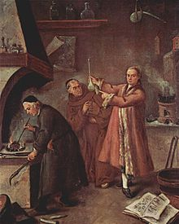
The Scientific Method
The scientific method has 4 basic components
Observation
Ask a question
Data collection
Collect evidence
Explanation
Make a hypothesis
Verification
Test the hypothesis

Slide 20
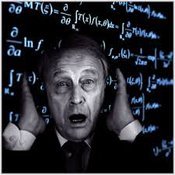
Math in Economics
Math is often used in economics to help us recognize and explain number patterns and statistical relationships
However, this is applied math, not theoretical math
Non-math majors need not fear!

Slide 21
The Fallacy of Composition
What is good for everyone is good for the individual and vice versa
Ex: Free trade can benefit Canadian society by resulting in lower prices for certain goods. However, some Canadians may lose their jobs because cheaper foreign goods are now available to compete with the more expensive goods produced in Canada.

Slide 22
Basic Fallacies, Laws, and Theories of Economics
The scientific method is used to prove hypotheses/generalizations that attempt to explain economic realities.
After they have been proven, these generalizations become economic principles, laws, or theories.
A fallacy is a hypothesis that has been proven false, but it still accepted by many people because it appears to make sense.

Slide 23
The Post Hoc Fallacy
What occurs before some event is logically the cause of it
Also called cause-and-effect fallacy
Derived from Latin phrase post hoc ergo propter hoc meaning “after this therefore because of this”
Ex: A newly elected government takes credit for improving the economy. Since the economy improved after the election, so the reasoning goes, the election result must have been responsible. However, the relationship between the two events may be more a coincidence than cause and effect.

Slide 24
The Fallacy of Single Causation
A particular event has one cause
Ex: A historian may argue that the stock market crash of 1929 caused the Great Depression of the 1930s, but this is an oversimplification. Many other factors contributed to the Great Depression.
However, since there was a meaningful connection between the stock market crash and the Great Depression, this is an example of the fallacy of single causation rather than the post hoc fallacy.

Slide 25
Name That Fallacy!

Slide 26
An economic crisis in Japan caused the 1998 decline of the Canadian dollar in international money markets.
The Fallacy of Single Causation

Slide 27
What is good for General Motors is good for the Canadian economy.
The Fallacy of Composition

Slide 28
Victoria, British Columbia, has one of the highest death rates in the country, therefore, it must be unhealthy to live there.
The Post Hoc Fallacy

Slide 29
Sarah found the work experience she got through her school’s co-operative education program to be of great personal benefit. Co-operative education should be a compulsory requirement for all secondary school students.
The Fallacy of Composition

Slide 30
A multi-car accident on the Trans-Canada highway was caused by the bad weather.
The Fallacy of Single Causation

Slide 31
If every Canadian worker received a 10% pay increase, the nation as a whole would be better off.
The Fallacy of Composition

Slide 32
The four components of the scientific method first outlined by Francis Bacon are observation, data collection, explanation, and verification. Although scientists today use many different processes to make their discoveries, they almost always make use of the four steps outlined by Bacon.
This is not a fallacy

Slide 33
Former prime minister Brian Mulroney was responsible for the economic recession of 1990.
The Fallacy of Single Causation

Slide 34
Economic Laws Affecting Production Possibilities
Economists use graphs of the production possibilities curve to illustrate the fundamental problem of scarcity.
Since wants will always exceed resources, production choices must be made
The production possibilities curve provides a visual model of these production choices.
The model is based on three major assumptions

Slide 35
First Assumption
Only two products can be produced by this simple economy
This makes the classic economic trade-off very clear
The increased production of one product can only be achieved by sacrificing a sufficient quantity of the other product.
There are two types of products
Consumer goods: Products and services that directly satisfy human wants (ex: bread)
Capital goods: Products used in the production of other goods (ex: ploughs)

Slide 36
Second Assumption
The economy has fixed technology and resources
The model is based on a short period of time
Assumes no technological advances will occur in that time period
Assumes the amount of resources available won’t change
i.e. resources can be shifted between goods produced, but no additional resources can be imported into the economy

Slide 37
Third Assumption
The economy is at full employment
Assumes that all resources, including labour, are fully employed and being used effectively and efficiently.

Slide 38
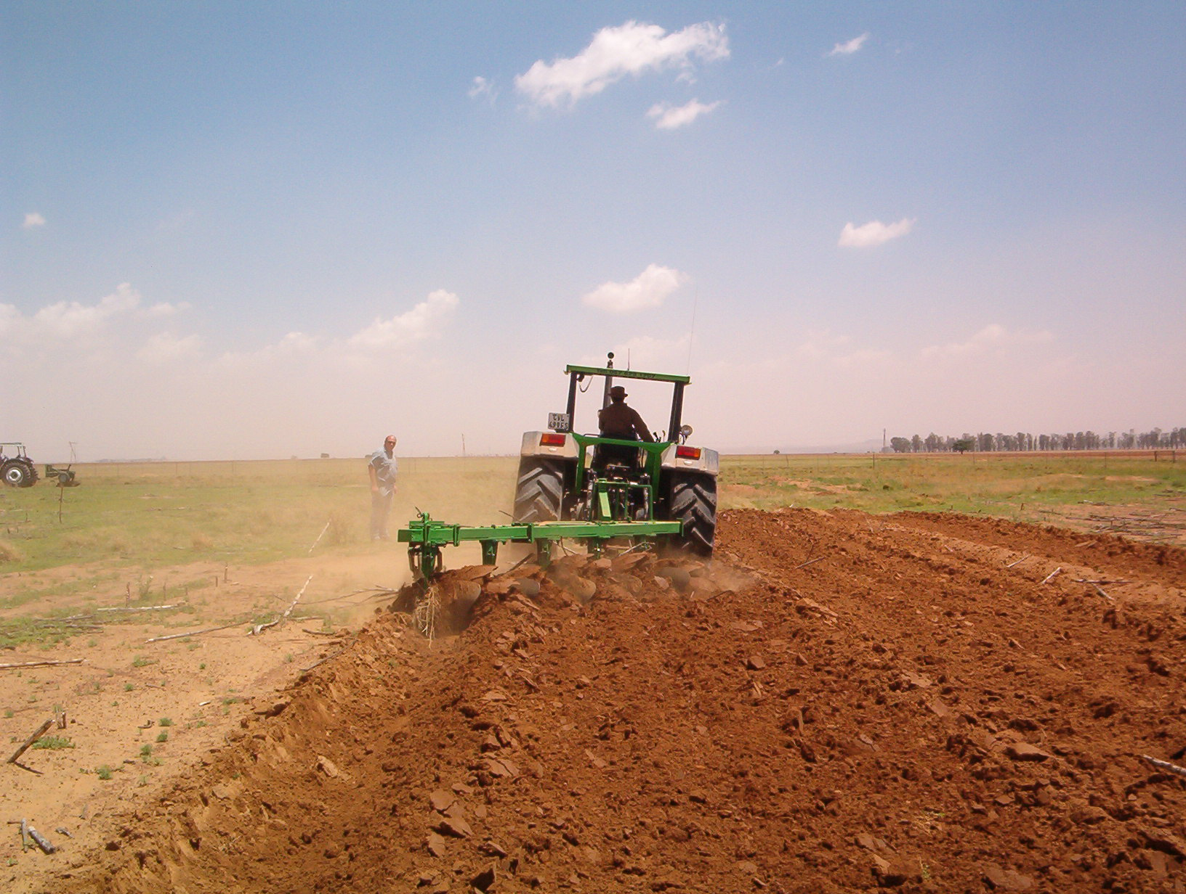
Production Possibilies for Bread and Ploughs
What combination of ploughs and bread should our simple economy choose to produce?
This question involves opportunity cost
The way we answer it will also clearly reflect the values of our society, so it also involves normative, or policy, economics

Slide 39
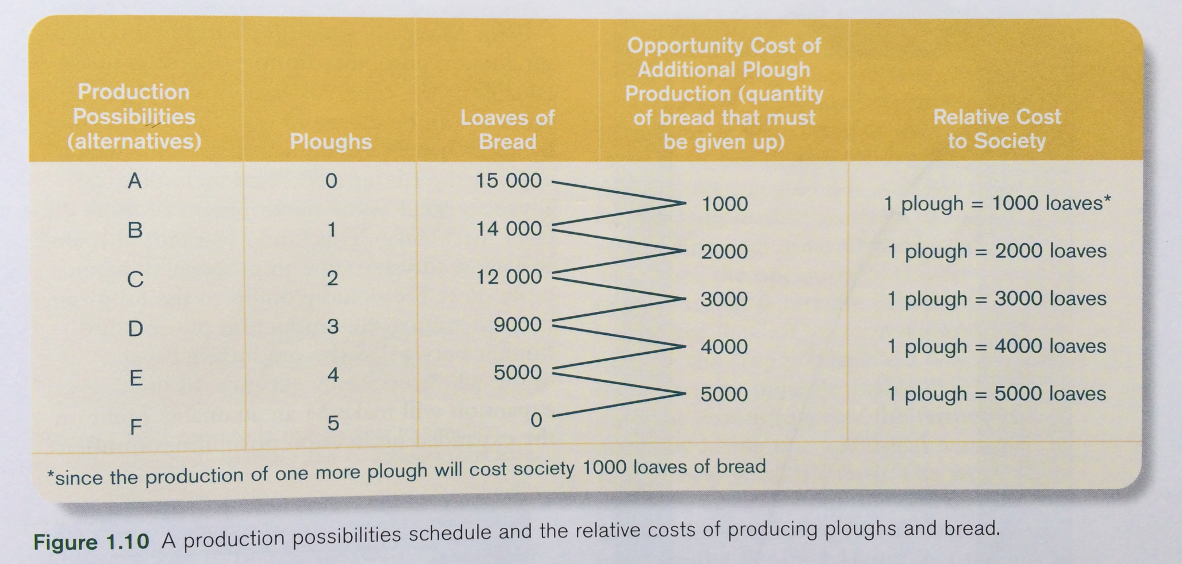
Production Possibilities for Bread and Ploughs

Slide 40
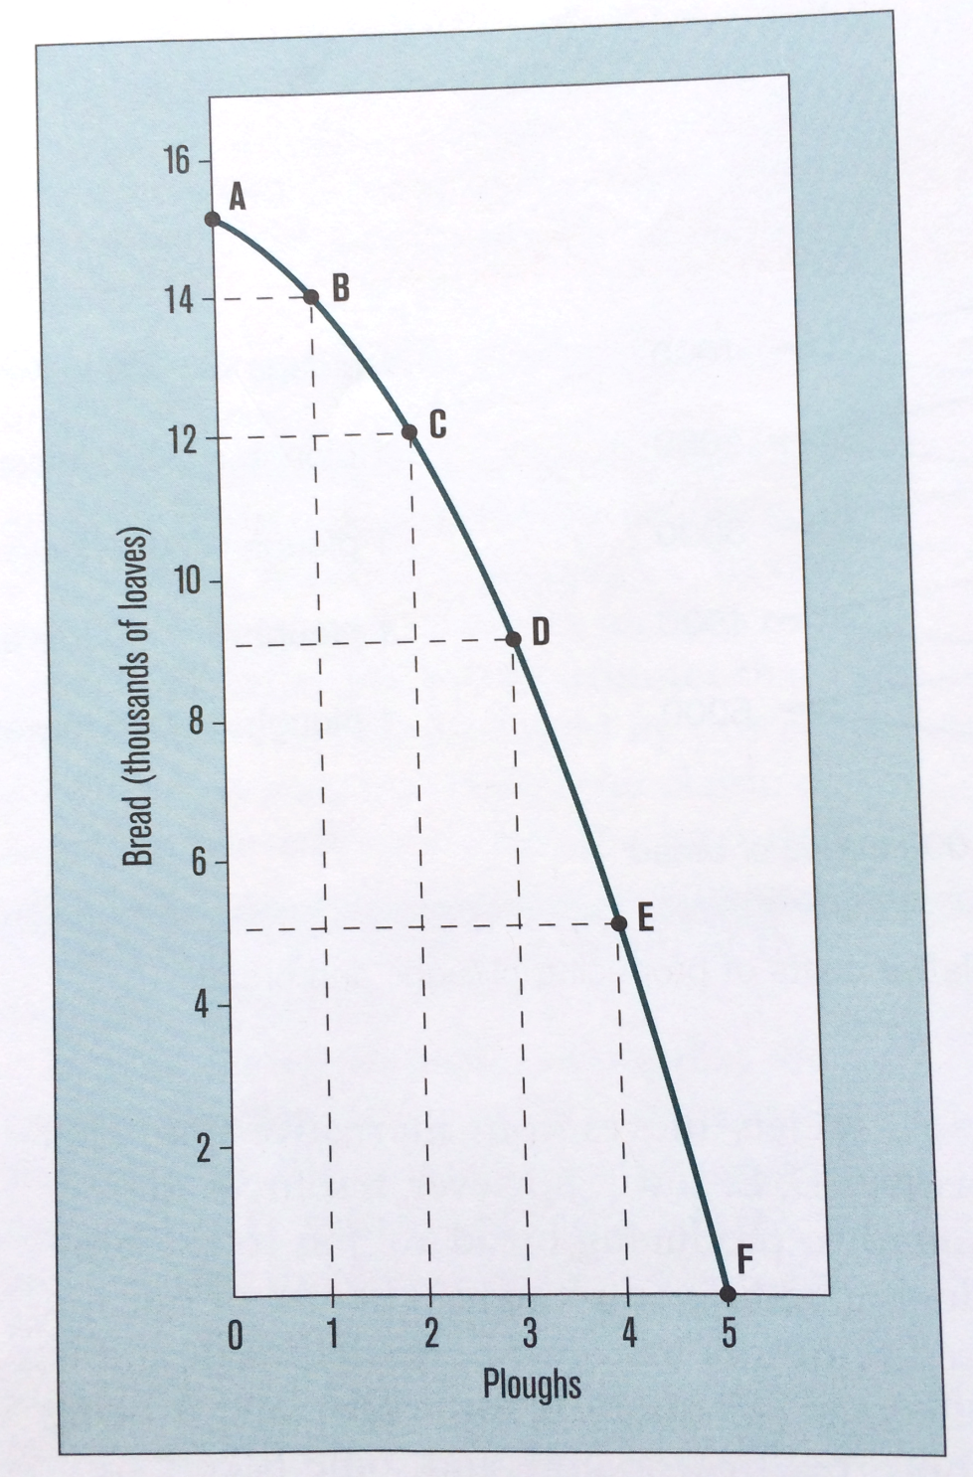

Slide 41
The law of increasing relative cost
In order to get larger amounts of one product, an ever-increasing amount of the other product is sacrificed
To understand why this occurs, we must understand the nature of the products being produced
Bread, is made primarily from wheat, which requires land and labour to grow
Ploughs require labour to produce, and land to a lesser extent
Therefore, the production of bread and ploughs uses resources in different proportions

Slide 42
The law of increasing relative cost
As we move down the production possibilities, resources more suited to producing ploughs and less suited to producing bread will be shifted to plough production
Eventually reaches a point where even resources better suited to producing bread are being shifted to produce ploughs
Ex: farmland is being converted to woodlots, bakers are being retrained as blacksmiths, etc.
This use of resources is less effective and less efficient

Slide 43
The Production Possibilities Curve as a Frontier
The production possibility schedule contains the maximum potential output that can be produced for each of the two products
The resulting curve represents the outer limit, or frontier, of production possibility
This frontier is only attainable is all productive resources are fully employed
In reality, part of the labour force may be unemployed, land may be uncultivated, some machines or factories may be idle, or some resources may be used ineffectively due to human error

Slide 44
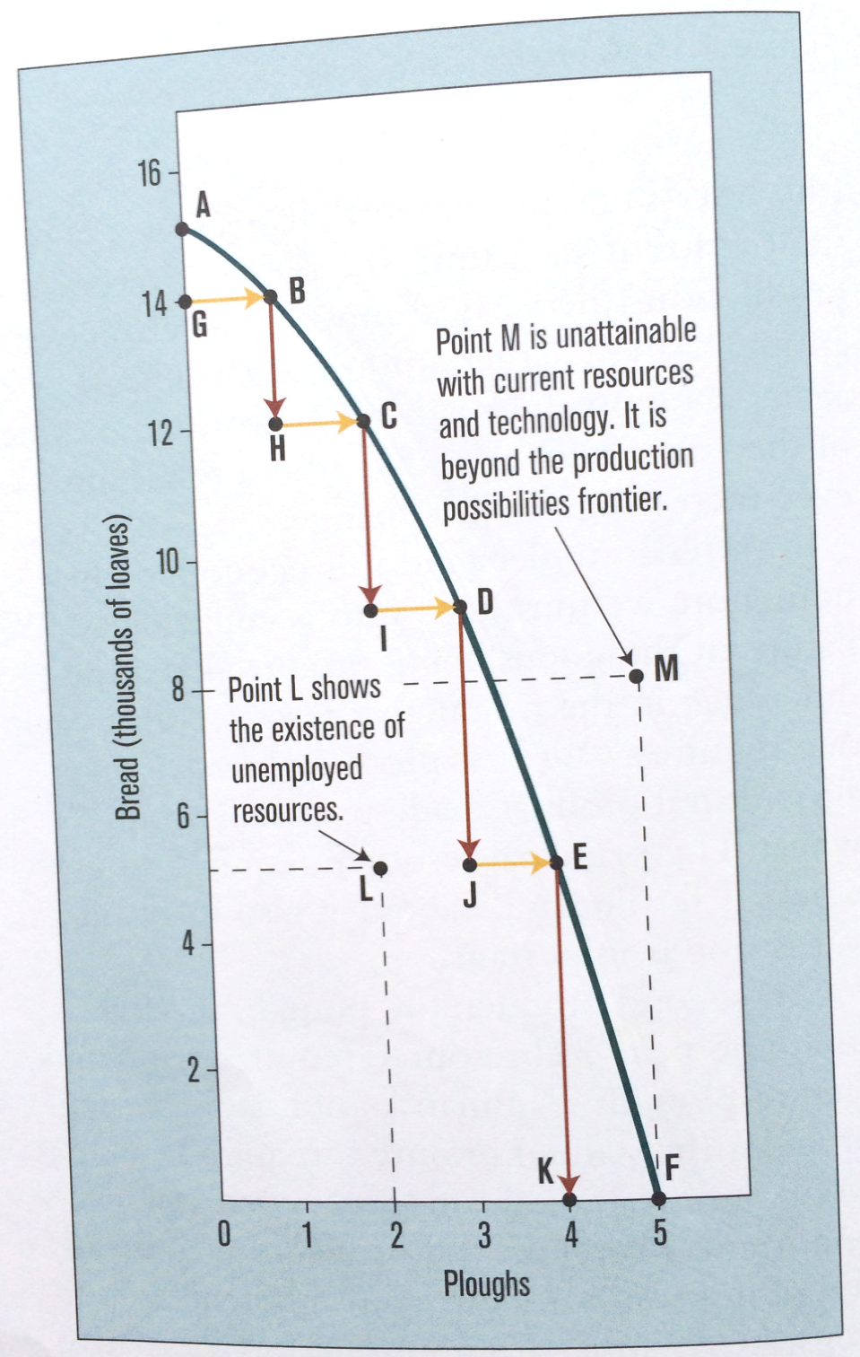

Slide 45
The law of diminishing returns
The law of increasing relative cost deals with the relationship between two outputs or products (i.e. bread and ploughs)
The law of diminishing returns deals with the relationship between an input (a productive resource such as labour) and the resulting output
States that outputs will increase when a particular input increases, but only to a certain point, after which increasing inputs will not have an appreciable effect on the production of outputs

Slide 46
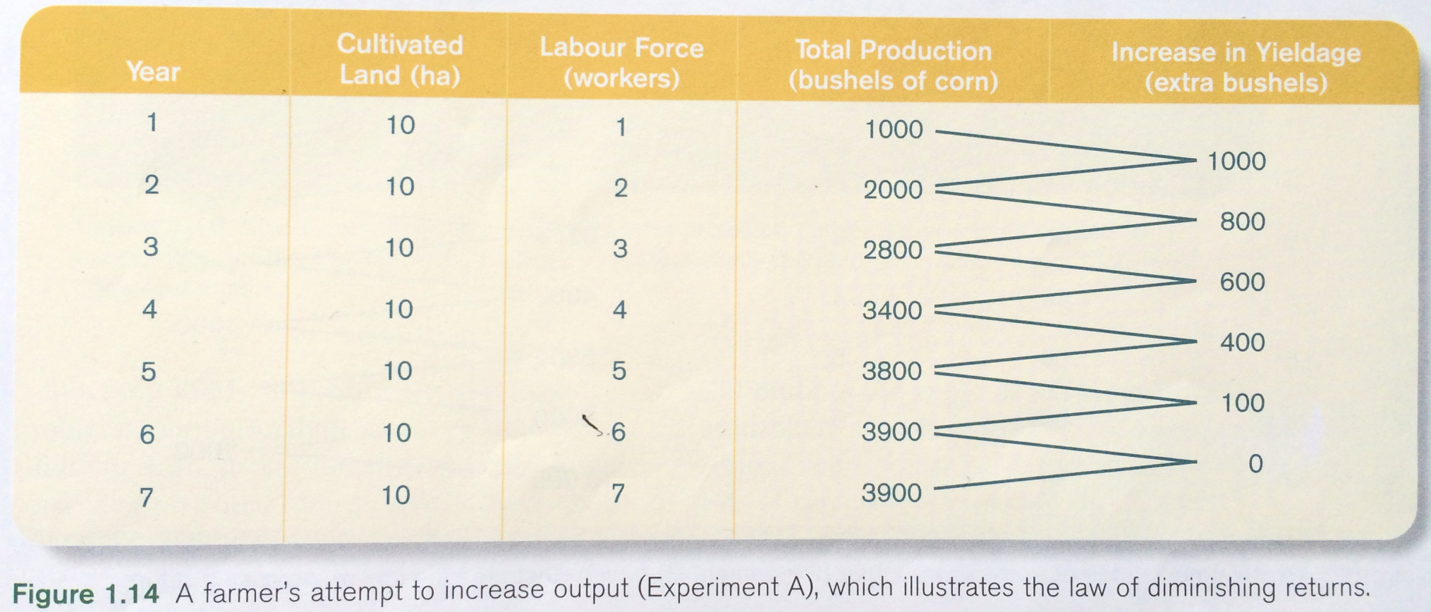
The law of diminishing returns

Slide 47
The law of increasing returns to scale
This law shows what happens when all productive resources are increased simultaneously

Slide 48
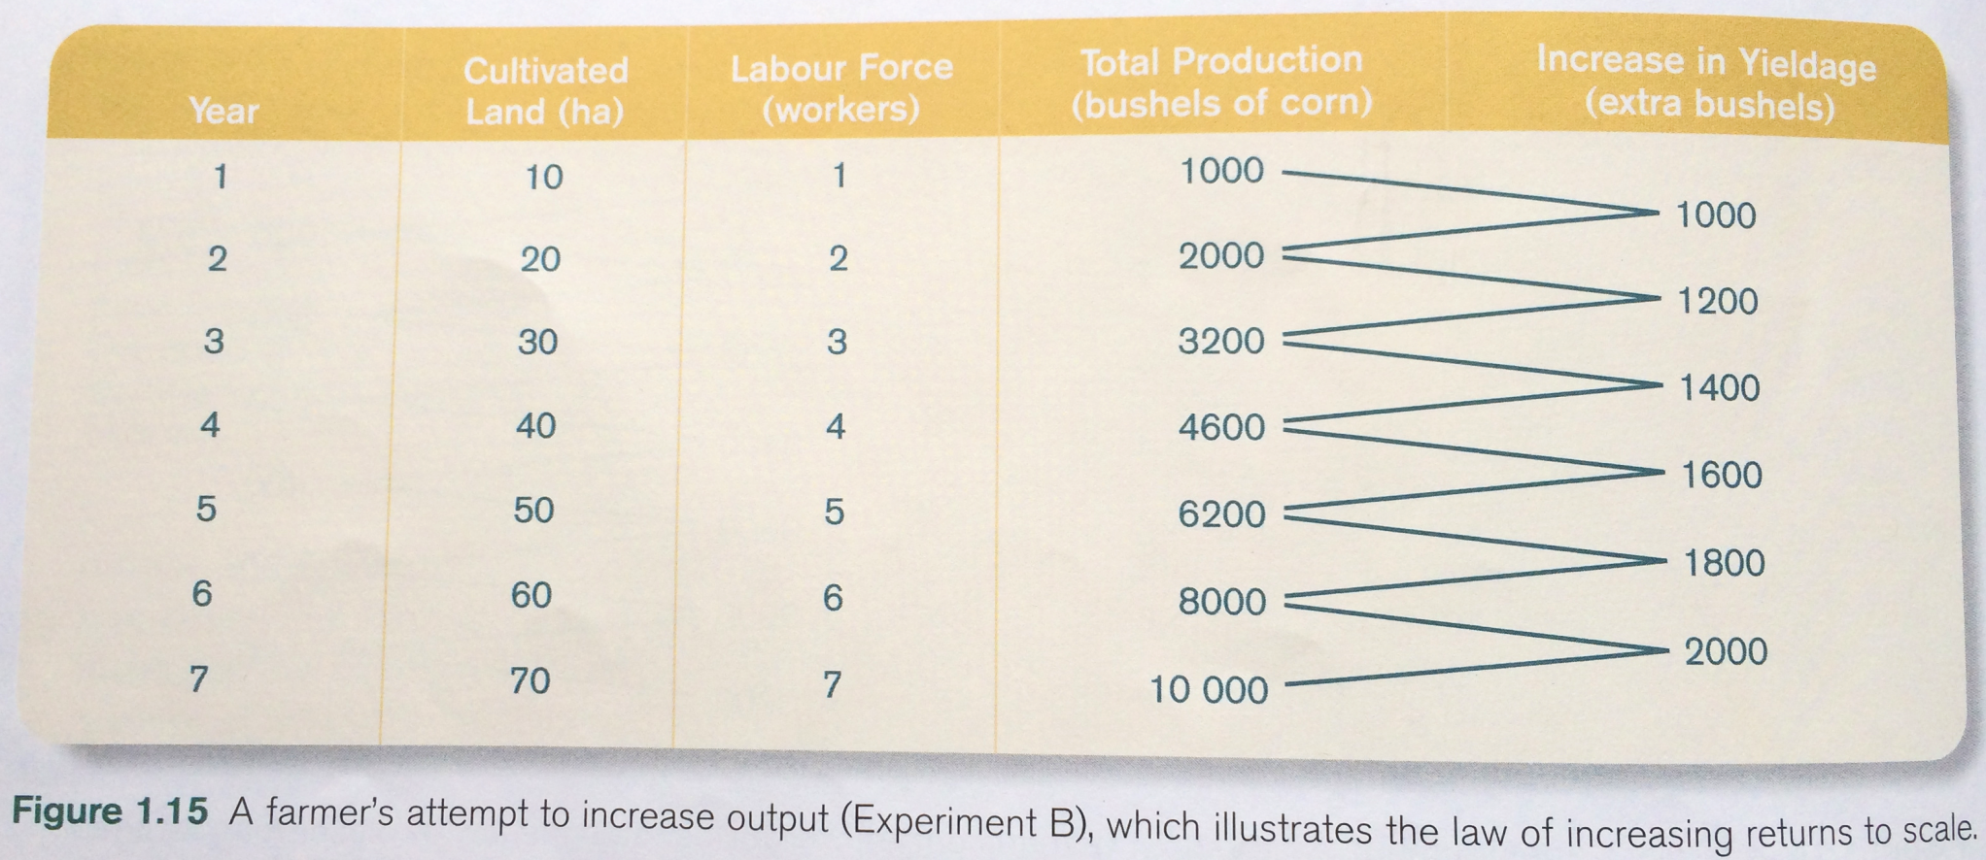
The law of increasing returns to scale

Slide 49
Production Possibilities: Laws
The law of increasing relative cost
The relationship between the two outputs (ex: bread and ploughs)
The law of diminishing returns
The relationship between an input (ex: labour) and the resulting output
The law of increasing returns to scale
The relationship between increasing all productive resources and the resulting output

Slide 50
Practice Activity

Slide 51
Figure 1: Production possibilities for country X
Production Possibility | Bicycles | Cheese (kg) | Opportunity Cost of Each Bicycle
A | 0 | 170
B | 1 | 160
C | 2 | 140
D | 3 | 110
E | 4 | 60
F | 5 | 0

Slide 52
Questions
Calculate the opportunity cost for each additional bicycle being produced. Fill in the values in the table.
Use the data in the table to graph a production possibilities curve.
Mark a point H on the graph that indicates widespread unemployment in country X.
Mark a point J that represents a production level that cannot be reached by X’s economy. Explain why this point is unattainable under present conditions. How might this production level be reached in the future?
Explain why this production possibility curve has a concave (bowed-out) curvature. What economic law is responsible for this curvature?

Slide 53
Assignment
Explain the difference between analytical and normative economics. Give your own examples of statements from both branches of economics.
After graduation, do you plan to continue your education, get a job, or travel? What are the opportunity costs of each alternative?
What is meant by the relative cost of a product? Explain how increased relative costs are related to opportunity costs and diminishing returns.

