Slide 2
Chapter 5: ACCOUNTING FOR MERCHANDISING OPERATIONS

Slide 3
Accounting for Merchandising Operations
Merchandising operations
Recording purchases of merchandise
Recording sales of merchandise
Completing the accounting cycle
Merchandising financial statements
Using the information in the financial statements

Slide 4
CHAPTER 5: Accounting for Merchandising Operations LEARNING OBJECTIVES
Describe the differences between service and merchandising companies.
Prepare entries for purchases under a perpetual inventory system.
Prepare entries for sales under a perpetual inventory system.
Perform the steps in the accounting cycle for a merchandising company.
Prepare single-step and multiple-step income statements.
Calculate the gross profit margin and profit margin.
Prepare the entries for purchases and sales under a periodic inventory system and calculate cost of goods sold (Appendix 5A).

Slide 5
Merchandising Operations
Purchasing products to resell to customers
Main source of revenue is sale of merchandise
Called Sales Revenue, or simply Sales
Two categories of expenses:
Cost of Goods Sold: cost of merchandise sold
Operating expenses: incurred in the process of earning sales revenue
Gross profit: difference between Sales Revenue and Cost of Goods Sold

Slide 6
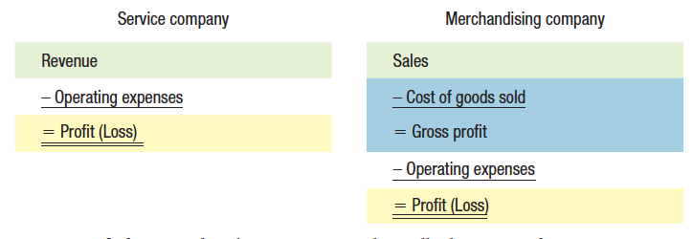
Income Measurement Process for a Merchandising Company

Slide 7
Perpetual Inventory System
Maintains detailed records of inventory purchases and sales
Continuously (perpetually) shows quantity and cost of inventory that should be on hand for each item
Cost of Goods Sold is calculated and recorded at the time of each sale

Slide 8
Periodic Inventory System
Detailed inventory records are not kept throughout the period
Cost of Goods Sold is calculated only at the end of the accounting period (periodically)

Slide 9
CHAPTER 5: Accounting for Merchandising Operations LEARNING OBJECTIVES
Describe the differences between service and merchandising companies.
Prepare entries for purchases under a perpetual inventory system.
Prepare entries for sales under a perpetual inventory system.
Perform the steps in the accounting cycle for a merchandising company.
Prepare single-step and multiple-step income statements.
Calculate the gross profit margin and profit margin.
Prepare the entries for purchases under a periodic inventory system and calculate cost of goods sold (Appendix 5A).

Slide 10
Perpetual Inventory System Recording Merchandise Purchases
When merchandise is purchased for resale:
Dr. Merchandise inventory (for cost of goods)
Cr. Accounts payable (purchases on credit) or Cash (cash purchases)
The purchase is normally recorded when the merchandise is received

Slide 11
Purchase Invoice

Slide 12
Recording Merchandise Purchase
What is the accounting entry?
Merchandise Inventory 1000
Accounts Payable 1000
To record goods purchased on account, terms 2/10, n/30

Slide 13
Freight Costs
Purchase invoice indicates when ownership of the goods is transferred from buyer to seller
FOB (Free on Board) Shipping Point:
Buyer accepts ownership at place of shipping and pays for shipping costs
Buyer debits Merchandise Inventory for cost of shipping
FOB Destination:
Buyer accepts ownership when goods are delivered to buyer’s place of business and seller pays freight costs
Seller debits Freight Out for cost of shipping

Slide 14
Freight Costs

Slide 15
Freight Cost for Mr. Singh
Assume shipping costs are $50. What is the accounting entry?
Dr. Merchandise Inventory 50
Cr. Cash 50
To record payment of freight on purchased goods

Slide 16
Purchase Returns & Allowances
Goods purchased may be damaged, defective, of inferior quality, or they may not meet purchaser’s specifications
Goods may be returned or purchase price may be reduced (an allowance)
Entry to record:
Dr. Cash or Accounts payable
Cr. Merchandise Inventory (for amount of return or adjustment)

Slide 17
Purchase Returns & Allowances
Purchase return is when buyer returns goods to the seller
Purchase allowance means buyer keeps good but the seller is willing to give a reduction from the price
If Mr. Singh returned defective basketballs to Nike costing $300, what would the transaction be?

Slide 18
Purchase Returns & Allowances
The entry to record:
Dr. Cash or Accounts payable $300
Cr. Merchandise Inventory $300
To record return of goods to Nike

Slide 19
Quantity and Purchase Discounts
Quantity discount: reduction in price due to the quantity being purchased
Purchase discount: reduction in price due to early payment of amount due
If pay early and get a purchase discount:
Dr. Accounts payable
Cr. Merchandise Inventory (for amount of discount)
Cr. Cash (for net amount paid)

Slide 20
Quantity and Purchase Discounts
On our invoice we notice 2/10 & n/30
Lets assume that Mr. Singh pays the balance owing of $700 (gross invoice was $1000 less purchase returns and allowances of $300) on Sept 26th 2017. What is the entry?
Dr. Accounts Payable 700
Cr. Merchandise Inventory 14
Cr. Cash 686

Slide 21
CHAPTER 5: Accounting for Merchandising Operations LEARNING OBJECTIVES
Describe the differences between service and merchandising companies.
Prepare entries for purchases under a perpetual inventory system.
Prepare entries for sales under a perpetual inventory system.
Perform the steps in the accounting cycle for a merchandising company.
Prepare single-step and multiple-step income statements.
Calculate the gross profit margin and profit margin.
Prepare the entries for purchases under a periodic inventory system and calculate cost of goods sold (Appendix 5A).

Slide 22
Recording Sales of Merchandise
Revenue is recorded when goods are transferred from seller to buyer
Two entries needed to record the sale:
To record sales revenue:
Dr. Cash or Accounts Receivable
Cr. Sales
To record cost of goods sold:
Dr. Cost of Goods Sold
Cr. Merchandise Inventory

Slide 23
Purchase Invoice

Slide 24
What is the accounting entry for Nike, assuming it costs them 500?
Accounts Receivable 1000
Sales 1000
To record credit sale to Nemesis Sports
Cost of Goods Sold 500
Merchandise Inventory 500

Slide 25
Freight Costs
If FOB destination, seller pays freight
Not part of cost of goods sold
Instead are an operating expense of seller
Costs incurred to earn revenue are recorded as expenses

Slide 26
Sales Returns & Allowances
Sales returns: when customers return merchandise to seller for credit or refund
Sales allowances: when seller grants customers a price reduction
Contra revenue account used to provide information
Seller’s entry required:
Dr. Sales returns and allowances Cr. Accounts receivable or cash
Also, if merchandise returned, and is saleable:
Dr. Merchandise inventory Cr. Cost of goods sold

Slide 27
Sales Returns & Allowances
Earlier Mr. Singh returned defective basketballs totally $300. What is the accounting entry Nike would make?
Sales Returns and Allowances 300
Accounts Receivable 300
To record credit granted to Nemesis Sports for returned goods

Slide 28
Sales Return & Allowances
If the merchandise returned is in good working condition, what is the accounting entry?
Merchandise Inventory 150
Cost of Goods Sold 150
What if the merchandise is not in good working condition?
Loss from damage goods 150
Cost of Goods Sold 150
What type of account is “loss of damage goods”?
Expense Account

Slide 29
Sales Discounts
Discount offered for early payment of bill
Discount amount taken is credited to Sales Discounts (a contra revenue account)
Opposite of a purchase discount
Original amount in Sales is not changed
To record sales discount:
Dr. Cash
Dr. Sales Discounts
Cr. Accounts Receivable

Slide 30
Sales Discount
What would the accounting entry be for Nike, given the discount to Nemesis?
Cash 686
Sales Discount 14
Accounts Receivable 700
If the discount was not taken, the only affected accounts would be Cash & A/R

Slide 31
Sales Taxes
Collected by merchandising companies on the goods that they sell
Sales taxes collected are not revenue
Treated as a liability until paid (as they are due to the government)
Periodically remitted to government

Slide 32
CHAPTER 5: Accounting for Merchandising Operations LEARNING OBJECTIVES
Describe the differences between service and merchandising companies.
Prepare entries for purchases under a perpetual inventory system.
Prepare entries for sales under a perpetual inventory system.
Perform the steps in the accounting cycle for a merchandising company.
Prepare single-step and multiple-step income statements.
Calculate the gross profit margin and profit margin.
Prepare the entries for purchases under a periodic inventory system and calculate cost of goods sold (Appendix 5A).

Slide 33
Completing the Accounting Cycle
Same types of adjusting entries as a service company
One additional adjustment for inventory
To ensure the recorded inventory amount agrees with the actual quantity on hand
A physical count is an important control feature
A perpetual system indicates what should exist
An inventory count will determine what does exist
Additional accounts to be closed:
Sales, Sales Returns and Allowances, Sales Discounts, Cost of Goods Sold, Freight Out

Slide 34
Adjusting Entries
At Nike, accounting records show an ending inventory balance of $40 500 at the end of September and a physical inventory count indicates only $40 000. What is the adjusting entry?
Cost of Goods Sold 500
Merchandise Inventory 500

Slide 35
CHAPTER 5: Accounting for Merchandising Operations LEARNING OBJECTIVES
Describe the differences between service and merchandising companies.
Prepare entries for purchases under a perpetual inventory system.
Prepare entries for sales under a perpetual inventory system.
Perform the steps in the accounting cycle for a merchandising company.
Prepare single-step and multiple-step income statements.
Calculate the gross profit margin and profit margin.
Prepare the entries for purchases under a periodic inventory system and calculate cost of goods sold (Appendix 5A).

Slide 36
Merchandising Income Statement
Single step: classified as revenues and expenses only
Multiple step: five main steps
1 Net Sales = Sales less returns, allowances, discounts
2 Gross Profit = Net Sales less Cost of Goods Sold
3 Profit from Operations = Gross Profit less Operating Expenses
4 Non-Operating Activities: activities not related to operations
5 Profit = Profit from Operations + Non-operating Activities

Slide 37
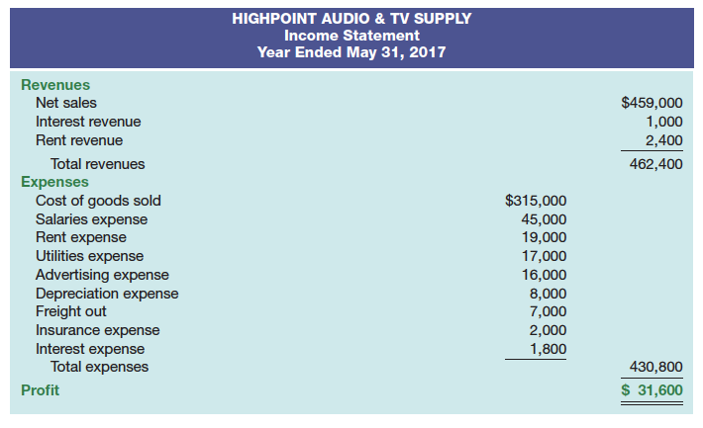
Single-Step Income Statement
All data are classified as either (1) revenues or (2) expenses

Slide 38
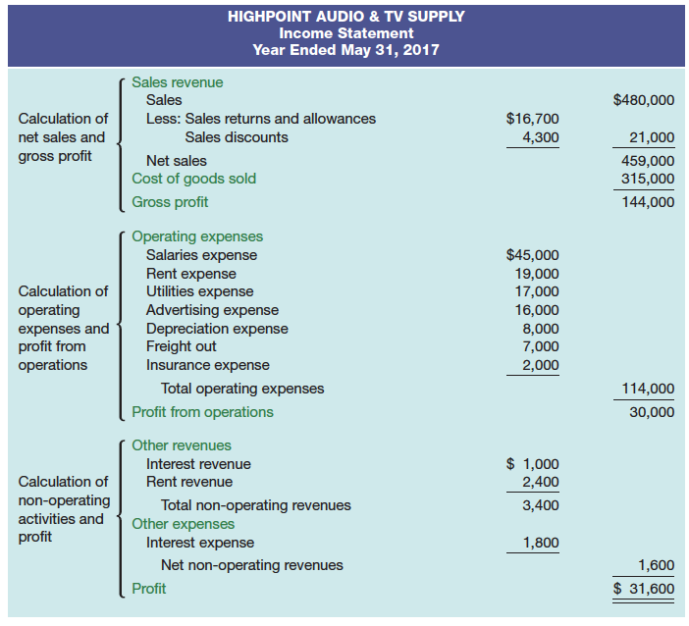
Multiple-Step Income Statement

Slide 39
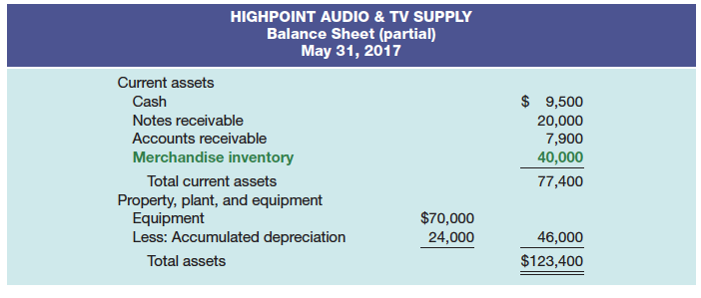
Classified Balance Sheet
Merchandise Inventory reported as a current asset following Accounts Receivable

Slide 40
CHAPTER 5: Accounting for Merchandising Operations LEARNING OBJECTIVES
Describe the differences between service and merchandising companies.
Prepare entries for purchases under a perpetual inventory system.
Prepare entries for sales under a perpetual inventory system.
Perform the steps in the accounting cycle for a merchandising company.
Prepare single-step and multiple-step income statements.
Calculate the gross profit margin and profit margin.
Prepare the entries for purchases under a periodic inventory system and calculate cost of goods sold (Appendix 5A).

Slide 41
Using the Information in the Financial Statements
Profitability ratios: measure profit or operating success for a specific time period
Gross profit margin:
Gross profit expressed as a percentage
Measures the effectiveness of a company’s purchasing and pricing policies

Slide 42
Using the Information in the Financial Statements 2
Profit margin:
The percentage of sales that results in profit
Measures the ability of a company to cover all expenses and provide a return to owners
= Profit ÷ Net Sales

Slide 43
CHAPTER 5: Accounting for Merchandising Operations LEARNING OBJECTIVES
Describe the differences between service and merchandising companies.
Prepare entries for purchases under a perpetual inventory system.
Prepare entries for sales under a perpetual inventory system.
Perform the steps in the accounting cycle for a merchandising company.
Prepare single-step and multiple-step income statements.
Calculate the gross profit margin and profit margin.
Prepare the entries for purchases under a periodic inventory system and calculate cost of goods sold (Appendix 5A).

Slide 44
Appendix 5A: Periodic Inventory System
Key differences compared to perpetual inventory system:
Calculation of Cost of Goods Sold is only performed at end of period
When physical inventory count is done
Accounting entries are different as a result

Slide 45
Recording Purchases of Merchandise
Merchandise Inventory account is not used; separate accounts are used instead:
Merchandise purchases are debited to Purchases account
Freight costs are debited to Freight In account
Returns and allowances are credited to Purchase Returns and Allowances account
Discounts are credited to Purchase Discounts account

Slide 46
Recording Sales of Merchandise
At time of sale, only Sales Revenue is recorded
Dr. Accounts receivable or Cash Cr. Sales
No entry is made to recognize cost of sales
Freight costs, sales returns, allowances and sales discounts are treated the same as under a perpetual inventory system

Slide 47
Calculating Cost of Goods Sold
Calculation of Cost of Goods Sold is only performed at end of period
Use equation to calculate
Shown in detail on multiple step income statement

Slide 48
Calculating Cost of Goods Sold 2
Cost of Goods Purchased
Add Purchases and Freight In
Subtract Purchase Returns and Allowances and Purchase Discounts
Cost of Goods on Hand
Based on physical count of inventory
= Number of units counted x unit cost
Cost of Goods Sold
= Cost of Goods on Hand at beginning of period + Cost of Goods Purchased – Cost of Goods on Hand at end of period

Slide 49
Completing the Accounting Cycle
Regular closing entries for all purchase and sales discounts, allowances, freight
Additional entry is required to close beginning merchandise inventory
Dr. Income summary Cr. Merchandise Inventory
Another entry is required to establish ending merchandise inventory
Dr. Merchandise Inventory Cr. Income summary

