Slide 2
Chapter 6:
INVENTORY COSTING

Slide 3
Inventory Costing
Determining inventory quantities
  Taking physical inventory
  Determining ownership of goods
Inventory cost determination methods
  Specific identification
  Cost formulas: FIFO and average
Financial Statement Effects
  Choice of cost determination method
  Inventory errors
Presentation and analysis
  Valuing inventory at lower of cost and net realizable value
  Reporting and analyzing inventory

Slide 4
CHAPTER 6: Inventory Costing
LEARNING OBJECTIVES
Describe the steps in determining inventory quantities.
Calculate cost of goods sold and ending inventory in a perpetual inventory system using the specific identification, FIFO, and weighted average methods of cost determination.
Explain the financial statement effects of inventory cost determination methods.
Determine the financial statement effects of inventory errors.
Value inventory at the lower of cost or net realizable value.
Demonstrate the presentation and analysis of inventory.
Calculate ending inventory and cost of goods sold in a periodic inventory system using FIFO and weighted average inventory cost formulas (Appendix 6A).
Estimate ending inventory using the gross profit and retail inventory methods (Appendix 6B).
4

Slide 5
Determining Inventory Quantities
All companies count their inventory at least once a year
  Must determine amount and value of inventory to prepare accurate financial statements
The determination of inventory quantities involves
  Taking a physical inventory of goods on hand
  Determining the ownership of the goods

Slide 6
Taking a Physical Inventory
Involves counting, weighing, or measuring each kind of inventory on hand
Strong internal controls needed for an accurate inventory count:
  Count done by employees not normally responsible for inventory
  Ensure items counted exist by observation
  Second count by another employee
  Ensure all items are counted only once and nothing is missed (use pre-numbered tags)

Slide 7
Determining Ownership
Only include inventory owned by company
Goods in Transit:
  On board a public carrier as at the count date
  Look at FOB point to determine if they should be included
Consigned Goods:
  Goods being sold that are owned by others
  Excluded from inventory of consignee (who is selling on behalf of the owner, the consignor)
  Example: Artist display their paintings at art galleries for sale. Art Gallary is not the owner.

Slide 8
TERMS OF SALE
FOB Shipping Point FOB Destination Point
Seller
Seller
Ownership passes to buyer here Ownership passes to buyer here
Public
Carrier
Co.
Public
Carrier
Co.
Buyer
Buyer

Slide 9
Sales Transaction
Only one entry is required to record a sale under a periodic method.

Slide 10
Recording Sales Returns & Allowances
The normal balance of Sales Returns and Allowances is a debit. Sales Returns and Allowances is a contra revenue account to the Sales account.

Slide 11
Purchase of Merchandise
For purchases on account, Purchases is debited and Accounts Payable is credited. For cash purchases, Purchases is debited and Cash is credited.

Slide 12
Purchase Returns & Allowances
For purchases returns and allowances that were originally made on account, Accounts Payable is debited and Purchase Returns and Allowances is credited. The Purchase Returns and Allowances account is a contra account.

Slide 13
Purchase Returns & Allowances
When the purchaser directly incurs the freight costs, the account Freight In is debited and Cash is credited.

Slide 14
CHAPTER 6: Inventory Costing
LEARNING OBJECTIVES
Describe the steps in determining inventory quantities.
Calculate cost of goods sold and ending inventory in a perpetual inventory system using the specific identification, FIFO, and weighted average methods of cost determination.
Explain the financial statement effects of inventory cost determination methods.
Determine the financial statement effects of inventory errors.
Value inventory at the lower of cost or net realizable value.
Demonstrate the presentation and analysis of inventory.
Calculate ending inventory and cost of goods sold in a periodic inventory system using FIFO and weighted average inventory cost formulas (Appendix 6A).
Estimate ending inventory using the gross profit and retail inventory methods (Appendix 6B).
14

Slide 15
Inventory Cost Determination
Specific Identification
  Tracks the actual physical flow of goods
  Each inventory item is marked with its cost
  Used where goods are not ordinarily interchangeable
  Eg. Cars
Cost Formulas
  Specific identification not always suitable
  A cost formula is used instead:
    First-in, first-out (FIFO)
    Weighted Average
    Last-in, First-out (LIFO)
  Flow of costs may not match physical flow

Slide 16
Inventory Costing in a Perpetual Inventory System
FIFO:
  FIFO rule is applied at the time of each sale
  FIFO (First-in, first-out)
Weighted Average:
  New average cost per unit is calculated after each purchase
LIFO:
  Goods that are purchased the most recently are first ones to be sold

Slide 17
Perpetual Inventory System -
First-in, First-out (FIFO)
FIFO assumes oldest goods are sold first
Costing:
  Costs of earliest goods purchased are first to be recognized as Cost of Goods Sold
  Costs of most recent goods purchased are recognized as ending inventory
Often reflects the actual physical flow of merchandise
Given the chart on the next slide, a physical inventory was counted at the end of the year determined 450 units remained on hand

Slide 18
Using FIFO

Slide 19
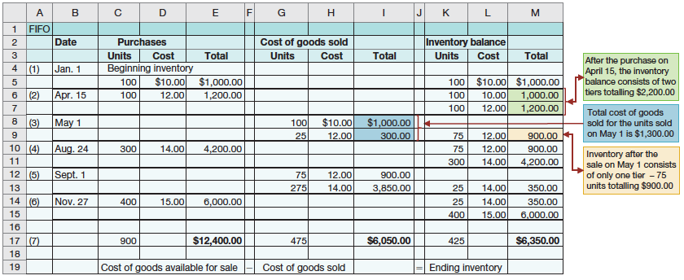
Perpetual System Inventory Costing – FIFO (Cont’d)
Ending inventory and cost of goods sold under FIFO is the same for perpetual and periodic systems

Slide 20
Perpetual Inventory System - Weighted Average
Assumes that it is not possible to measure specific physical flow of inventory
  So we use a weighted average unit cost
Applied when goods are sold:
  to units sold to determine cost of goods sold
  to units on hand to determine ending inventory

Slide 21
Average Cost
+
=

Slide 22
Perpetual System Inventory Costing –
Weighted Average (Cont’d)
Under a perpetual inventory system, a new weighted average is calculated after each purchase.
This average is then applied to:
  Units sold, to determine cost of goods sold
  Remaining units on hand, to determine ending inventory

Slide 23
LIFO
Latest goods purchased assumed to be first sold
Seldom coincides with actual physical flow of inventory
Costing:
  Costs of earliest goods purchased remain in ending inventory
  Costs of most recent goods purchased are first to be recognized as Cost of Goods Sold
Recent changes prohibit its use in Canada

Slide 24
Using LIFO

Slide 25
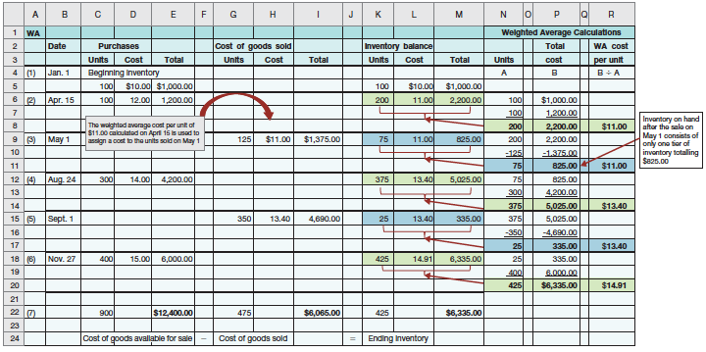
Perpetual System Inventory Costing –
Weighted Average (Cont’d)

Slide 26
CHAPTER 6: Inventory Costing
LEARNING OBJECTIVES
Describe the steps in determining inventory quantities.
Calculate cost of goods sold and ending inventory in a perpetual inventory system using the specific identification, FIFO, and weighted average methods of cost determination.
Explain the financial statement effects of inventory cost determination methods.
Determine the financial statement effects of inventory errors.
Value inventory at the lower of cost or net realizable value.
Demonstrate the presentation and analysis of inventory.
Calculate ending inventory and cost of goods sold in a periodic inventory system using FIFO and weighted average inventory cost formulas (Appendix 6A).
Estimate ending inventory using the gross profit and retail inventory methods (Appendix 6B).
26

Slide 27
Financial Statement Effects
Income statement effect:
  When prices rising, FIFO produces higher profit
  When prices falling, opposite is true
Balance sheet effect:
  FIFO provides the most current valuation of inventory
  More closely approximates replacement cost
Cost formula should be used consistently
  Enhances comparability of statements over time
  Choose the method that best corresponds with actual physical flow

Slide 28
CHAPTER 6: Inventory Costing
LEARNING OBJECTIVES
Describe the steps in determining inventory quantities.
Calculate cost of goods sold and ending inventory in a perpetual inventory system using the specific identification, FIFO, and weighted average methods of cost determination.
Explain the financial statement effects of inventory cost determination methods.
Determine the financial statement effects of inventory errors.
Value inventory at the lower of cost or net realizable value.
Demonstrate the presentation and analysis of inventory.
Calculate ending inventory and cost of goods sold in a periodic inventory system using FIFO and weighted average inventory cost formulas (Appendix 6A).
Estimate ending inventory using the gross profit and retail inventory methods (Appendix 6B).
28

Slide 29
Inventory Errors
Errors in inventory affect both income statement and balance sheet
  Through the calculation of cost of goods sold
Ending inventory of one period becomes beginning inventory of the next period
  Errors in ending inventory carry over to the following period

Slide 30
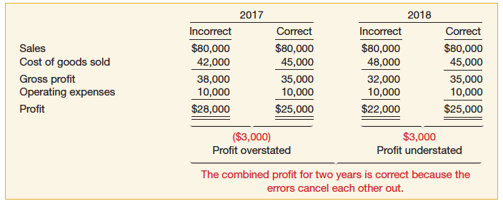
Income Statement Effects
Effect of inventory errors on the current year’s income statement:
An error in ending inventory of one period will have the reverse effect on profit of the next period

Slide 31

Balance Sheet Errors
Effect can be determined by using the basic accounting equation:
Assets = Liabilities + Owner’s Equity
An error in ending inventory in one period will cause an error in beginning inventory in the next period

Slide 32
CHAPTER 6: Inventory Costing
LEARNING OBJECTIVES
Describe the steps in determining inventory quantities.
Calculate cost of goods sold and ending inventory in a perpetual inventory system using the specific identification, FIFO, and weighted average methods of cost determination.
Explain the financial statement effects of inventory cost determination methods.
Determine the financial statement effects of inventory errors.
Value inventory at the lower of cost or net realizable value.
Demonstrate the presentation and analysis of inventory.
Calculate ending inventory and cost of goods sold in a periodic inventory system using FIFO and weighted average inventory cost formulas (Appendix 6A).
Estimate ending inventory using the gross profit and retail inventory methods (Appendix 6B).
32

Slide 33
Inventory Valuation
Sometimes, before reporting inventory we must first ensure that it’s properly valued
Lower of cost and net realizable value (LCM)
  when realizable value of inventory is lower than cost, it is written down to that lower value
  Net realizable value: selling price less any costs to make the goods ready for sale
Assessed on an item-by-item basis
Reversed if net realizable value increases before goods are sold

Slide 34
LCM

Slide 35
LCM
If Nemesis TV company applied the LCM rule, it would report its inventory at $159 000 on its balance sheet
What is the accounting entry to reflect the Net Realizable Value?
Dr COGS 9000
Cr Merchandising Inventory 9000
To record decline inventory value from original cost of $168 000 to market value of $159 000

Slide 36
LCM Cont’d
What happens to our Net Income and Owner’s Equity in this example?
Reduces both by 9000

Slide 37
CHAPTER 6: Inventory Costing
LEARNING OBJECTIVES
Describe the steps in determining inventory quantities.
Calculate cost of goods sold and ending inventory in a perpetual inventory system using the specific identification, FIFO, and weighted average methods of cost determination.
Explain the financial statement effects of inventory cost determination methods.
Determine the financial statement effects of inventory errors.
Value inventory at the lower of cost or net realizable value.
Demonstrate the presentation and analysis of inventory.
Calculate ending inventory and cost of goods sold in a periodic inventory system using FIFO and weighted average inventory cost formulas (Appendix 6A).
Estimate ending inventory using the gross profit and retail inventory methods (Appendix 6B).
37

Slide 38
Classifying and Reporting Inventory
Depends on whether company is a merchandiser or manufacturer
  Merchandiser buys its inventory – only one classification used
  Manufacturer produces its inventory – classified into raw materials, work in process and finished goods
Typically recorded as a current asset, but can be non-current if not sold in one year

Slide 39
Analysis of Inventory
Must balance competing objectives:
  Excessive levels of inventory leads to high carrying costs
  Too little inventory may result in lost sales
Ratios help determine whether a company has too much or too little inventory:
  Inventory turnover ratio
  Days sales in inventory

Slide 40
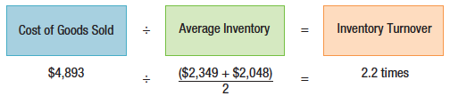
Inventory Turnover Ratio
= Cost of Goods Sold ÷ Average Inventory
The number of times inventory is sold (“turns over”) during a given period
The more times inventory turns over, the more efficiently sales are being made
Average inventory is usually average of beginning and ending inventories

Slide 41
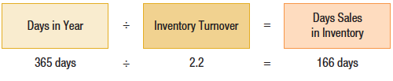
Days Sales in Inventory
= Days in Year ÷ Inventory Turnover
The number of days on average that the inventory is on hand before being sold
Compare over years and with industry averages

Slide 42
CHAPTER 6: Inventory Costing
LEARNING OBJECTIVES
Describe the steps in determining inventory quantities.
Calculate cost of goods sold and ending inventory in a perpetual inventory system using the specific identification, FIFO, and weighted average methods of cost determination.
Explain the financial statement effects of inventory cost determination methods.
Determine the financial statement effects of inventory errors.
Value inventory at the lower of cost or net realizable value.
Demonstrate the presentation and analysis of inventory.
Calculate ending inventory and cost of goods sold in a periodic inventory system using FIFO and weighted average inventory cost formulas (Appendix 6A).
Estimate ending inventory using the gross profit and retail inventory methods (Appendix 6B).
42

Slide 43
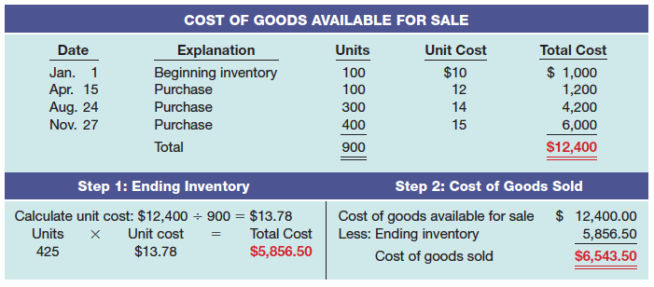
Appendix 6A: Inventory Cost Formulas in Periodic Systems: FIFO

Slide 44
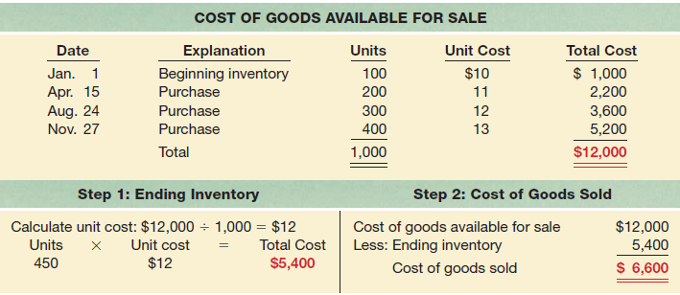
Inventory Cost Formulas in Periodic Systems: Weighted Average

Slide 45
CHAPTER 6: Inventory Costing
LEARNING OBJECTIVES
Describe the steps in determining inventory quantities.
Calculate cost of goods sold and ending inventory in a perpetual inventory system using the specific identification, FIFO, and weighted average methods of cost determination.
Explain the financial statement effects of inventory cost determination methods.
Determine the financial statement effects of inventory errors.
Value inventory at the lower of cost or net realizable value.
Demonstrate the presentation and analysis of inventory.
Calculate ending inventory and cost of goods sold in a periodic inventory system using FIFO and weighted average inventory cost formulas (Appendix 6A).
Estimate ending inventory using the gross profit and retail inventory methods (Appendix 6B).
45

Slide 46
Appendix 6B: Estimating Inventories
Not always possible or practical to count inventory – must be estimated
  Two estimating methods are available
Gross profit method
  Estimated gross profit = net sales × gross profit margin
  Estimated cost of goods sold = net sales − estimated gross profit
  Estimated ending inventory = goods available for sale − cost estimated cost of goods sold

Slide 47
Appendix 6B: Estimating Inventories 2
Retail inventory method uses the cost-to-retail ratio applied to ending inventory at retail to determine the estimated cost of the inventory
Calculation:
  Ending inventory at retail = goods available for sale at retail − net sales
  Cost-to-retail ratio = goods available for sale at cost ÷ goods available for sale at retail
  Estimated cost of ending inventory = ending inventory at retail × cost-to-retail ratio

